Slide 1
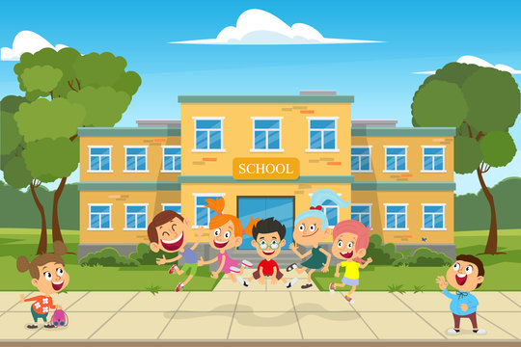
All About ME!
RE: Creation Why is the word ‘God’ important to Christians?
Geography: Locational
Identify on a map the four countries and capital cities of the UK.
Vocabulary – Map, Country, England, Wales, Scotland, Northern Ireland, Capital city, Cardiff, London, Edinburgh, Belfast, UK, United Kingdom, British, Great Britain
Art:. Create images from a variety of media e.g. photocopies material, fabric, crepe paper , magazines etc.
Arrange and glue materials to different backgrounds.
Sort and group materials for different purposes e.g. colour texture.
Fold, crumple, tear and overlap papers
Shape
Create and arrange shapes appropriately
Vocabulary – collage, tear, cut
Robins
Class
Autumn Term 1 2024
Computing:
Multi-media
Digital photography
PE: We will be improving our gymnastic skills and ball skills in Year 1 and 2.
In Year R will be working on our sending and receiving skills and improving our core stability.
History: Changes in living memory
Chronological Understanding
Recount parts of stories and memories about the past
Knowledge and understanding of past events, people and changes in the past
Tell the difference between past and present in own and other people’s lives.
Historical enquiry
English: YR,1 and 2: Will be following the Little Wandle Phonics and spelling programme.
Y1 and 2: will be writing information lists and a description. We will be looking at using capital letters and full stops correctly as well as using adjectives in our writing
Texts: Q Pootle 5, Little Red
Concept:
Remembering
Science: Observe changes over time and, with guidance, begin to notice patterns and relationships.
Identifying, grouping and classifying.
Use simple features to
compare objects, materials and living things and, with help, decide how to sort and group them.
Vocabulary – Baby, adult, offspring, human, animal
Music: We will be singing a wide variety of rhymes and action songs with an awareness of character and/ or mood and accompanying percussion instruments to our singing
Maths
In maths this half-term, Year 1 and 2 will be working on number: place value, addition and subtraction.
Year R will be working on their subitising skills, counting and the composition of numbers up to 5.
Jigsaw/PSHE: Being me in my world
Safeguarding: Healthy lifestyles

