Slide 1
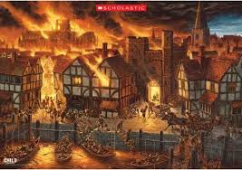
History: We will be learning about The Great Fire of London. What were the consequences of The Great Fire of London?. Use simple timelines to order events or objects. Show knowledge and understanding about the past in different ways (eg. role play, drawing, writing, talking).
Discuss importance of Samuel Pepys’s diary. Look at artefacts and discuss what we think they are.
The
Great Fire of London
Robins
Class
Autumn Term 2 2024
DT: We will be planning, designing, making and evaluating our own fire engine. We will be using a range of tools and exploring how axles and wheels work.
Music: We will be singing Christmas songs ready for the Nativity:
Little Angel Gets her wings
PE
In year 1 and 2 we will be playing team games and we will be developing our Dance skills.
Year R will continue to work on sending and receiving skills and improving core stability through Dance
Consequences
Jigsaw/PSHE – Celebrating Difference
Geography: We will be looking at the landmarks of London and how it has changed over the centuries.
RE
Our RE focus this half-term is Why do Christians perform Nativity plays at Christmas?
Maths
In maths this half-term, Year 1 and 2 will be working on multiplication and division, fractions and geometry as well as revising Number and Place Value. Year R will be working on their counting and subitising skills.
English
We will continue the Little Wandle Phonics and spelling programme. We will be looking at a range of non-fiction books about The Great Fire of London.
We will be looking at the text: Flashlight by Lizi Boyd and focussing on narrative writing. We will also be focussing on using the correct punctuation: Capital letters, full stops, question marks, exclamation marks and commas for listing.
Safeguarding – Fire Safety
.

