Slide 1
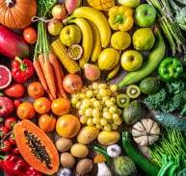
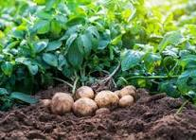
Geography -
Why do people grow their own vegetables? What food can we grow in our country and which foods are imported?
Food
DT: Opportunities to use tools/utensils for food preparation. To plan and prepare a healthy meal following the Eatwell Guide. Discuss choice of food, utensils needed, quantities and presentation
Robins
Class
Spring Term 1 2025
Art and Design: To explore textures. Look at Van Gogh’s Wheatfield painting and to design own farm scene using simple shapes to make a collage.
Music: Charanga Music Programme: Hands, Feet, Heart and Living on a Prayer
Science – Where does food come from? Can we grow our own food. What do animals eat? We will also learn about food chains.
Jigsaw/PSHE – Dreams and Goals: Aspirations, how to achieve goals and understanding the emotions that go with this.
PE
To develop Gymnastics and
Football (ball skills)
RE: Specialness -
What is special to Hindus?
English Year 1 and 2: Text Oliver’s vegetables by Vivian French
Text 2: The Rainbow Bear by Michael Morpurgo. Skills: letter writing and descriptive writing
Little Wandle Phonics and Spelling programme.
Year R – Text: Jack and the Beanstalk, The Little Red Hen, Jasper’s Beanstalk
Maths: Year 1 and 2: To continue with addition and subtraction.
Measurement: Time and Mass
Fraction, Geometry, Multiplication and Division
Year R: NCETM Mastering Number: subitising, counting and composition of numbers to 5. Begin to explore 6 and 7. White Rose Maths planning:
Safeguarding
Nutrition- creating a healthy lunch box.

