Slide 2


Worship
COMPASSION
CREATIVITY
COURAGE

Slide 4
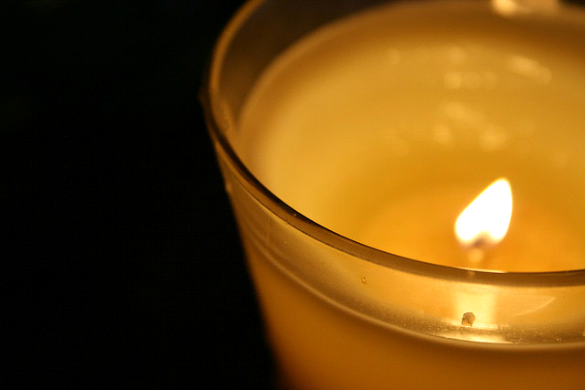
Candle Prayer
Heavenly Father
We light these candles to
remind us that You are
the light of the world.
We come together now
to
pray and to praise
and to
remove all darkness
from our
hearts and minds.
Amen

Slide 5

Worship 4th October 2021
Hope

Slide 6
Leader - The Lord is here
Response- His spirit is with us

Slide 7
Read John 12:46 where Jesus says ‘I have come into the world as a light, so that no one who believes in me should stay in darkness.’ Look at the image of a lighthouse. Talk about what a lighthouse meant in the past to sailors (safety, home soon) after a long and often difficult trip at sea. A lighthouse might have been the only light in a violent storm, granting optimism to those who saw it. A lighthouse is a symbol to many Christians. It is used to reflect God's power to protect and comfort. The beacon symbolizes the light of Christ as a guide for life. When we find ourselves struggling or losing hope where do we go for support?

Slide 8
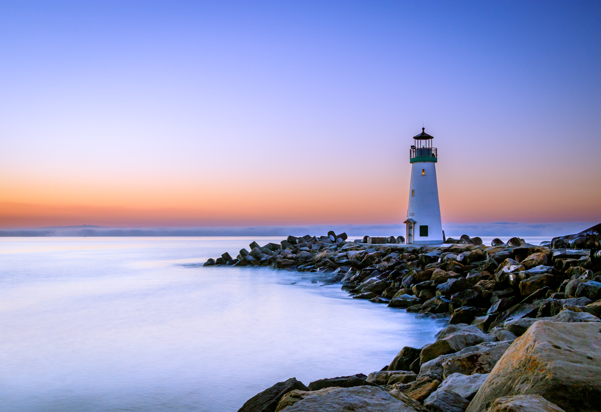
Look at this image of a lighthouse.
What did a lighthouse meant in the past to sailors after a long and often difficult trip at sea?

Slide 9

A lighthouse might have been the only light in a violent storm, granting optimism to those who saw it. A lighthouse is a symbol to many Christians. It is used to reflect God's power to protect and comfort. The beacon symbolizes the light of Christ as a guide for life.
When we find ourselves struggling or losing hope where do we go for support?

Slide 10
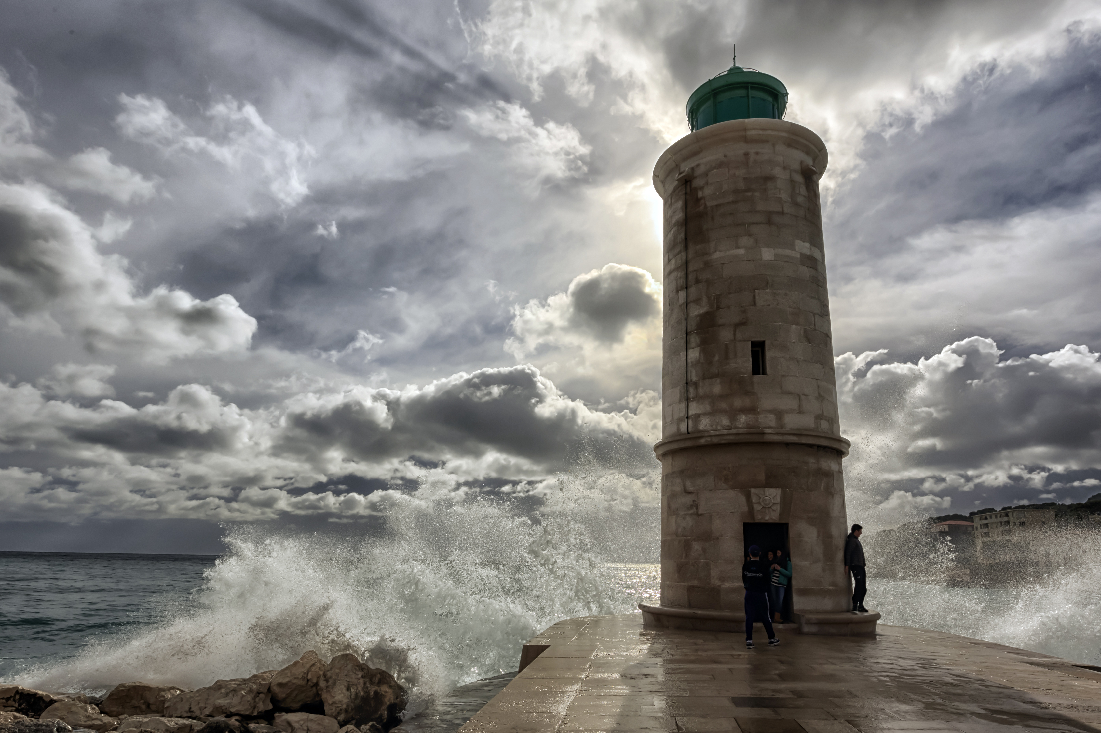
Listen to My Lighthouse by Rend Collective. Reflect on the image of this lighthouse as Jesus being the light of the world and God being the power of all hope.
https://www.youtube.com/watch?v=lFBZJGSgyVQ

Slide 12
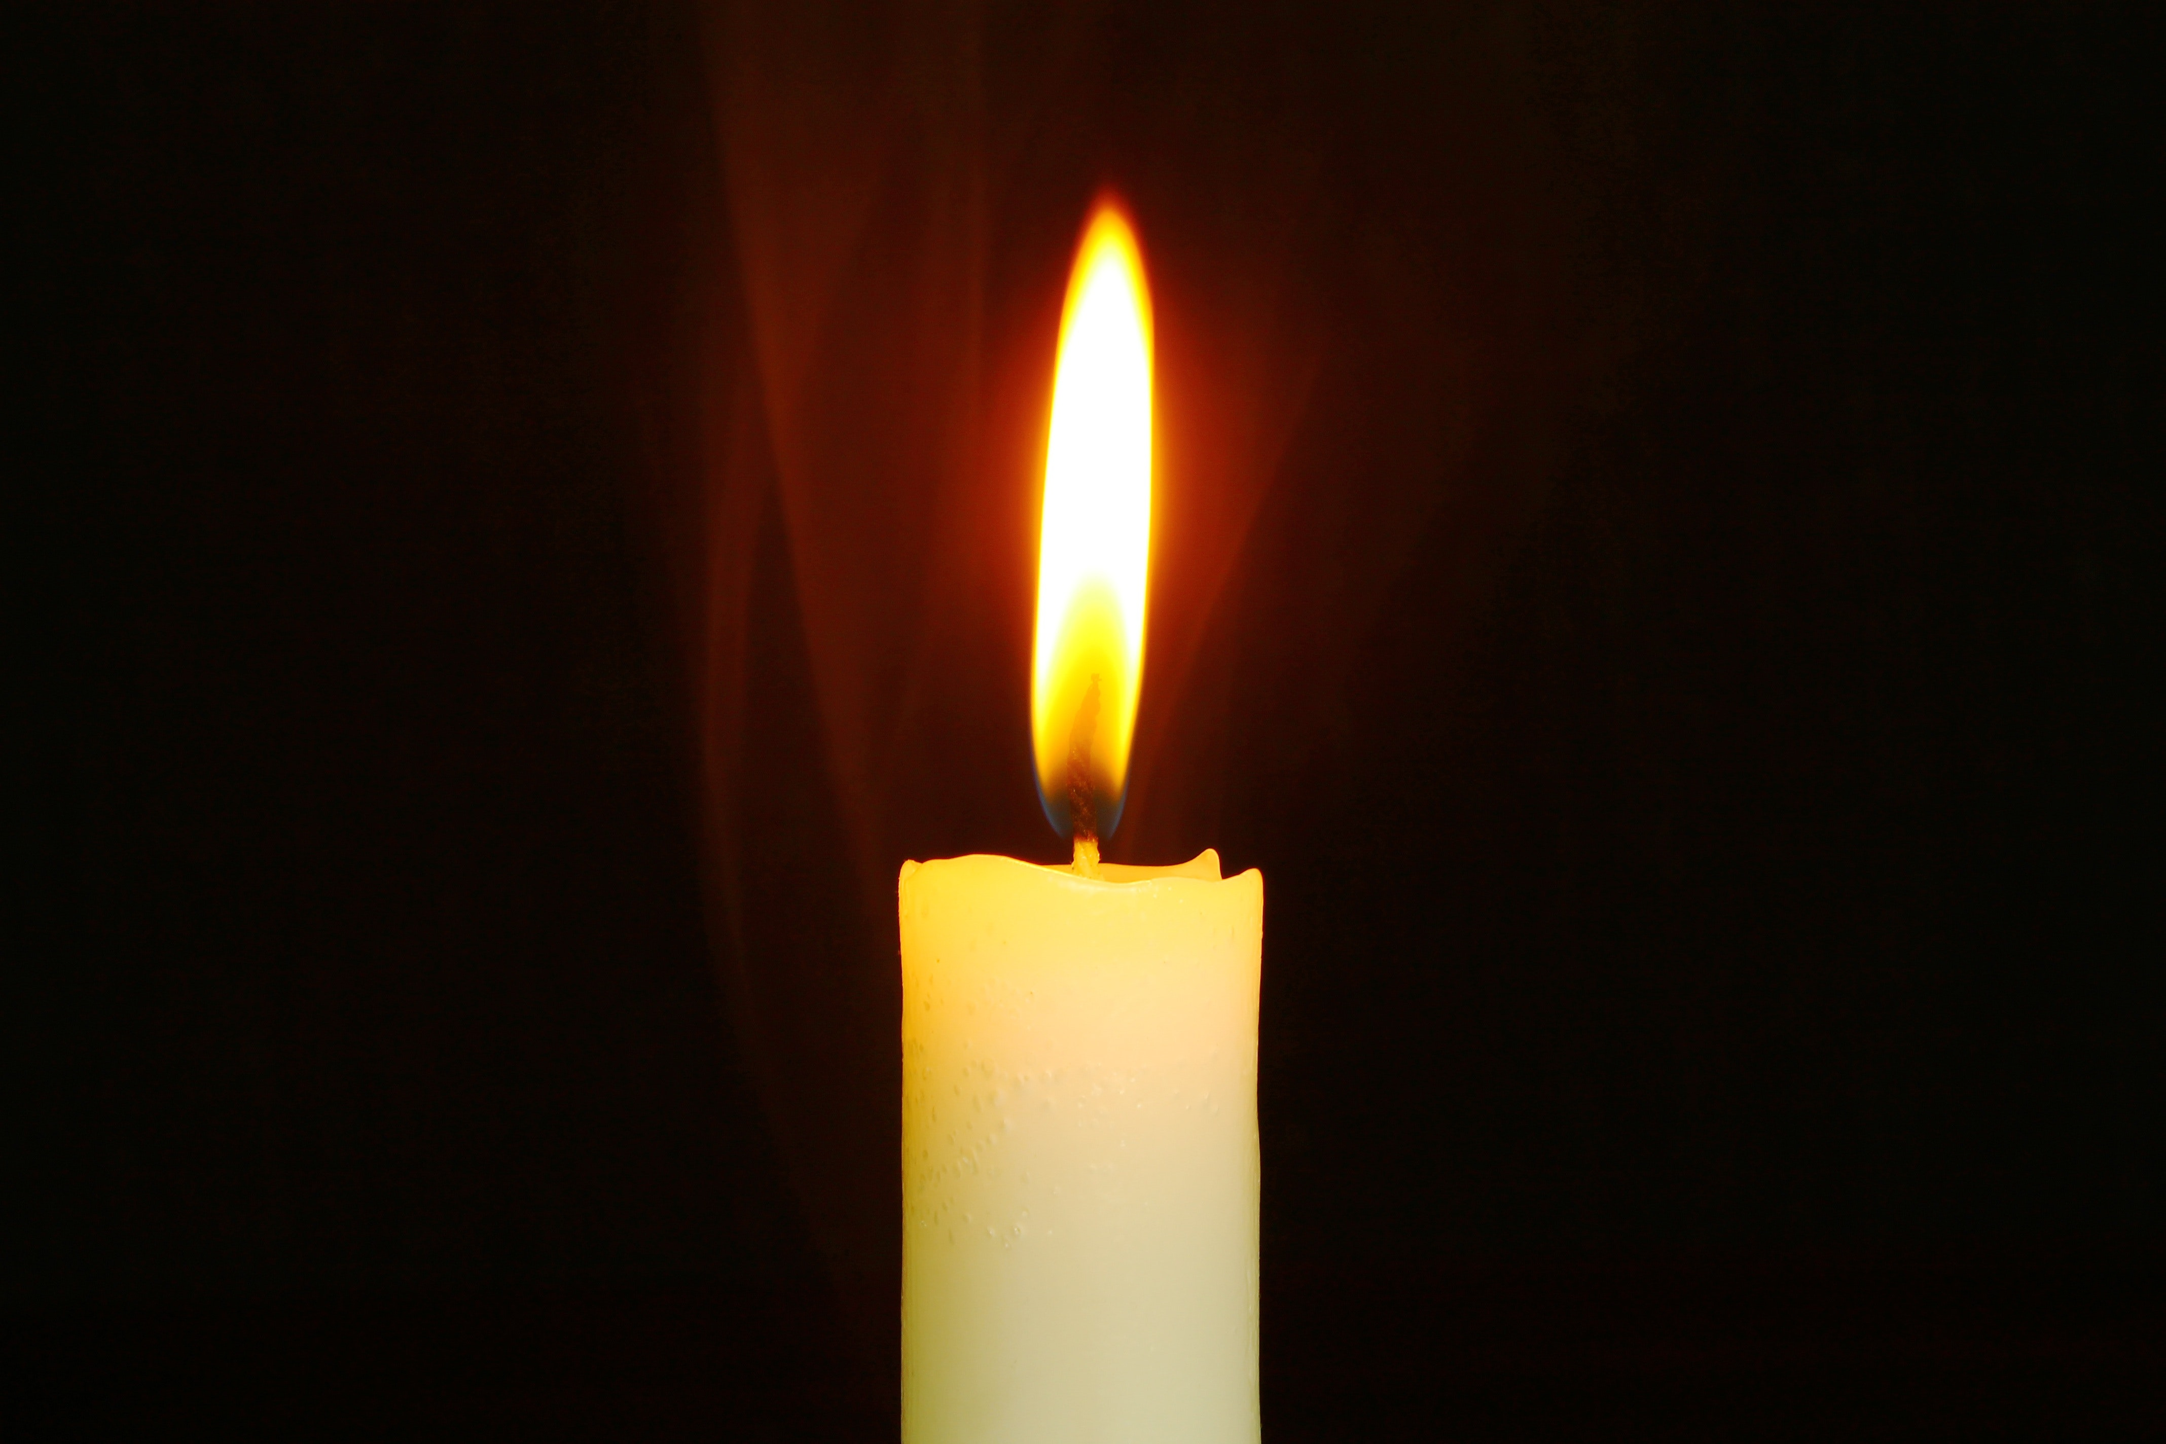
May the light of Christ shine in all our hearts Response – Amen.

Slide 13

May the peace of
The Lord be with you always
And also with you

