Slide 1


Worship
COMPASSION
CREATIVITY
COURAGE

Slide 2
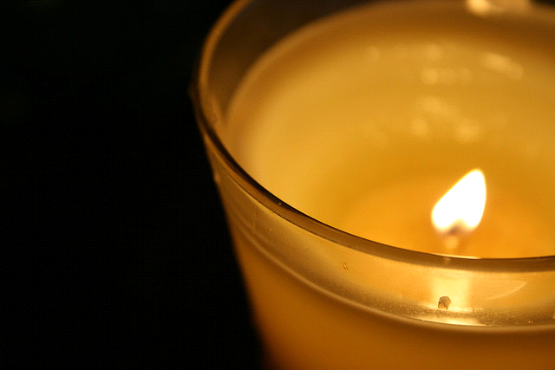
Candle Prayer
Heavenly Father
We light these candles to
remind us that You are
the light of the world.
We come together now
to
pray and to praise
and to
remove all darkness
from our
hearts and minds.
Amen

Slide 3

Worship 18th October 2021
Hope

Slide 4
Leader – The Lord is here.
Response – His spirit is with us.

Slide 5

Spirituality-
Why it is important to have hope when we are faced with challenges?
Joshua 1:9 ‘Remember that I have commanded you to be determined and confident! Do not be afraid or discouraged, for I, the Lord your God, am with you wherever you go.”
Use the mirror to reflect upon what this means………….

Slide 6

Read this together:
‘Hope is a baton, something to be held onto but also passed on. Hope comes to us… to flow through us.’ If you were passing on the baton of hope through the door what/who would be on the other side to receive the baton?

Slide 7

I wonder what it means, especially just now? I wonder how hope might flow through you today?
You could say a prayer to ask God to help you to pass on this baton of hope. Would anyone like to say a prayer to pass this hope baton on…………..?

Slide 8
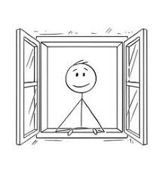
Class worship
If you were the person looking out of this window-What would a world full of hope look like on the other side? Talk about and then represent what you would see……………………………..

Slide 9
Song- My hope is in the Lord
https://www.youtube.com/watch?v=tJePCzTaQo4

Slide 10

Leader - We go into the world to walk in God's light, to rejoice in God's love and to reflect God's glory.
Response – Amen

Slide 12

May the peace of
The Lord be with you always
And also with you

