Slide 1


Worship
COMPASSION
CREATIVITY
COURAGE

Slide 2
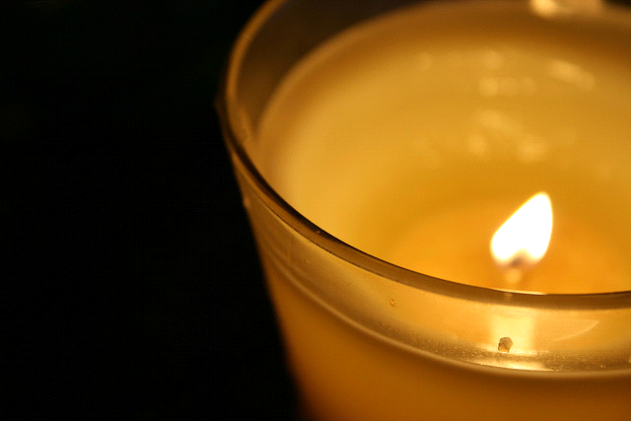
Candle Prayer
Heavenly Father
We light these candles to
remind us that You are
the light of the world.
We come together now
to
pray and to praise
and to
remove all darkness
from our
hearts and minds.
Amen

Slide 3


Worship 1st November 2021
Peace

Slide 4
Leader – Make us to know your ways, O Lord
Response – and teach us your paths

Slide 5
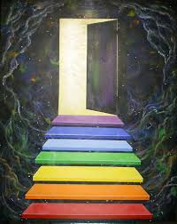
What is peace?
What do we think this means?

Slide 6
Peace has a range of meanings from silence to the end of war.
Peace is something that most people long for an end to hatred, hurting and even harmful noise.
But why is peace so hard to find? Are we frightened of silence? Are we unable to live peacefully with each other? Especially if we have differences?
Finding and making peace is so hard to find, when we do find it we have to guard it as it is precious.

Slide 7

Spirituality-
Mathew 5:9- “God blesses those that make peace. They will be called his children”.
Use the mirror to reflect upon what you think this means………….

Slide 8
https://youtu.be/qO4y3Necgxs

Slide 9
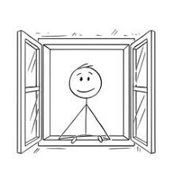
Class worship
Consider a place where you are most at peace. EYs/KS1 can draw it. KS2 can draw it and write words to describe it and how it feels to be there.

Slide 10
Song-Peace like a river
https://www.youtube.com/watch?v=d6085sLXCMs

Slide 11

God of peace,
We pray for peace
around the world.
Where there is hatred, sow seeds of calm.
Where there is destruction, help us to rebuild.
Where children are crying, bring an end to tears.
Shelter your peoples and protect them.
Guide them and keep them from harm.
Amen.
Where there is destruction, help us to rebuild.
Where children are crying, bring an end to tears.
Shelter your peoples and protect them.
Guide them and keep them from harm.
Amen.

Slide 13

May the peace of
The Lord be with you always
And also with you

