Slide 1


Worship
COMPASSION
CREATIVITY
COURAGE

Slide 2
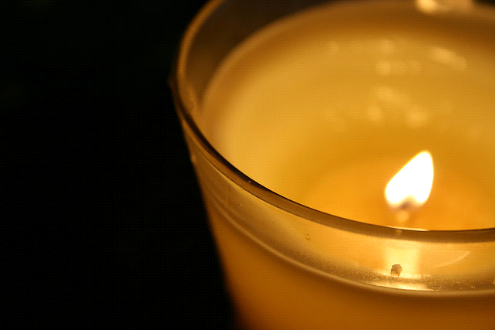
Candle Prayer
Heavenly Father
We light these candles to
remind us that You are
the light of the world.
We come together now
to
pray and to praise
and to
remove all darkness
from our
hearts and minds.
Amen

Slide 3
Worship 8th November 2021
Peace

Slide 4
Leader – Make us to know your ways, O Lord
Response – and teach us your paths

Slide 5
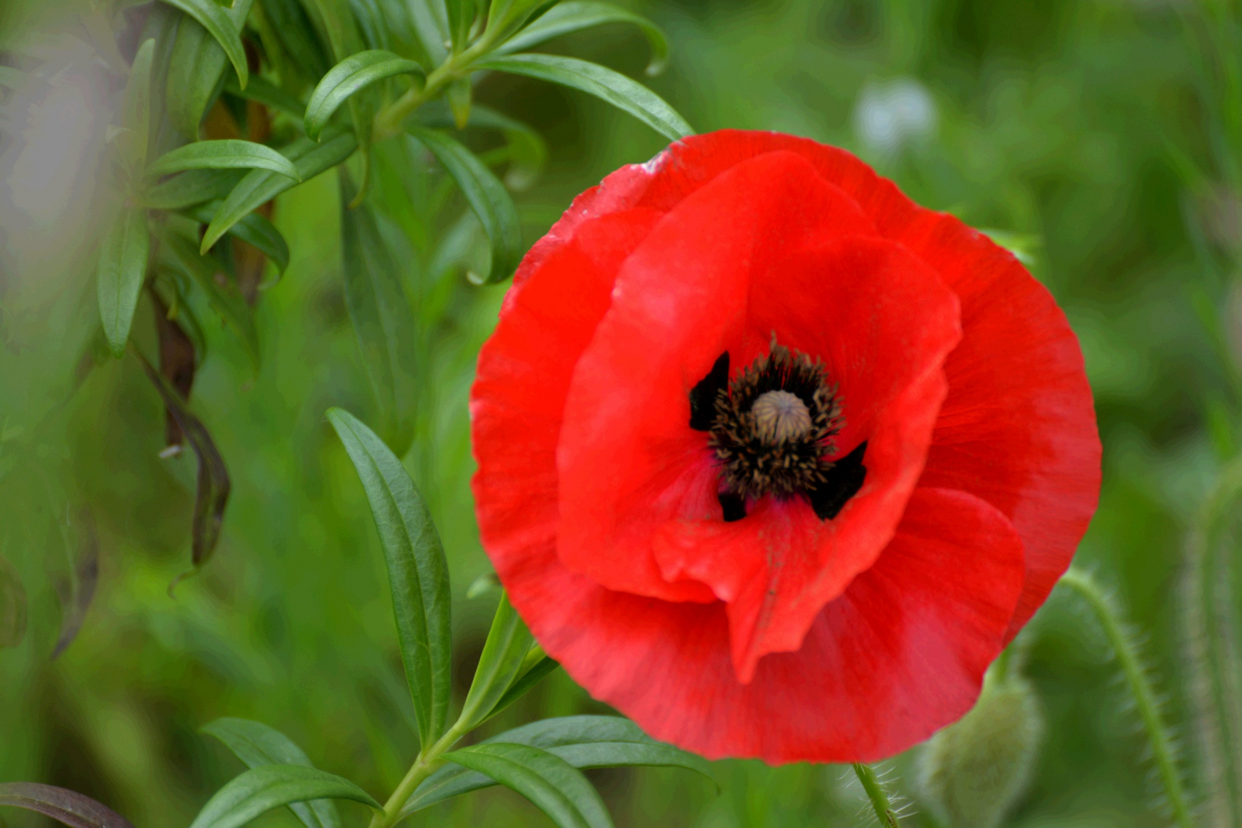
Why is this flower seen as important at this time?

Slide 6
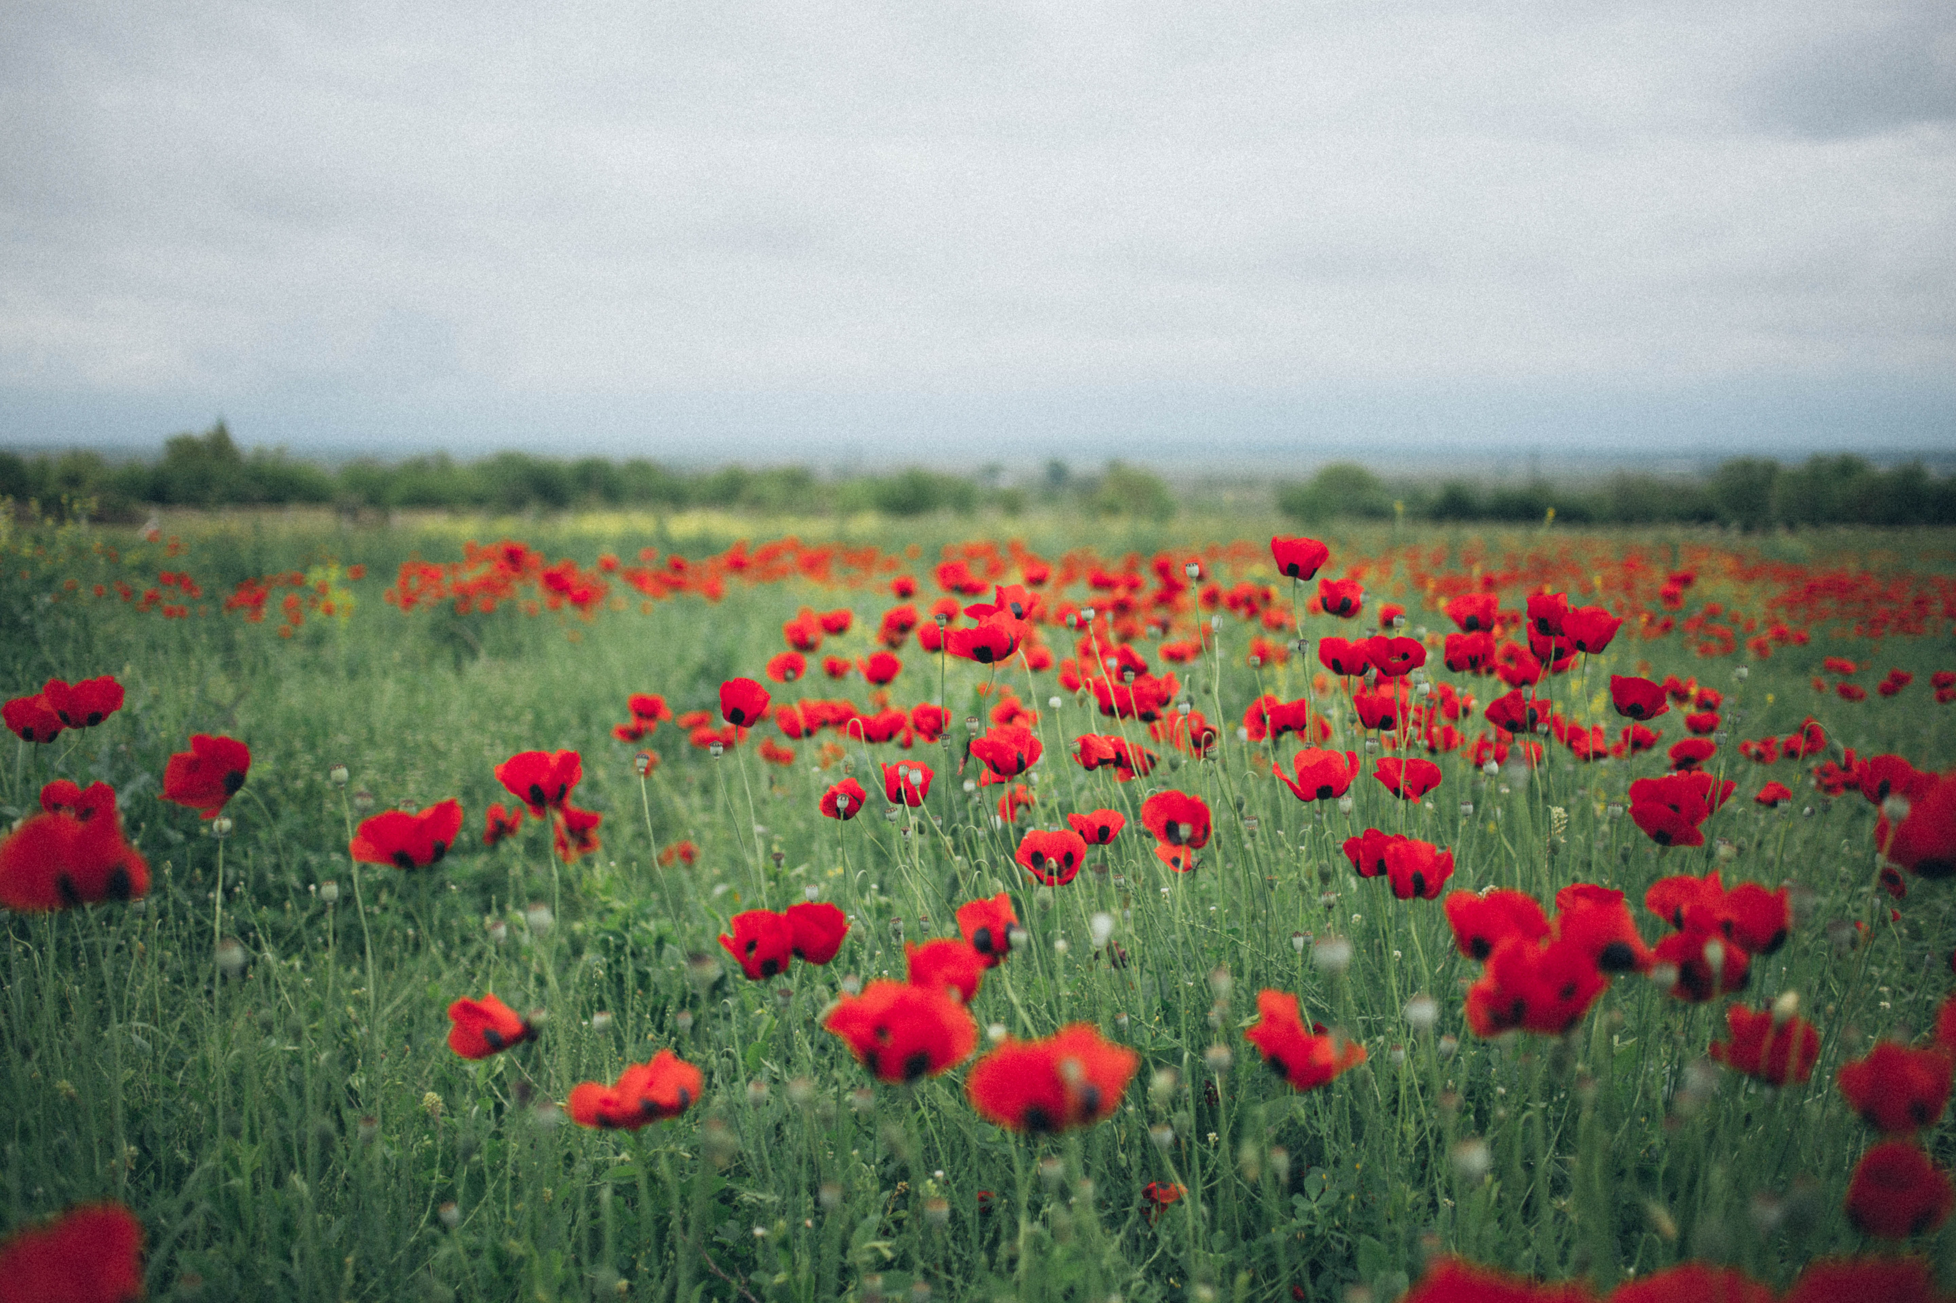

“ A vote for Peace”
The poppy can be described as “A vote for peace”. Use the mirror to reflect upon what you think this means………….

Slide 7
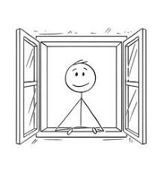
With poppies as a symbol of peace in mind, close you eyes, listen and imagine what might be happening in this clip.
https://youtu.be/jeR5JWaIcpo

Slide 8
Open your eyes and this time watch the clip. Was it similar to what you imagined? If so how? If not why not?

Slide 9
God’s peace gift to us is Jesus. He is God’s gift to all who will receive Him. Jesus makes peace with God for us and as we learn how to pass this gift on, we become peacemakers and peace-givers too. He empowers us to be peace-bringers.

Slide 10
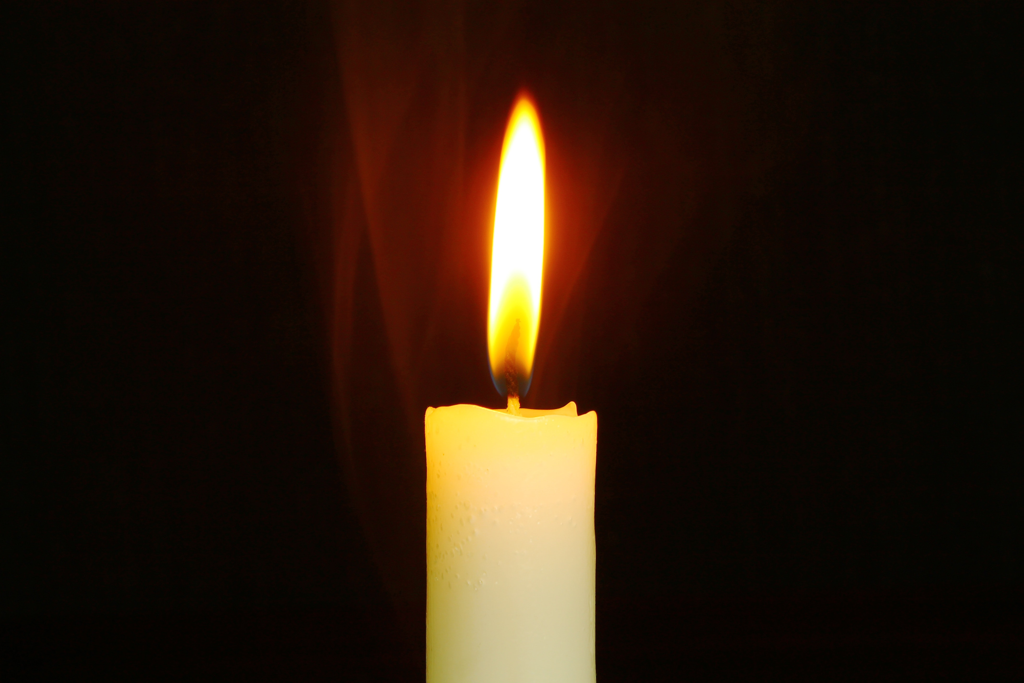

Reflection…………..
Look at the poppy. Poppies are bright and cheerful flowers: give thanks to God for the lives of those who have died in war, remembering all the joy they brought to families and friends, and all the good things they did for their home and their country.
Then look at the red petals: red reminds us of danger and harm. Ask God to be close to those who are still facing danger each day, to give courage to the armed forces, and compassion to all who help others.
Imagine you are holding the poppy in your hand: poppies are also fragile and need to be handled gently. God cares for those who are hurting and those who are sad. Ask God to comfort all who are grieving the loss of someone they love.
Finally imagine you are placing a finger on the centre of the poppy: ask God to help you play your part in working for peace in the world.
Amen.

Slide 11
Song- Make me a channel of your Peace
https://www.youtube.com/watch?v=ihhvm6eLWZI

Slide 12
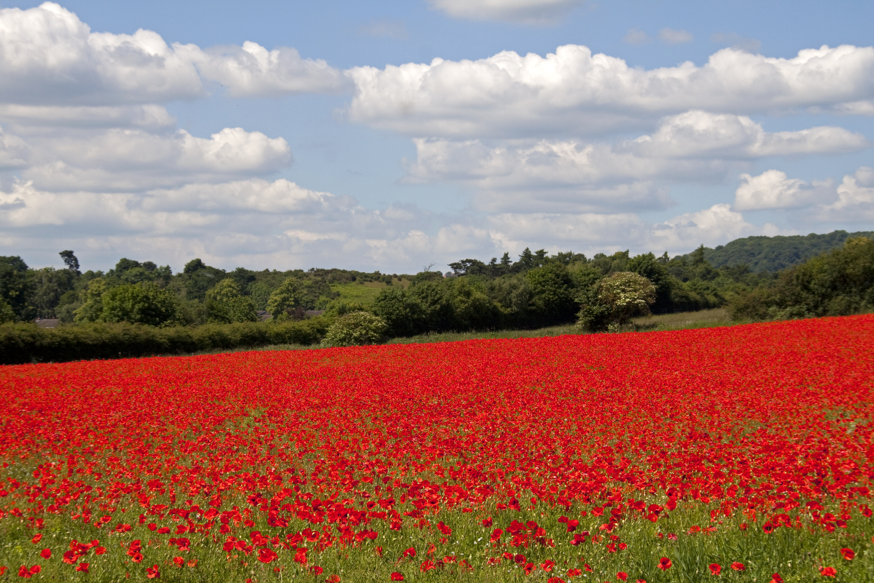
Class worship
Write your own class poems about peace. Eys/KS1 collectively and KS2 in the back of your RE books. Display in your class worship areas.

Slide 14

May the peace of
The Lord be with you always
And also with you

