Slide 1


Worship
COMPASSION
CREATIVITY
COURAGE

Slide 2
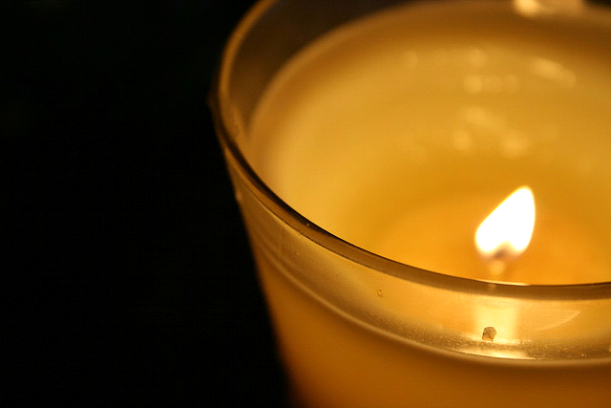
Candle Prayer
Heavenly Father
We light these candles to
remind us that You are
the light of the world.
We come together now
to
pray and to praise
and to
remove all darkness
from our
hearts and minds.
Amen

Slide 3
Worship 15th November 2021
Peace Makers

Slide 4
Leader - The Lord is good
Response- He made us and we belong to him

Slide 5
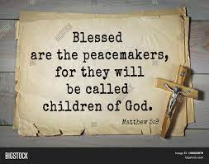

Slide 6

Reflection: Can you think of a time when you were the peacemaker?

Slide 7
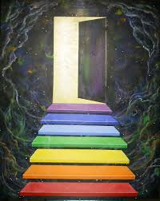
What made you make that decision to be the Peacemaker? How did it make you feel?

Slide 8


Slide 9
https://youtu.be/A2PPN3-n7xU

Slide 10
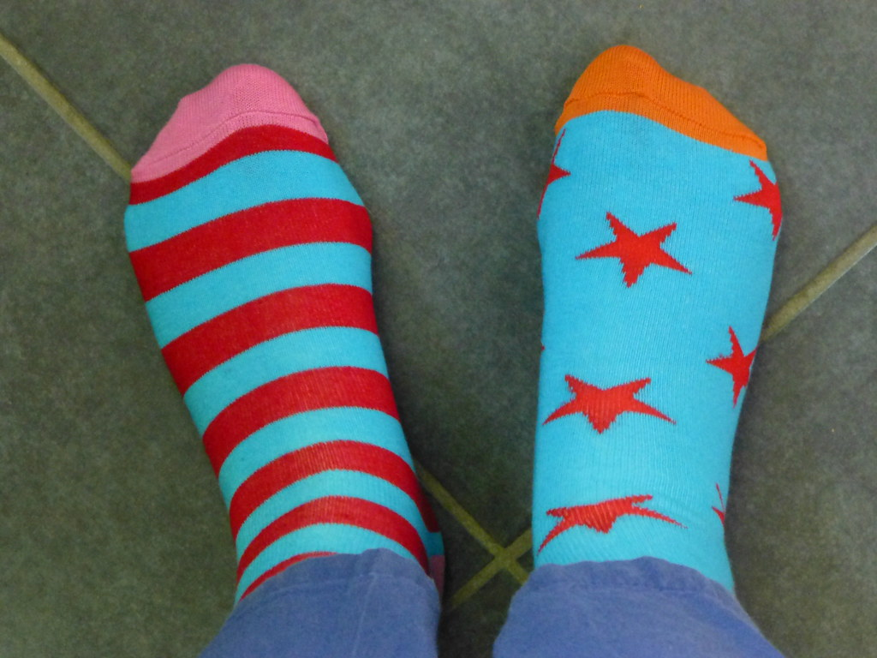
Wear odd socks! Why?!

Slide 11
Ask if someone’s OK. Say you’re sorry. Just say hey.
In a world that can sometimes feel like it’s filled with negativity, one kind word can provide a moment of hope. It can be a turning point. It can change someone’s perspective. It can change their day. It can change the course of a conversation and break the cycle of bullying.
Best of all, one kind word leads to another. Kindness fuels kindness. So from the playground to Parliament, and from our phones to our homes, together, our actions can fire a chain reaction that powers positivity.
It starts with one kind word. It starts today.

Slide 12
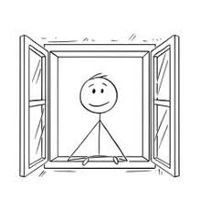
What would the world, our school be like if everyone was at peace with each other and everyone could say just one kind word?

Slide 13
Peace Like a River………….
https://www.youtube.com/watch?v=d6085sLXCMs

Slide 14
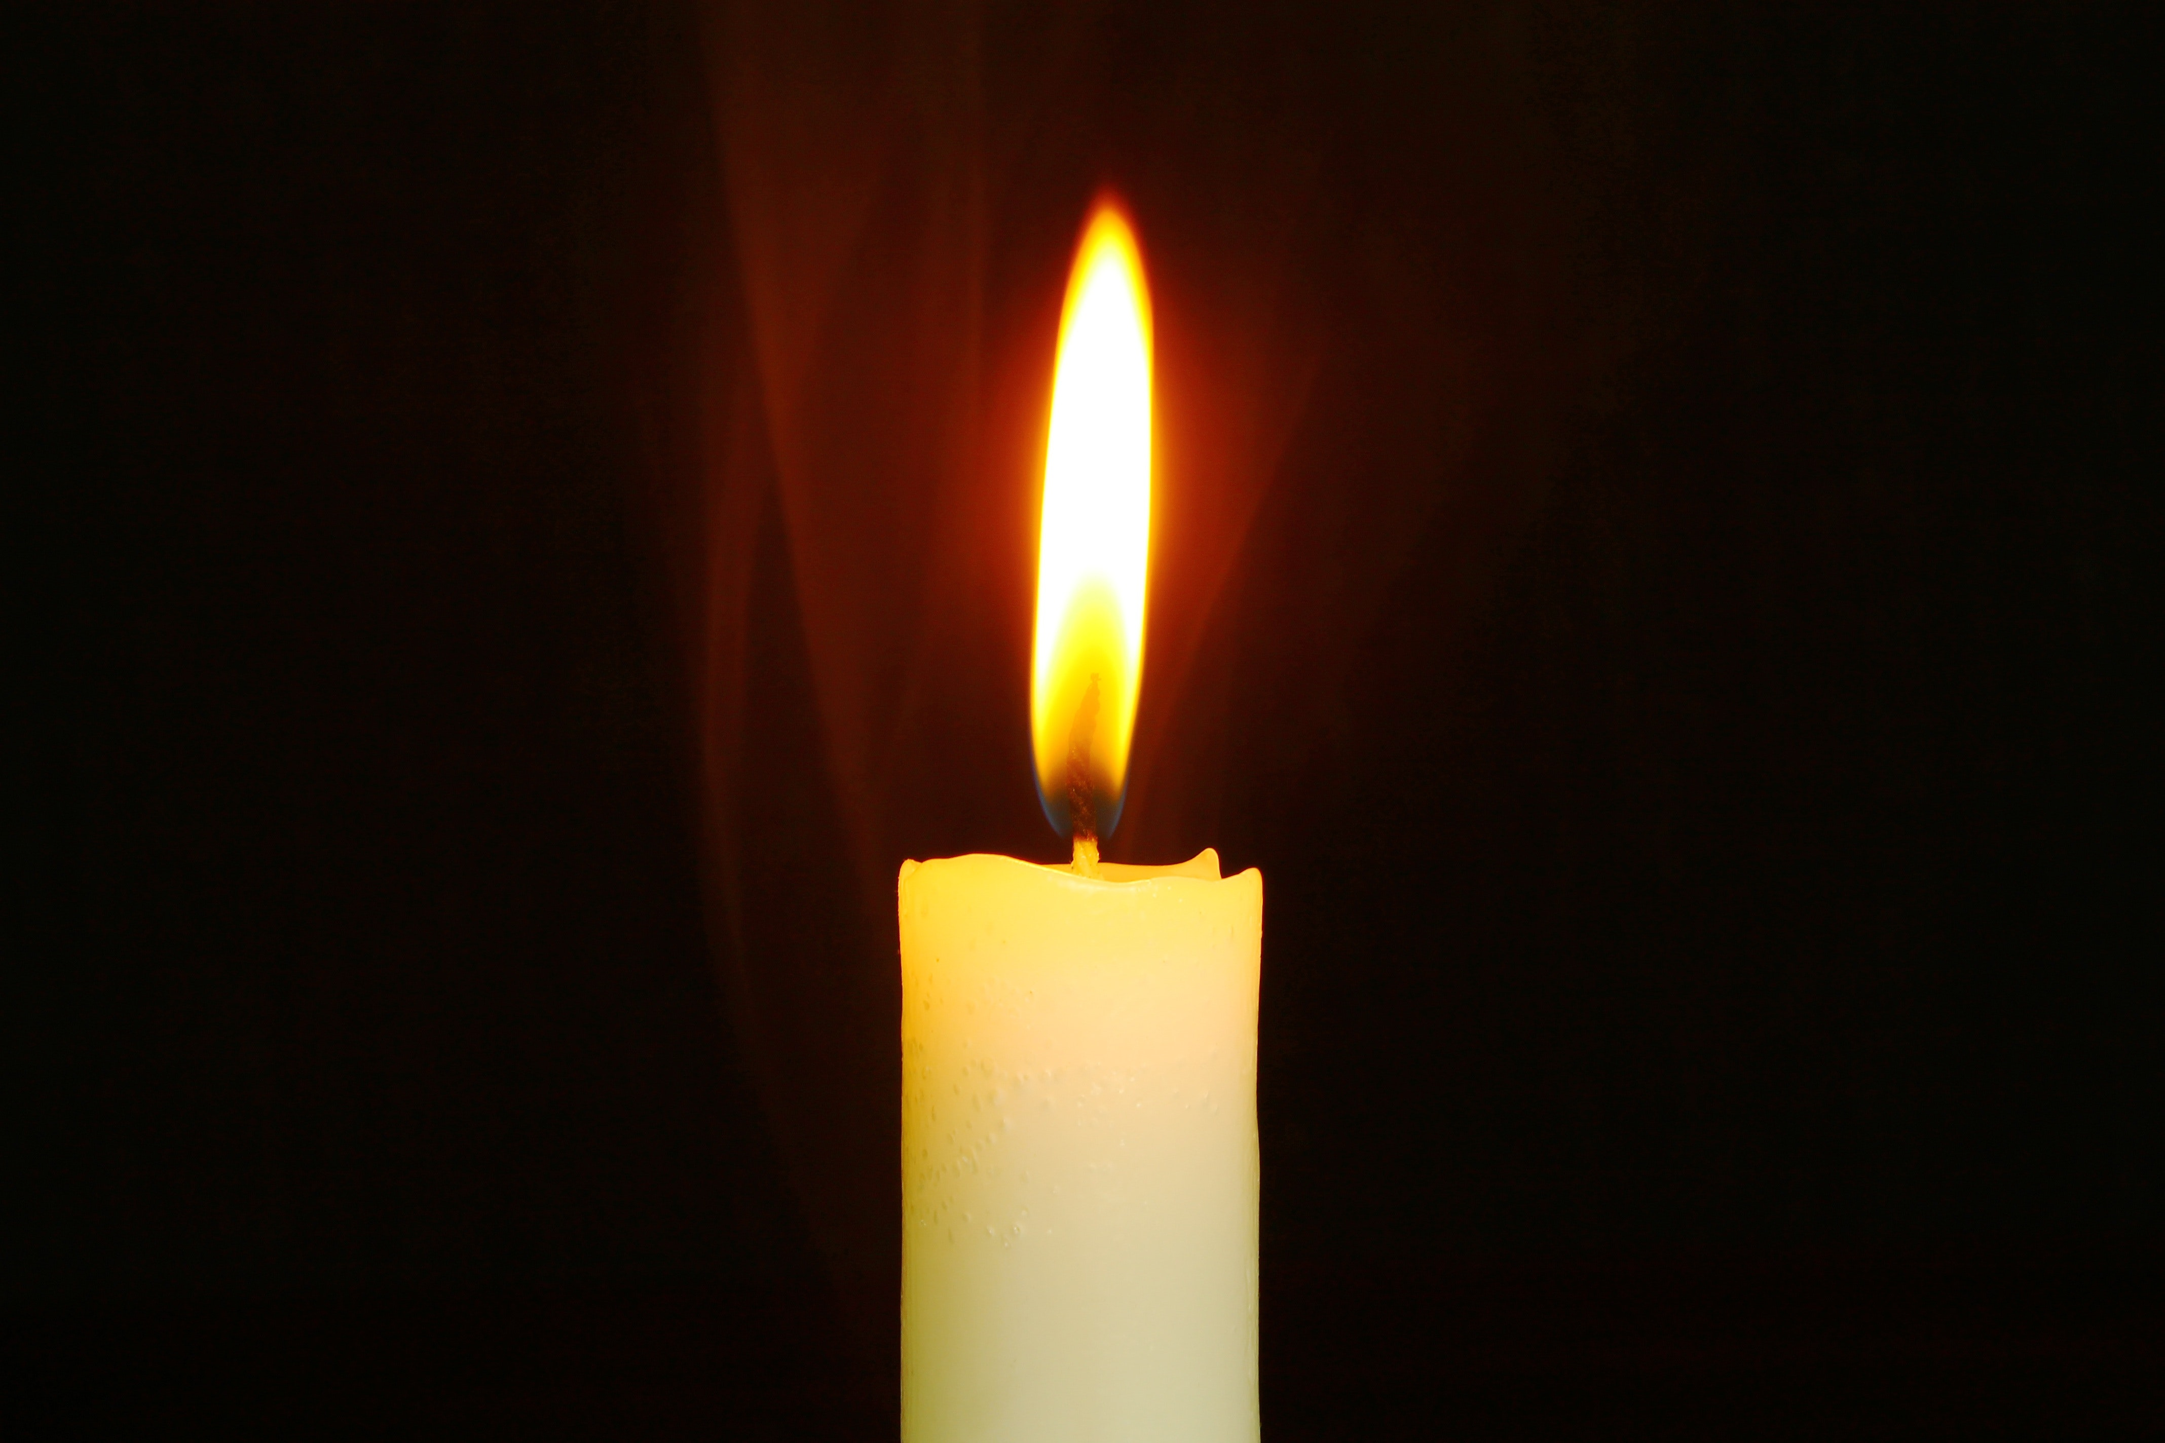
Reflection…………..
Dear Lord Jesus,
Please help us to say just one kind word to everyone,
So that we may have peace in our school, family, community and the world.
Amen.

Slide 15
Class worship
Compliments- One Kind word- Create a class display in you worship area to show how many kind words have been said each day.

Slide 17

May the peace of
The Lord be with you always
And also with you

