Slide 1

Love
Which of our Core Christian Values does this link to?

Slide 2

Engage
Love is……………………………….

Slide 3
"Love Is Patient and Kind" - 1 Corinthians 13 (Bible Animation) | Logos Bible Software – YouTube

Slide 4
Agape love- Selfness, Unconditional love.
Luke 5 : 17-26 The paralysed man

Slide 5

Reflect
S ORRY
T HANK YOU
O THERS
P LEASE

Slide 6
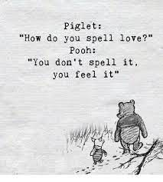
Send Out
Remember, love is an action, a verb
How could you show love to people with the things you do?

