Slide 1

Love
Monday 14th March 2022

Slide 2
Gathering
Leader- As we gather here in love today.
All- Bless us o’ Lord

Slide 3
Psalm
God is “a compassionate and gracious God, slow to anger, abounding in love and faithfulness” (Psalm 86:15). God is compassionate and sympathetic. However, God’s compassion is more than mere sympathy and pity. God's compassion is related to His mercy, kindness, patience, grace, forgiveness, and love.

Slide 4
https://youtu.be/uof6QNKfooA
Holy Tales Bible Stories - Abraham and the Sacrifice of Isaac
https://www.youtube.com › watch

Slide 5
Love the Lord | Kids Worship Motions with Lyrics | CJ and Friends - Bing video
https://youtu.be/vdMIxCdlY-c?t=153

Slide 6
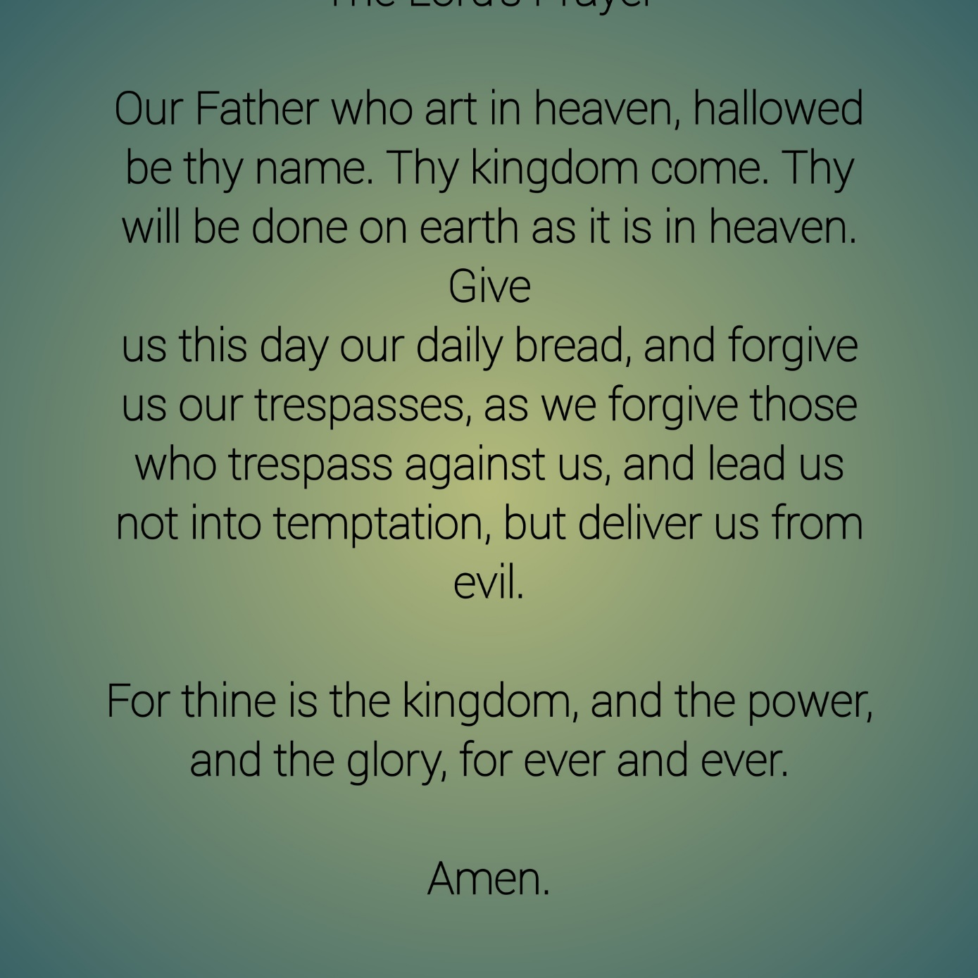
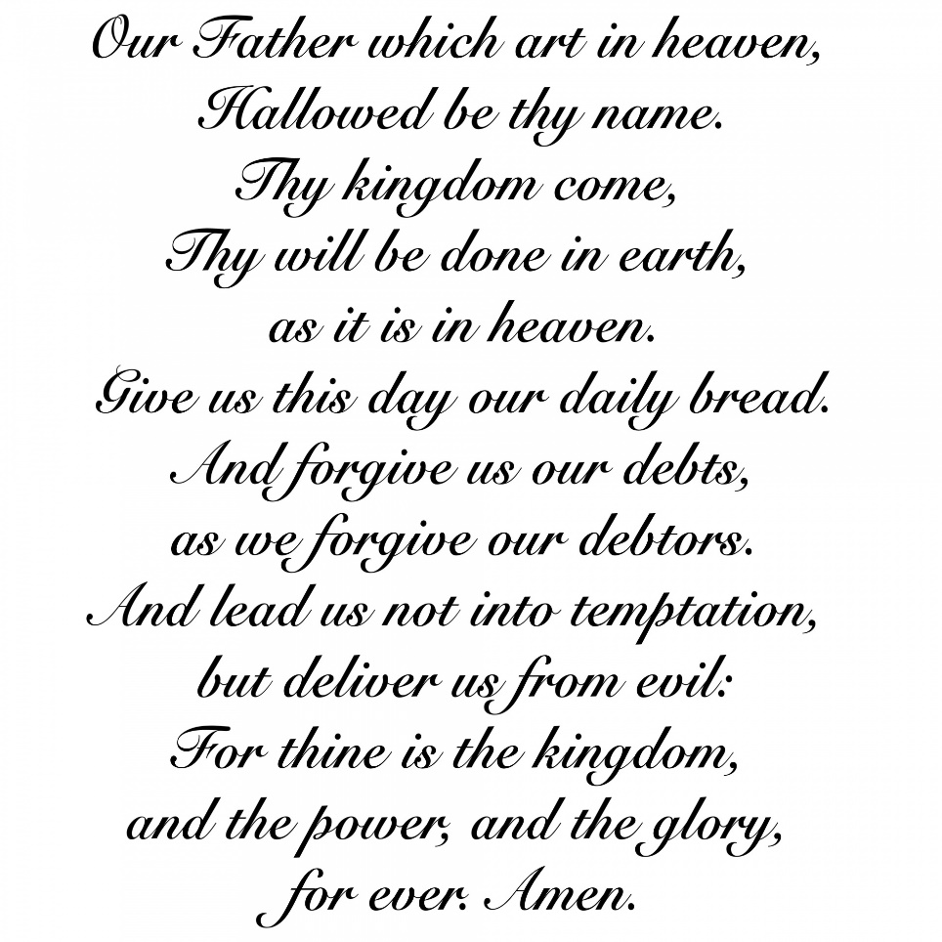
The Lord’s Prayer

Slide 7
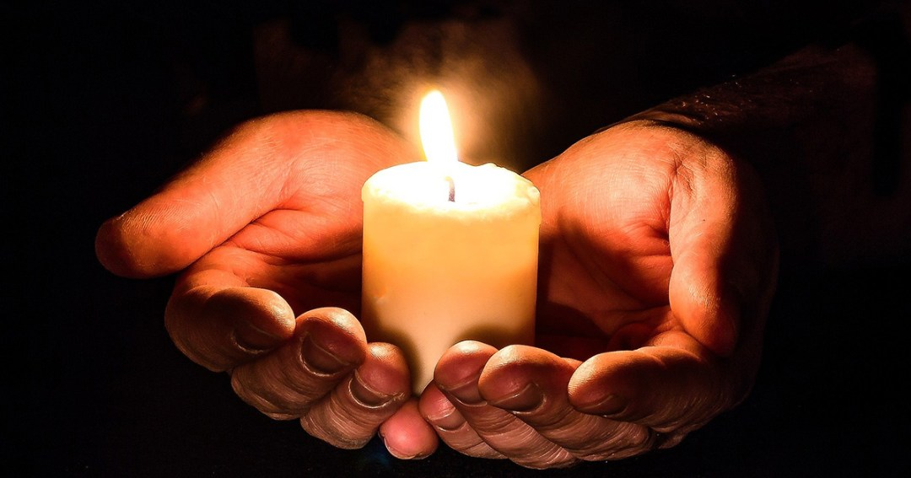
Time for Reflection

