Slide 1
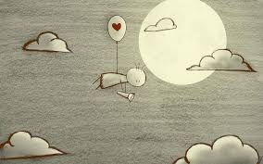
Love
Collective Worship
How does Jesus want us to show our love for each other.
Notes:
Decide who is going to be your partner so you can talk to them.

Slide 2

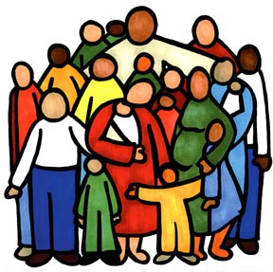
Tell your partner all about a person you love?
Notes:
Allow the children a few moments to talk about the people they love.

Slide 3

In Matthew's gospel Jesus tells the disciples this parable.
What do you think? Suppose someone has a hundred sheep, and one of them strays, does he not leave the other ninety-nine on the hillside and go in search of the one that strayed? Truly I tell you: if he should find it, he is more delighted over that sheep than the ninety-nine that didn’t stray. In the same way, it is not the Father’s will that one of these little ones should be lost.
Matthew 18: 12-14

Slide 4

Every morning Liam got up before anyone else was awake. As soon as the sunshine was lightening the window behind the curtains, Buster would start wagging his tail and nuzzling him to wake up. Then up they would get, creeping downstairs quietly, until Liam opened the back door and Buster would burst out into the garden.
This Wednesday morning was different. The sun shone down through the gap at the edge of the curtain and woke Liam by shining in his eyes. He sat up and rubbed them wondering where Buster was. Buster lay on the floor breathing heavily, his sad eyes full of pain.

Slide 5

“Mum, mum,” called Liam “mum come quickly, Buster’s not well.”
Liam flew into their bedroom and shook his mum awake.
“Mum Buster needs your help, come on!”
Wearily mum got out of bed and trailed back to Liam’s room to look at the suffering dog. She knelt down and stroked his hot head, Buster didn’t even look up.
“We’ll ring the vet,” said mum but her face was worried and her eyes full of tears.

Slide 6
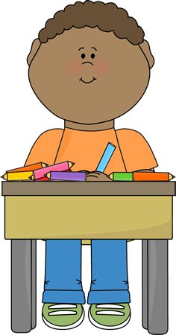
All that day at school Liam couldn’t think about his work. He kept looking out of the window and wondering how Buster was and if mum had got him to the vets yet.
When it was time to go home Liam couldn’t wait to get out. He hopped from foot to foot waiting for the others to be ready. As soon as he was out of the door Liam flew across the playground towards his mum. But even as he was running he could see her sad face; her eyes red from crying.
“Where’s Buster?” he asked anxiously.
“He’s very unwell Liam,” she said firmly “he has to stay at the vets and when he comes home we’ll have to take special care of him.”

Slide 7
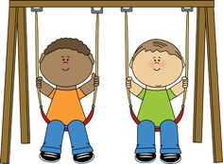
That evening Liam sat on the seat of the swing in the garden, rocking sadly. He couldn’t stop thinking about Buster. How he growled and wagged his head when they played tug with his rope toy. How he would jump up and lick Liam’s face when he got to the school gate. Liam felt his whole world was upside down.

Slide 8
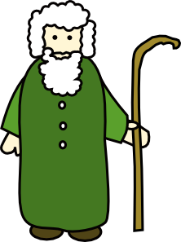
Aunty Sue walked across the grass and sat on the next seat of the swing. She looked across at him sadly and said, “He’ll be home soon.”
Liam smiled but his top lip quivered a little.
After a while Aunty Sue carried on; “Do you remember the story they told us in church on Sunday about how the shepherd wasn’t happy until he’d found his lost sheep?”
Liam nodded.
“Well Jesus loves us just like that. When we think our heart is breaking he comes and finds us just like the shepherd going to look for that lost sheep. Then he carries us along too until we’re feeling better.”

Slide 9
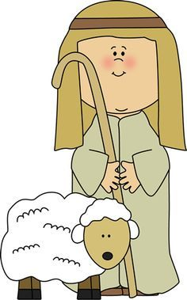
Does Jesus love Buster?” Liam wanted to know.
“Yes he does, he’s helping Buster right now and we can help Jesus do it by praying for Buster too.”
“Will he make him better?”
“I hope so,” said Aunty Sue “but sometimes it isn’t always possible. Sometimes sad things happen but that doesn’t mean that Jesus has stopped loving us or doesn’t love us very much.”

Slide 10
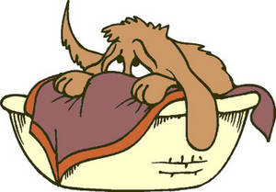
That night Liam went to bed wishing Buster was with him. He missed that warm furry body lying next to his legs; he tossed about but couldn’t quite get off to sleep. Very quietly he asked Jesus to look after Buster and bring him home.
When Liam came home from school the next day Buster lay in his basket in the kitchen. He tried to lift his head and wag his tail when he saw Liam but he was too weak. Liam knelt quietly next to the basket and stroked Buster’s head. He rested his forehead gently against Buster’s.
“I’ll help carry you like Jesus until you’re better.” he promised.

Slide 11
God really only loves people.
Do you agree or disagree?
If God really does love us, how do we know that he does?
How does Buster show his love for Liam?
What do we do to show we love other people?
Notes:
There are 4 questions on this slide; the first 2 are about God’s love for us and the second 2 are about how we love each other. You don’t need to use all of the questions.

Slide 12

Think about the people you love the most; it might be your mum or dad or even your sister or brother. It could be your best friend.
Imagine the things you do together; think of yourself doing those things that you enjoy most with the person you love.
Put your hands into a cup shape as if you were going to lift up some water in them.
Now imagine placing those people you love one by one into the palms of your hands.
Holy and loving God we place those people we love into your hands.
Thank you that you are a wise and loving God who give us many people to love us.
We place each one into your loving care.
Amen
Notes:
You may want to light a candle or play some quiet music for the back ground to this. Allow the children plenty of time to think about the people they love using the prompts.

