Slide 1

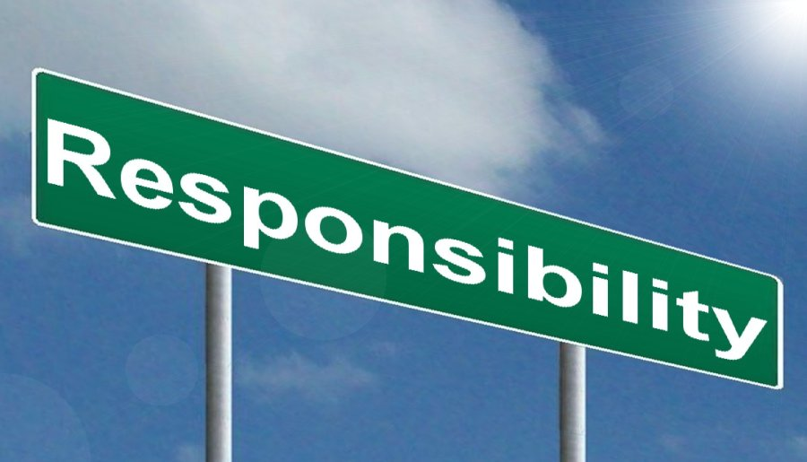
Responsibility
Song- Our God is a great big God

Slide 2
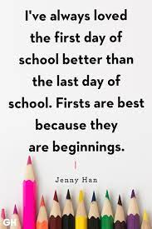
Mrs Hawkings-As God’s people we have gathered:
Children- let us worship him together.

Slide 3
New beginnings, new responsibilities?
Being responsible means being dependable, keeping promises and honouring our commitments. It is accepting the consequences for what we say and do. It also means developing our potential. People who are responsible don't make excuses for their actions or blame others when things go wrong.
Can you name something you will be responsible for in class/school this year?

Slide 4
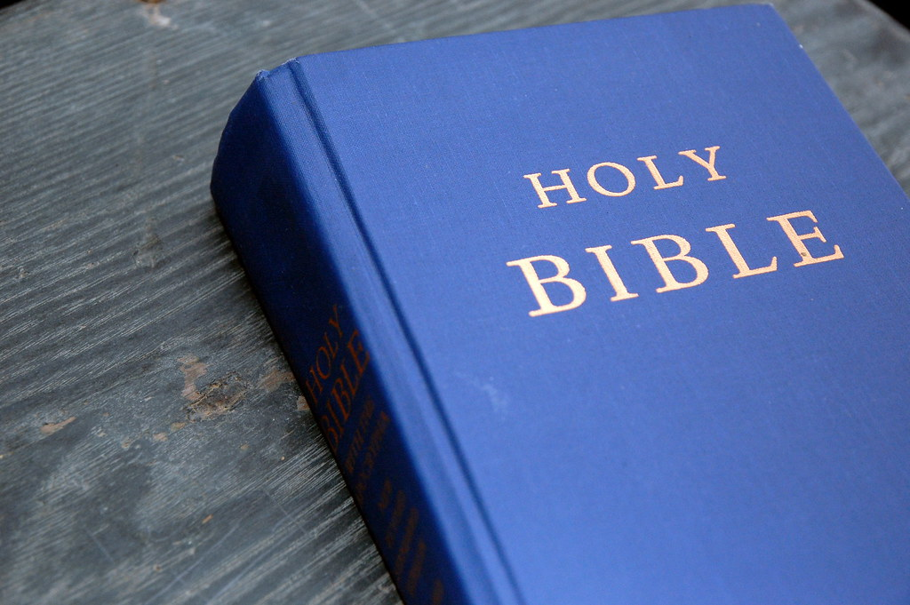
What does the Bible say?
The Bible has a lot to say about taking responsibility. For example, we are to be responsible for the way we act toward others (Luke 10:30-37). We are responsible for the way we treat our families (1 Timothy 5:8). We are responsible to study God’s Word (2 Timothy 2:15). And we are responsible for the way we handle money (Hebrews 13:5).
God has done so much for us. He created us. He sent his son, Jesus, to die for us. He saves us from the punishment for our sins. As a way to show our thanks to him for all he’s done for us, we want to honour him. We do this by taking responsibility to live a life pleasing to him.
Bible has a lot to say about taking responsibility. For example, we are to be responsible for the way we act toward others

Slide 5
https://www.youtube.com/watch?v=eSgggvXrLvM

Slide 6
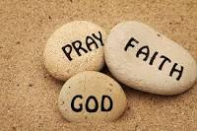
Prayer Pebbles
Thank you/Please

Slide 7
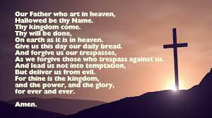
The Lord’s Prayer

Slide 8
Class challenge
Responsibility jar
Which class can be the most responsible?
Which class will achieve most responsibility nuggets?

