Slide 1

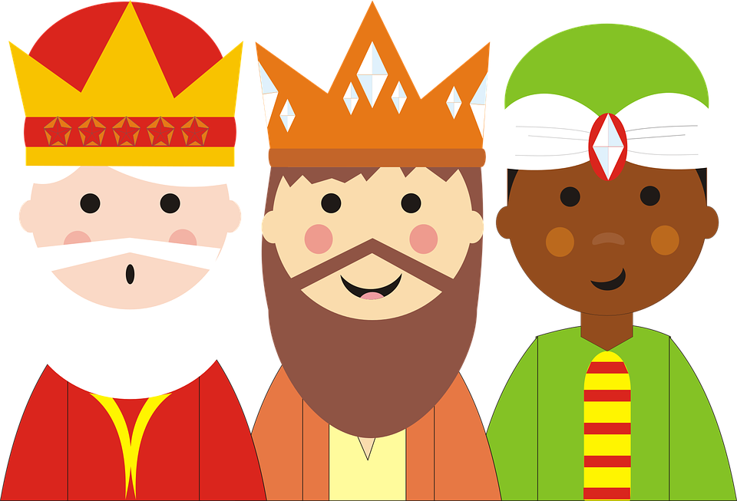
Feast of the Epiphany
Notes:
OPTIONAL- Appropriate music could be played quietly for a few minutes to help create a prayerful atmosphere for collective worship or while pupils enter if an assembly. You may wish to light a candle and have a Bible displayed. The liturgical colour for today is white. Symbols for a prayer table could include wrapped gifts, a globe, figures of the wise men from a nativity scene.
Reader: We gather as a school family to continue our celebration of the birth of Jesus, the Light of the world, God’s gift of love to all. The name Jesus means ‘Saviour’.

Slide 2

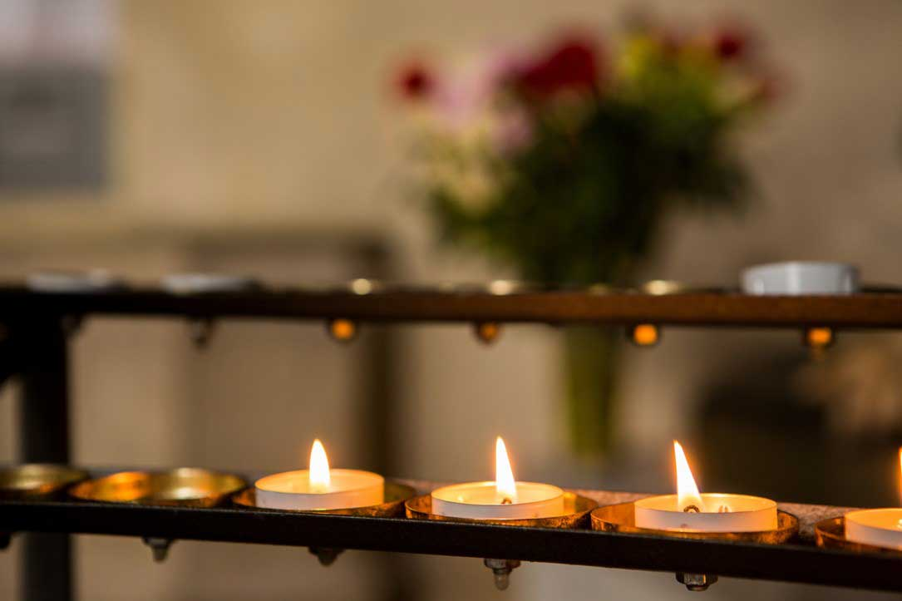
We gather…
The light of Christ has come into the world!
Notes:
Reader: The light has come to shine on all people throughout the world, to guide them to the new life offered by Jesus.
Photo credit: Thom Flint | CAFOD (2017)
Candles in St George's Cathedral, Southwark

Slide 3

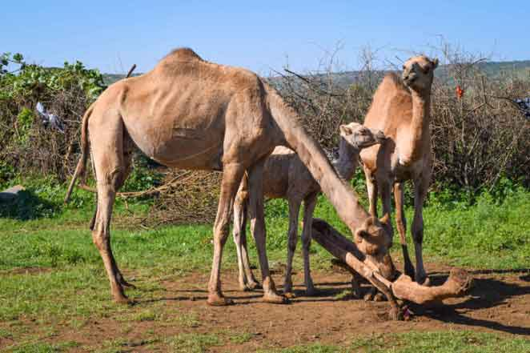

We listen…
A reading from the Gospel of Matthew
Notes:
Reader: In the gospel of Matthew, we hear the story of how some wise men from another part of the world were led by a star and travelled the long journey to Bethlehem, looking for Jesus. They found him in a stable.
Reader: A reading from the Gospel of Mark: “After Jesus had been born at Bethlehem in Judaea during the reign of King Herod, some wise men came to Jerusalem from the east... And suddenly the star they had seen rising went forward and halted over the place where the child was. The sight of the star filled them with delight and going into the house they saw the child with his mother Mary and falling to their knees they did him homage. Then, opening their treasures, they offered him gifts of gold, frankincense and myrrh.”
The Gospel of the Lord
All: Praise to you Lord Jesus Christ.
(Matthew 2:1, 9-12)
Reader: The Son of God, Jesus, came into the world, to give life to every member of the human race. No matter what our race, nationality, colour or religion, each of us is made in the image and likeness of God. For all of us, this is a day of real celebration – we, too, are chosen.
Photo credit: Samson Haileyesus | CAFOD (2015)

Slide 4
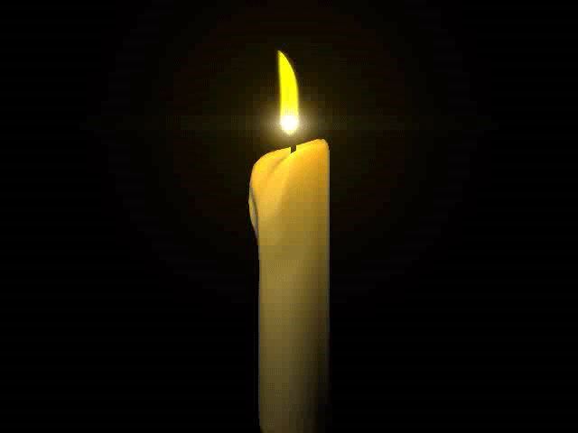


SACRED SILENCE
We respond…
What is God saying to us?
Imagine you are one of the wise men.
How would you have felt seeing Jesus?
Why do you think this day is important?
Notes:
Optional slide- Following the reading of the Word, you may wish to provide a moment for ‘Sacred Silence’ with questions for children to ponder.
Reader: Imagine you are one of the wise men.
How would you have felt seeing Jesus?
Why do you think this day is important?
Let us have a moment of silence to think about God’s words.

Slide 5
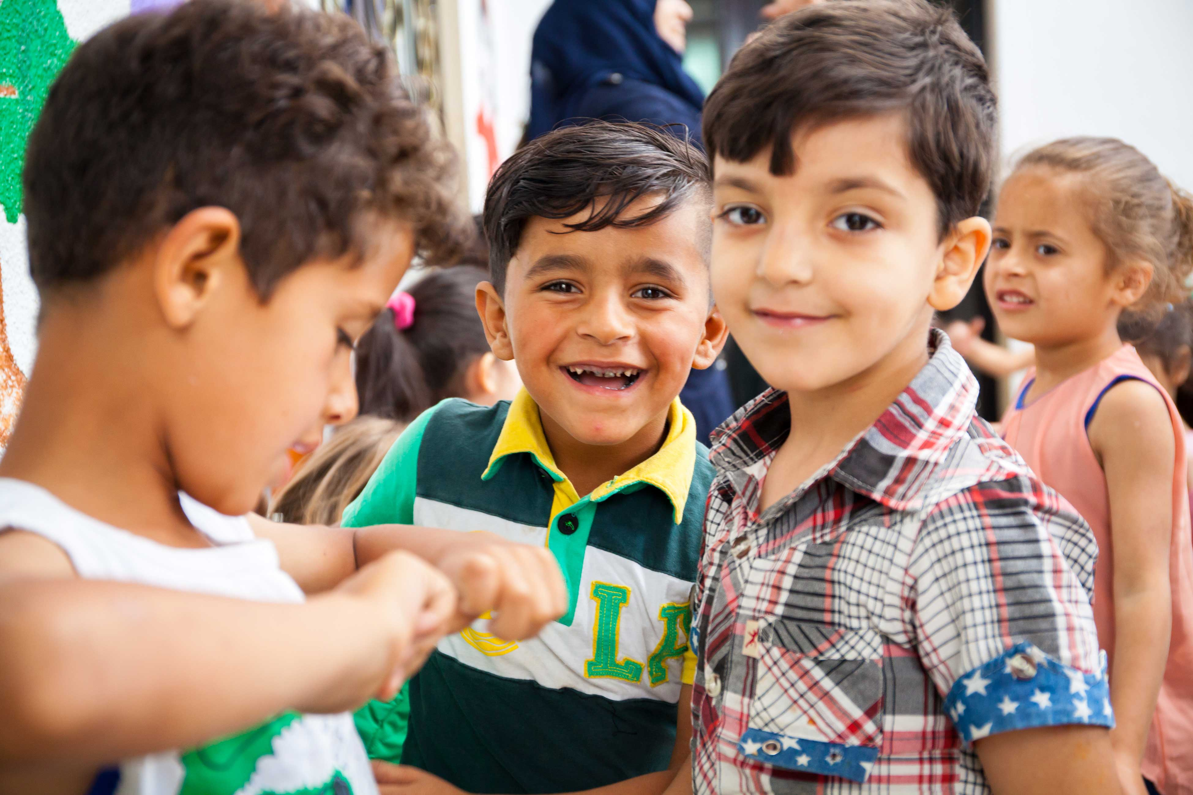
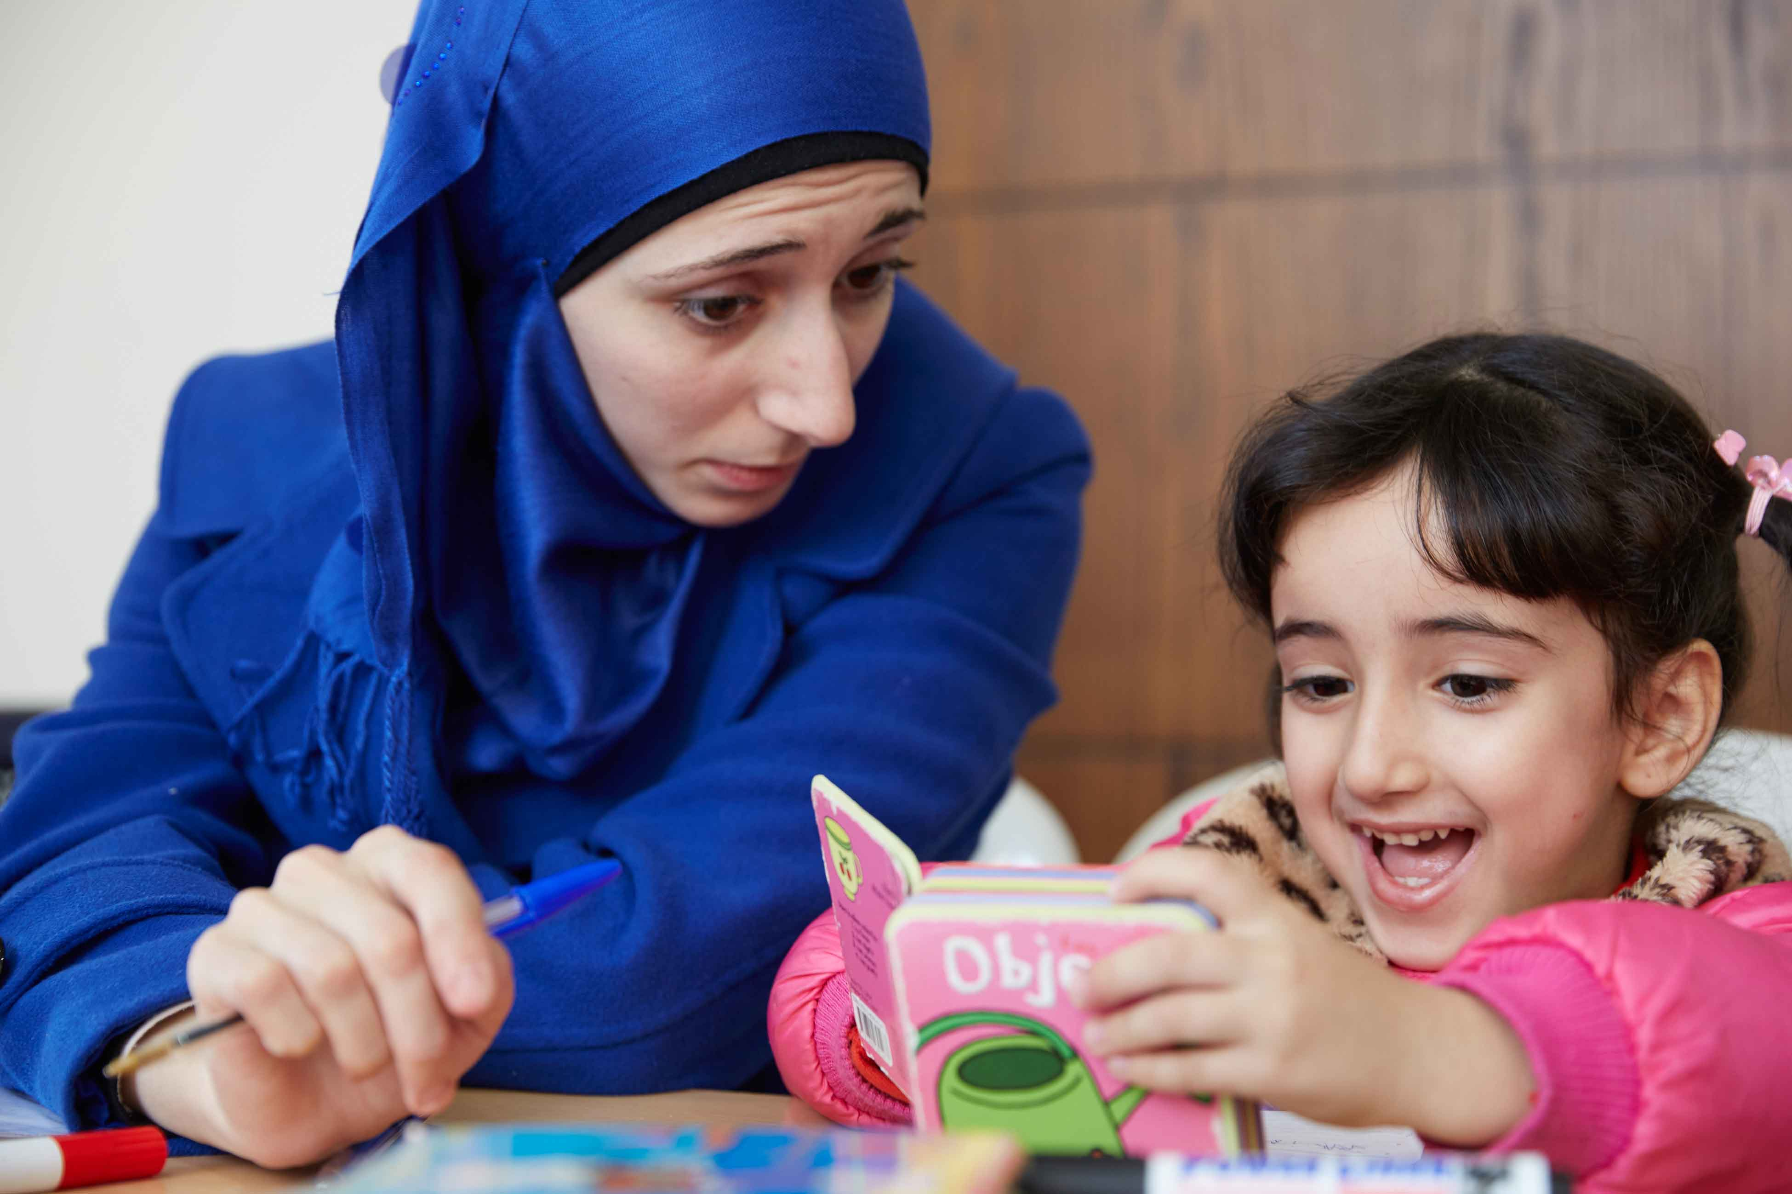
We respond…
Notes:
Reader: Following the teaching of Jesus, we believe that everyone is chosen and special. That’s why CAFOD recognises all people as our sisters and brothers. CAFOD works with all people whatever their skin colour, nationality or religion. We are all equal. For example, in two of its projects, CAFOD is working in Jordan and Lebanon with children from Syria.
Reader: Mary and Joseph had to travel to Bethlehem and the wise men travelled there to meet Jesus. Why do people decide to move and live in a different country? There are many different reasons why people move. Some move out of choice but sadly some are forced to leave their homes.
Reader: What might it feel like to be forced to leave your home, to find somewhere safe to live? CAFOD and its partners help children who been forced to leave their homes and move to new countries.
Photo credit: (left) Louise Norton | CAFOD (2017) (right) Dario Mitidieri | CAFOD (2015)

Slide 6
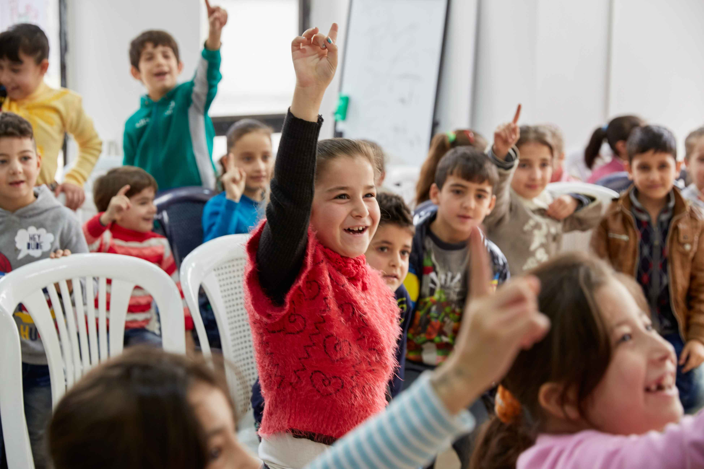
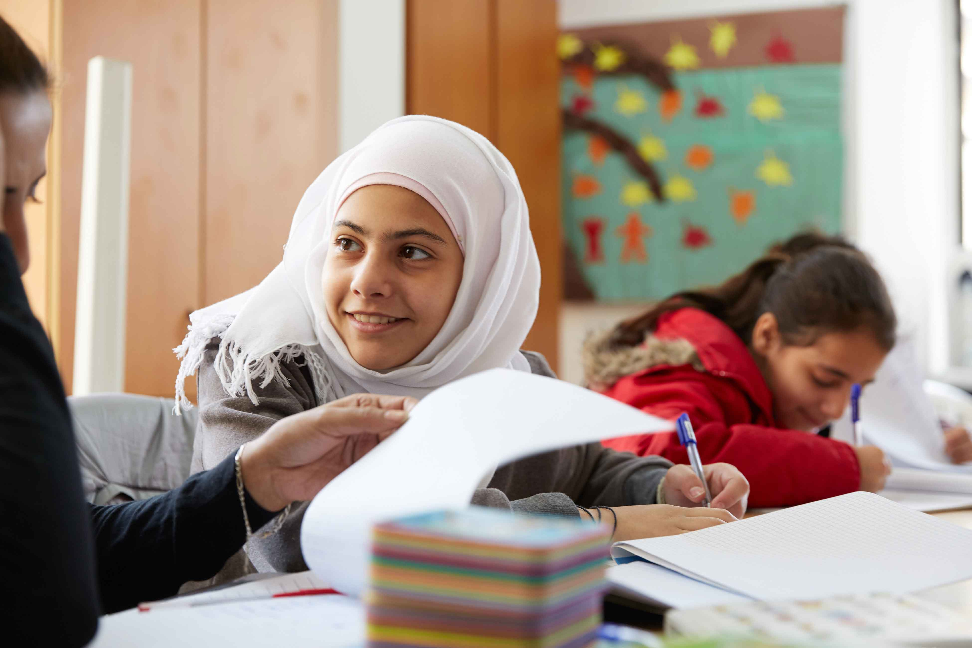
We respond…
Notes:
Reader: Where do you think these children are? Children from Syria come to a special CAFOD partner Centre to help them with difficulties they might be living through such as memories about war. They are given the chance to do fun activities such as puppet making or playing with a clown. Some of the older children learn French and adults can get medical help.
Photo credit: Dario Mitidieri | CAFOD (2015)

Slide 7
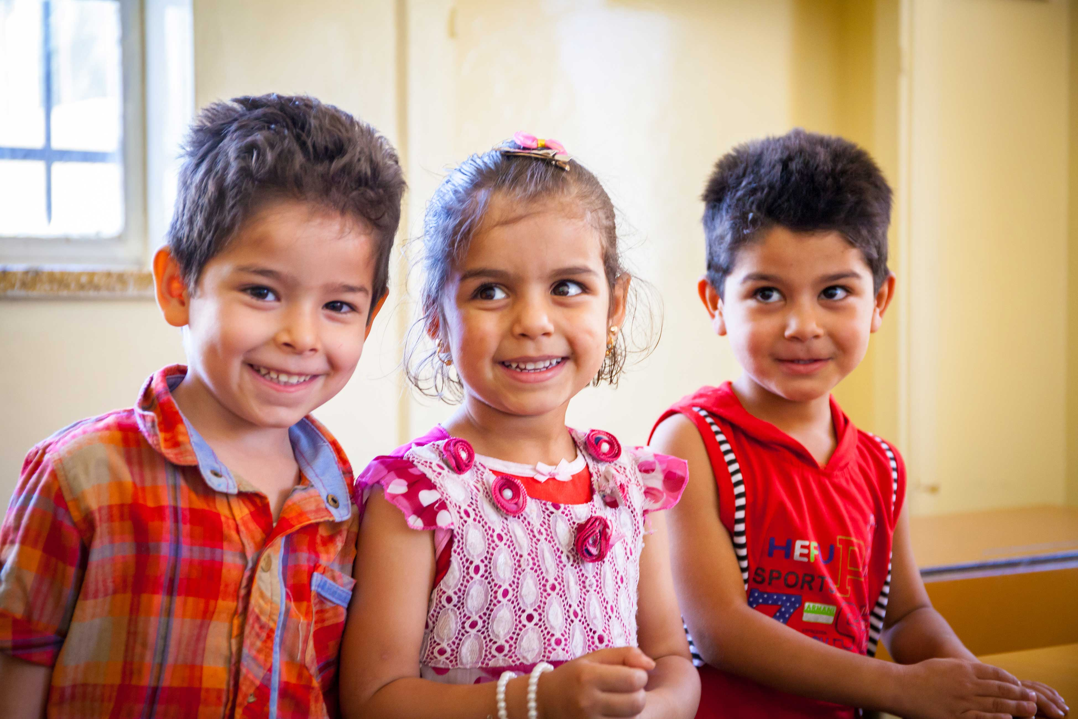
We respond…
Notes:
OPTIONAL SLIDE- additional detail for a KS2 assembly
Reader: This is Yamone, Waed and Ali . They are refugees from Syria. With CAFOD’s support, they and many other children can get help with English, Arabic and Maths classes.
Children are also given a snack and packed lunch but Layal (the Project Officer) said: “For some children it is the only meal they get. They take it home to share with their brothers and sisters”.
Photo credit: Dario Mitidieri | CAFOD (2015)

Slide 8

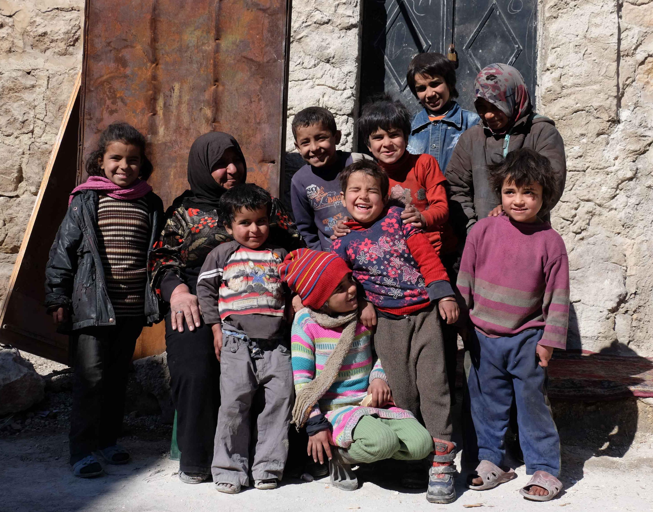
The light of Christ has come into the world!
Going forth…
Response:
May we show our thanks to you, by serving our sisters and brothers throughout the world.
Notes:
The following prayers can be printed off and read by readers; all responding with the response on the slide.
Reader: Jesus, Guide on our journey, let us see with your eyes, so that we may recognise you in every person of every race, nationality and colour. (Response: May we show our thanks to you, by serving our sisters and brothers throughout the world)
Reader: Jesus, Light of the world, may we be a light for those whose lives we share; may our kindness and care bring courage and hope to those who are sad. (Response: May we show our thanks to you, by serving our sisters and brothers throughout the world)
Reader: Jesus, bringer of comfort, help us to realise that we have gifts to offer to you through your people every day, and these gifts are precious to you. (Response: May we show our thanks to you, by serving our sisters and brothers throughout the world)
Photo credit: Patrick Nicholson | Caritas (2017)

