Slide 1
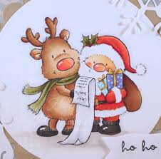
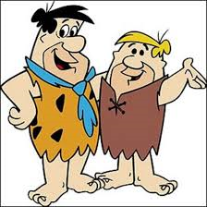
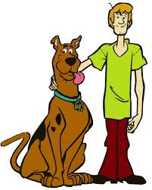
Friendship

Slide 2
TRUST
How do we know we can trust our friends?
Think about who you trust?

Slide 3
The Helpful Servant- Old Testament
How an important man had to put his trust in a young servant girl in his household

Slide 4
Why was it difficult for the servant girl to trust Naaman and his wife.
How did her trust in God help the servant girl?
Who else in the story has to put their trust in somebody

Slide 5
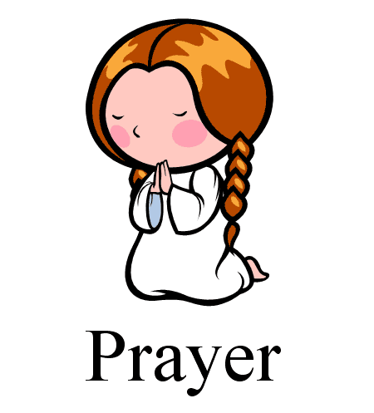
Dear Lord,
Help us to look for friends in unexpected places and situations and to make our school a place where we trust each other and build lasting friendships.
Amen.

Slide 6
Naaman
Servant Girl
Wife
Elisha
God

Slide 7
Class Worship
EYs/KS1- Read Can’t You Sleep Little Bear in story time. Talk about how trust plays a big part in the story.
KS2-Create an acrostic poem in small groups- maximum 3 with the word TRUST.

