Slide 1
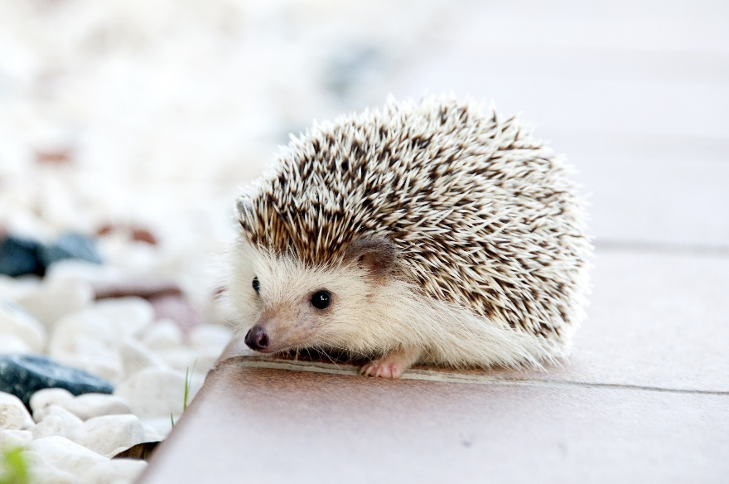
SAVE THE ENVIRONMENT !

Slide 2
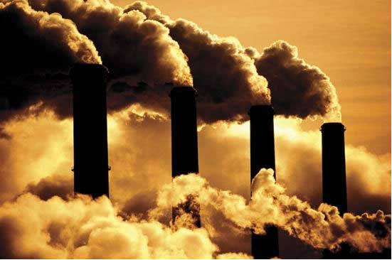
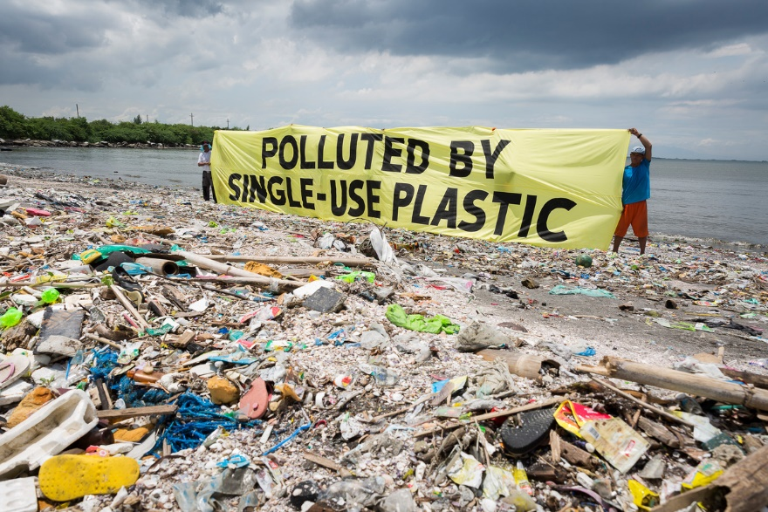

Slide 3

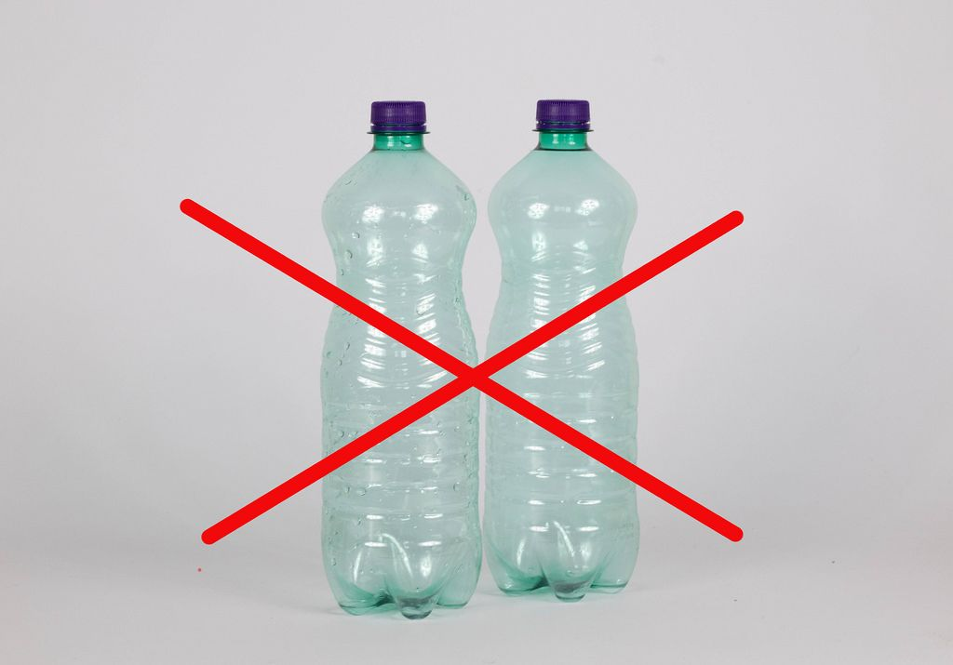
Did you know?
In Africa plastic is band.So if you go on holiday and land in An airport with a plastic bottle or bag you get kicked out!

Slide 4


Slide 5
recycling
Answer:

Slide 6
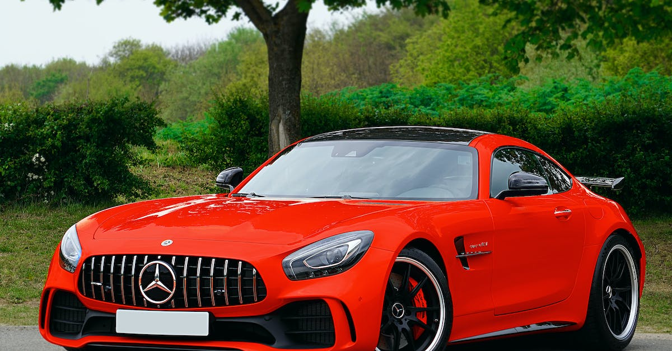
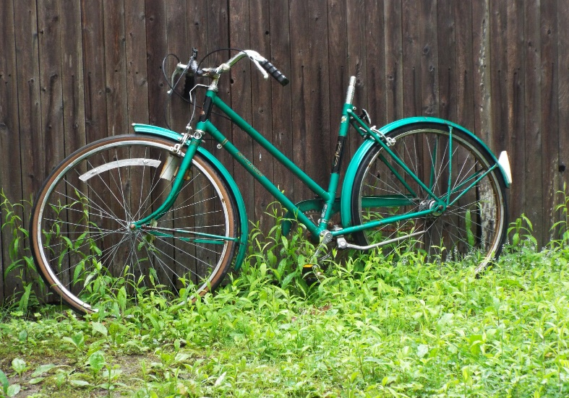
Car gases!
Which is better for the envirment?

Slide 7
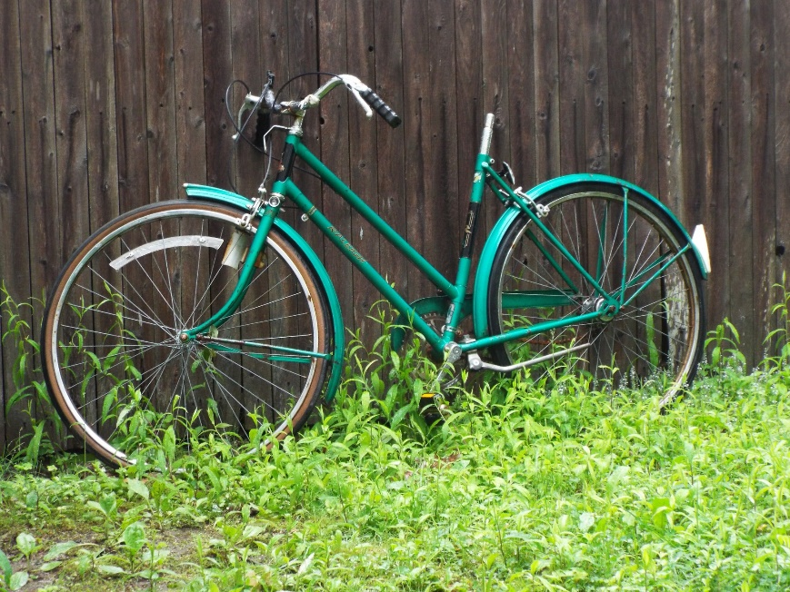
CAR GASES!
ANSWERS:
NO!
YES

Slide 8
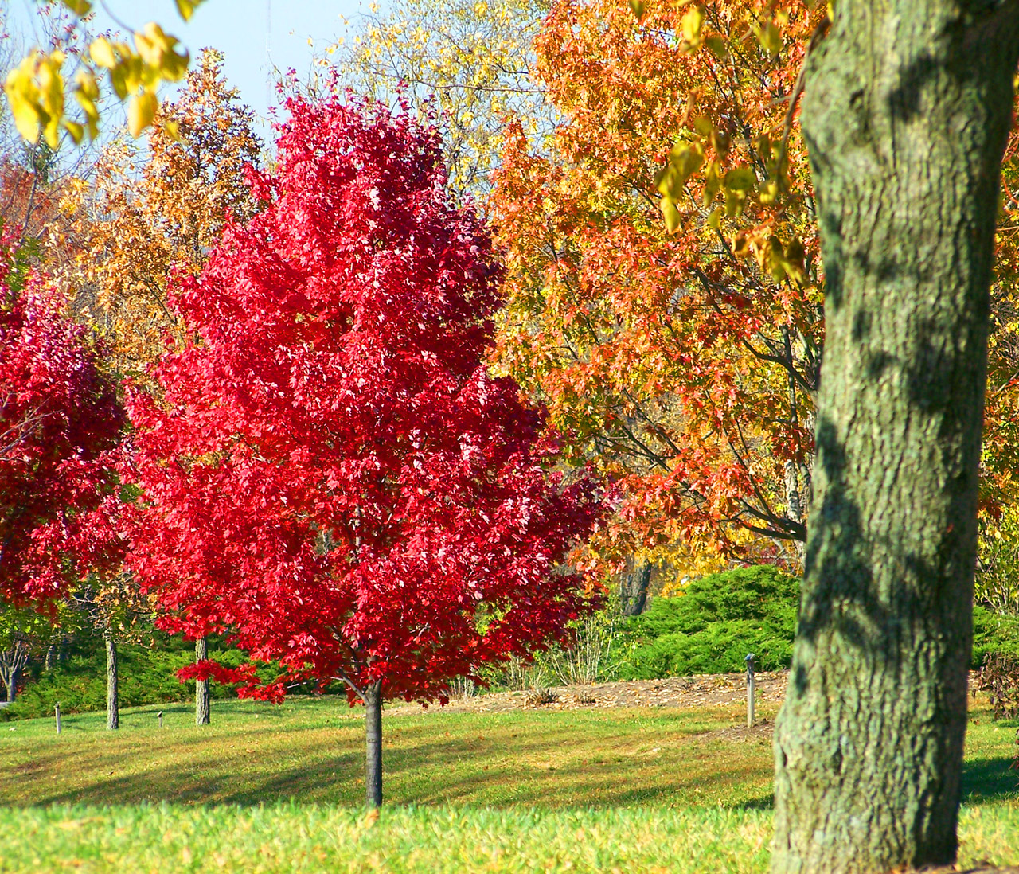

Slide 9
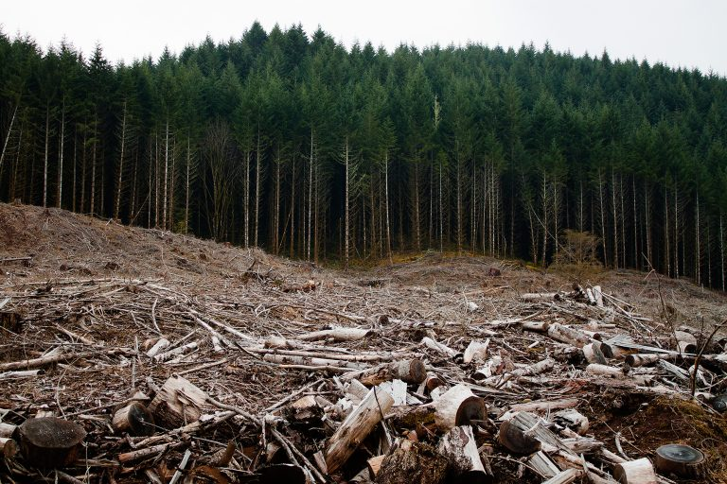

Slide 10

Climate change
Climate change is made by loads of gases collected in the air.

Slide 11
Did you know !
In 500 years people will have to were gas masks. If people don’t help to save the envirment.

Slide 12
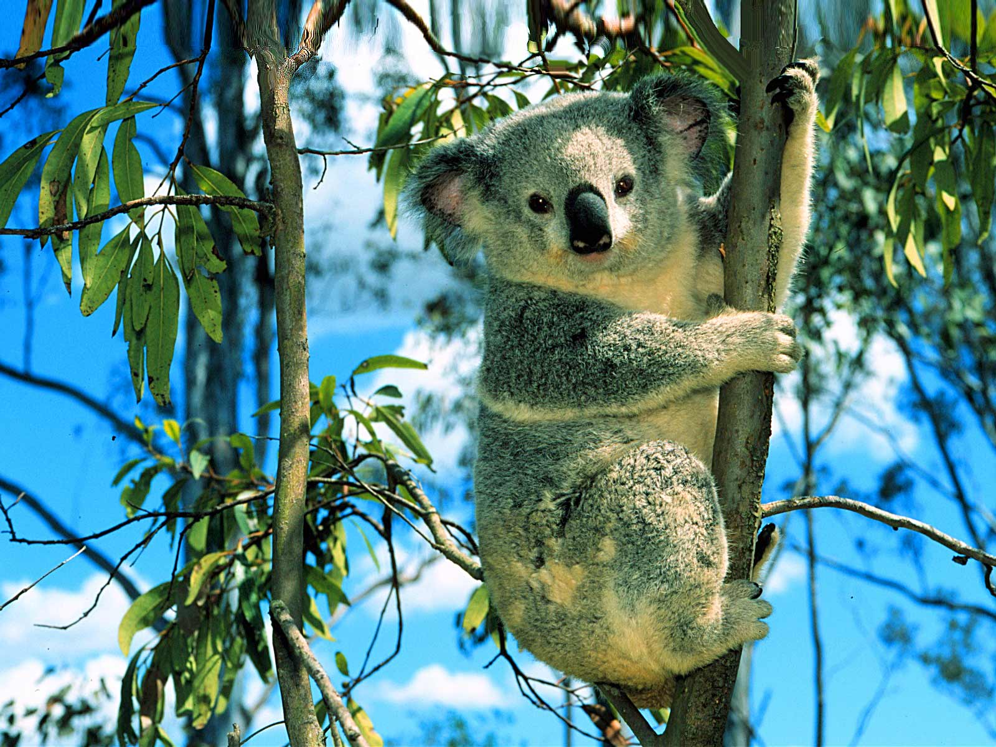
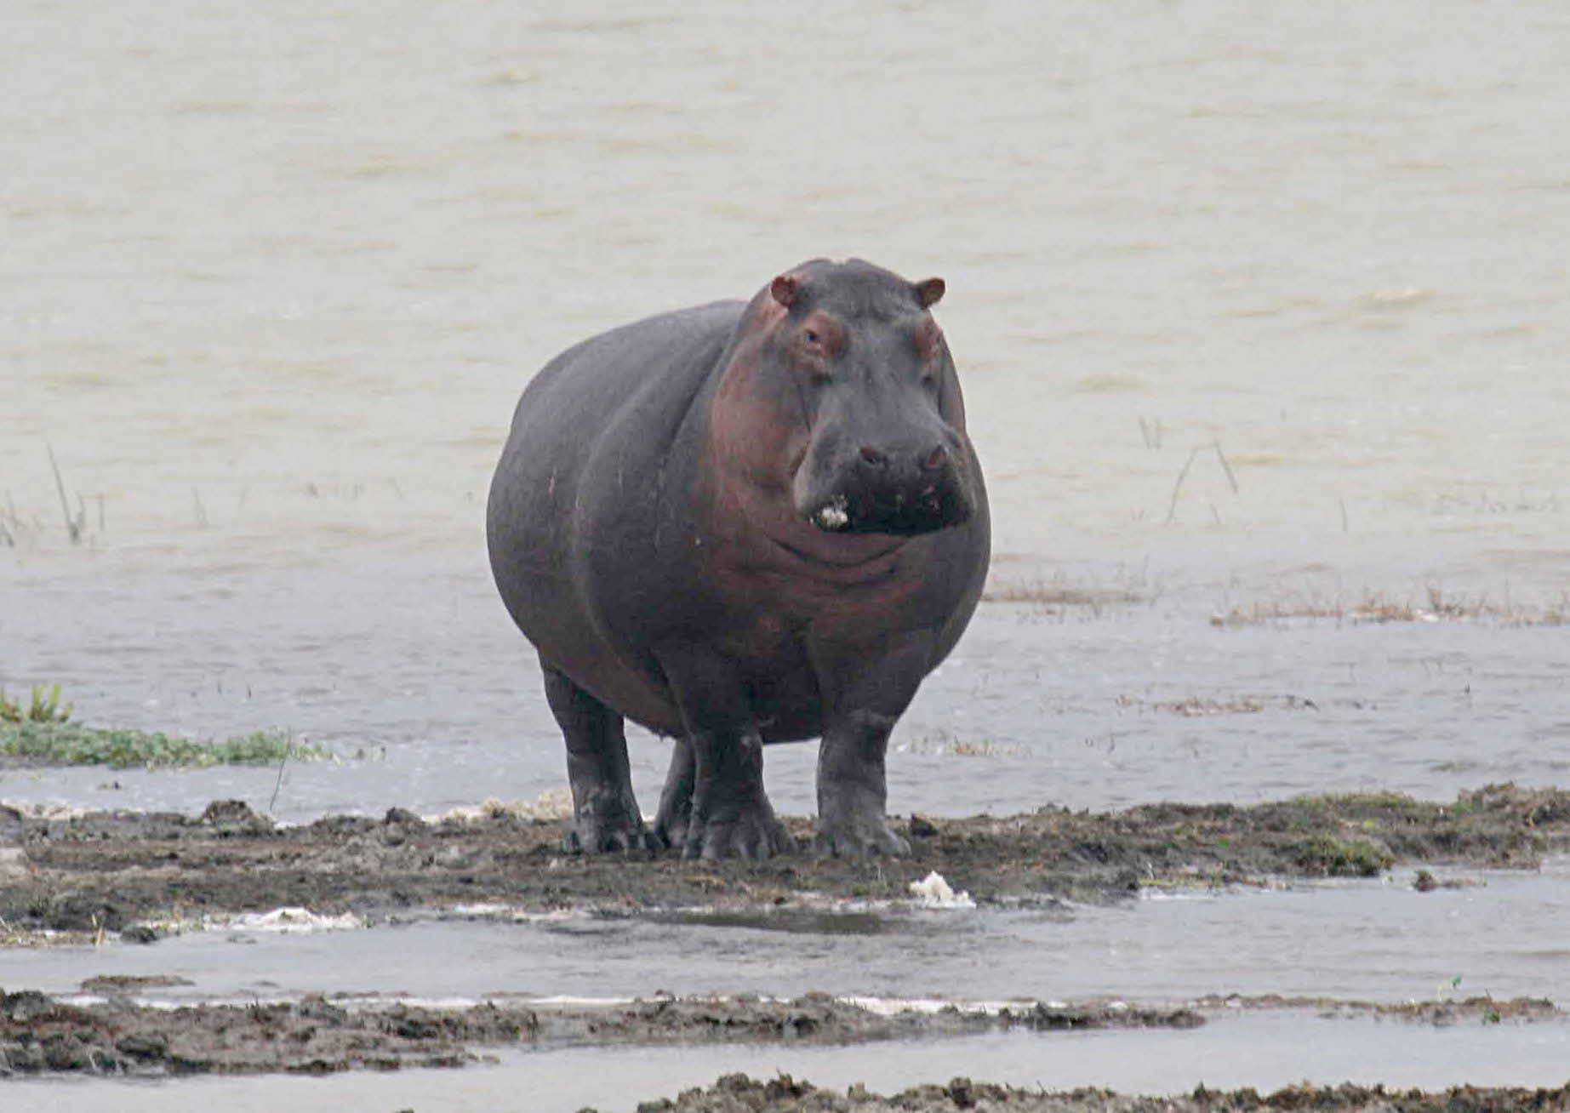
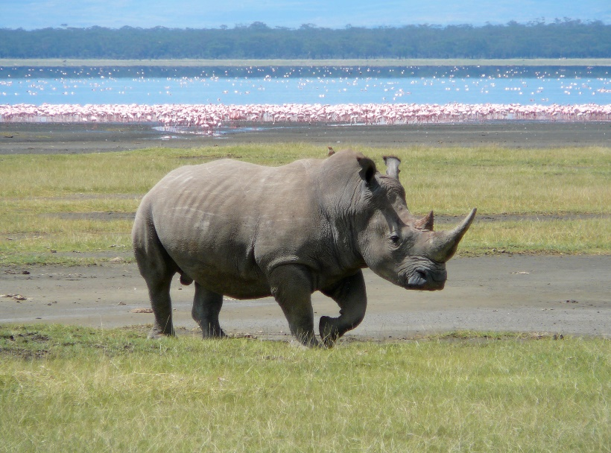
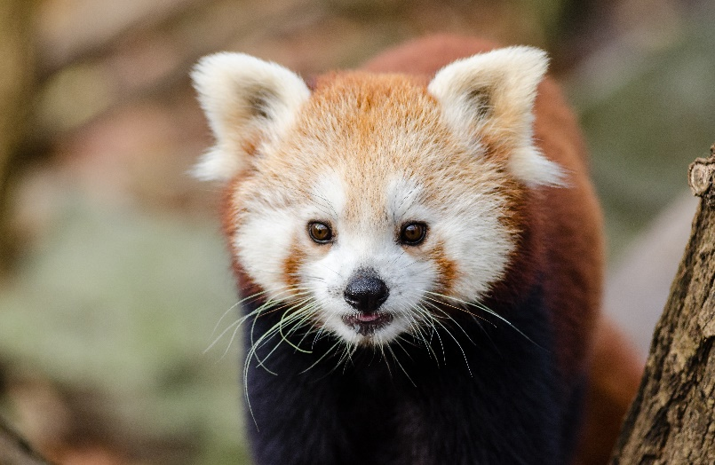
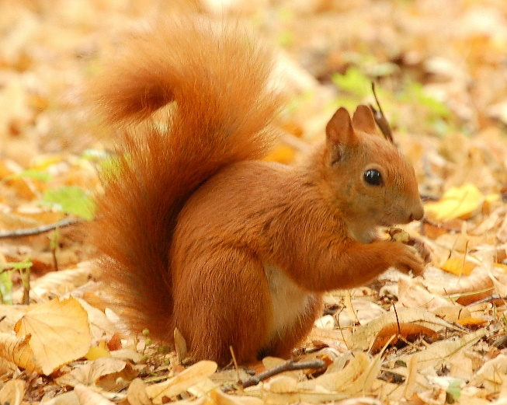
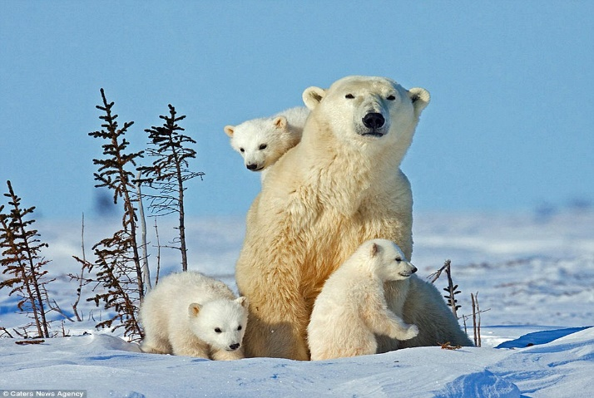
Animals in danger!

