Slide 1
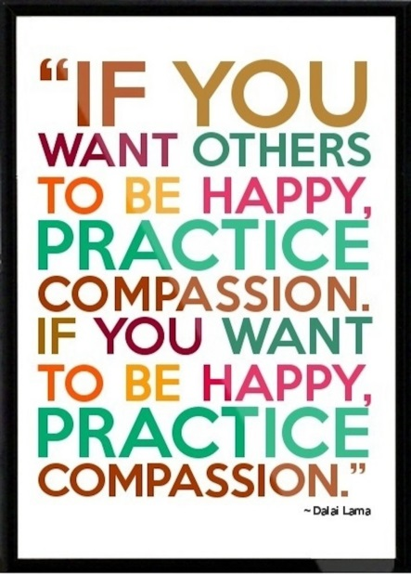
Compassion

Slide 2
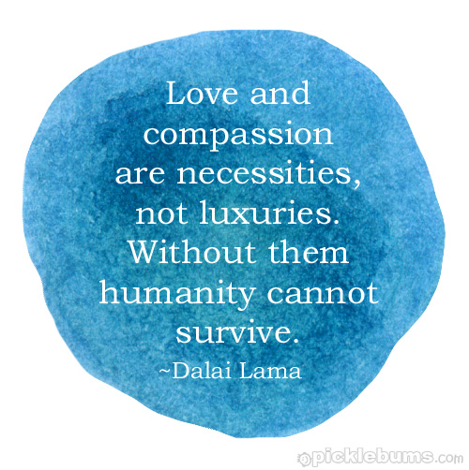
Music
Joyful, Joyful

Slide 3
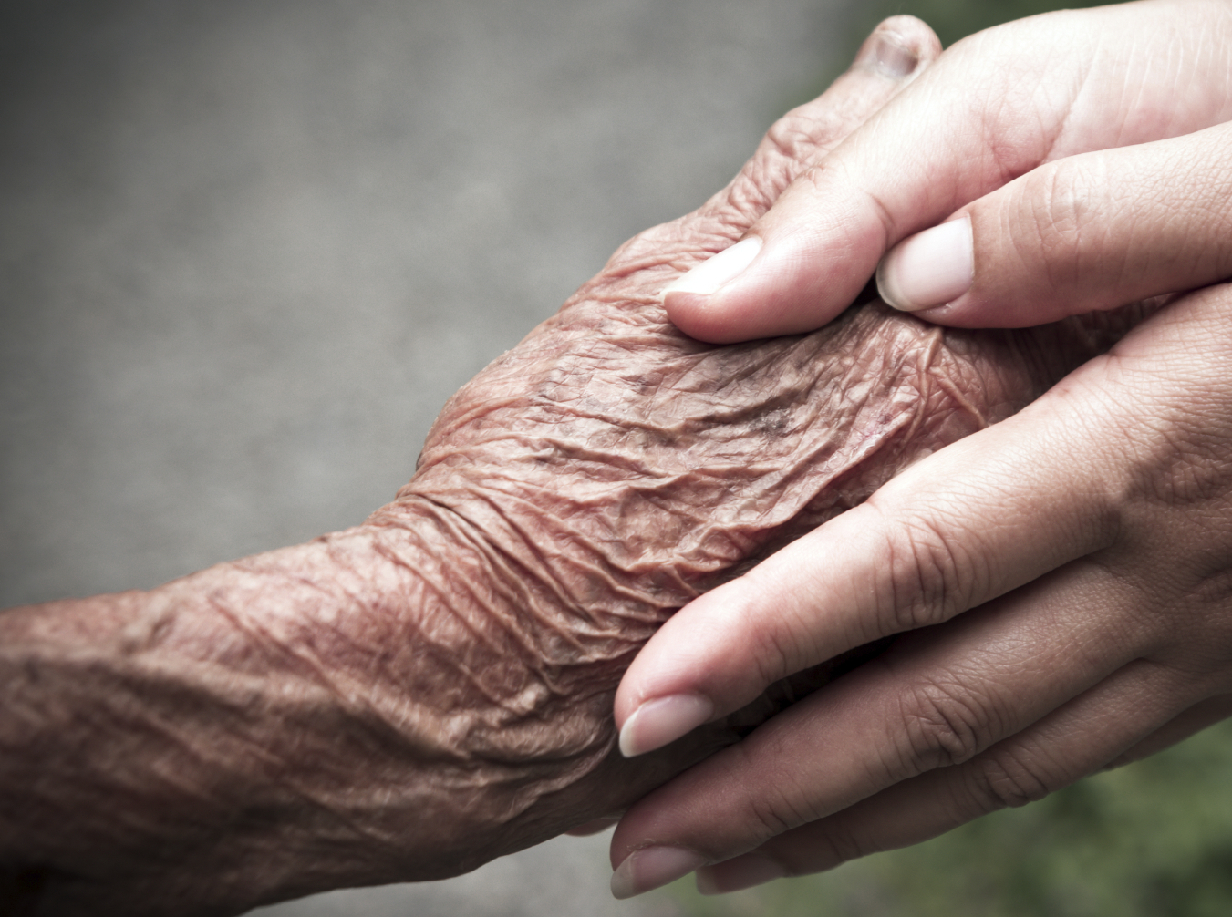
What words do you think of?

Slide 4
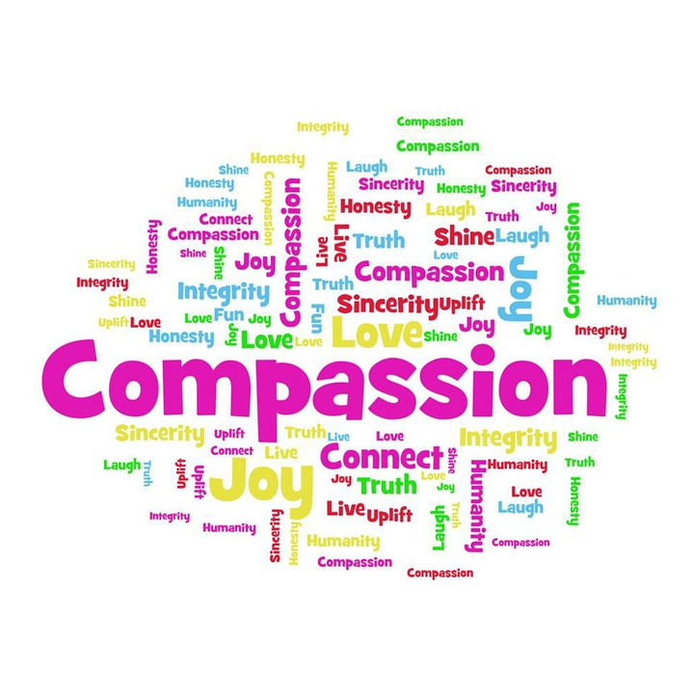

Slide 5
C= Caring
O=Offering help
M=Making a difference
P=Putting others first
A=Always listening
S=Sensitive to others
S=Serving others
I=Interested in others
O=Offering care
N=Noticing a need

Slide 6
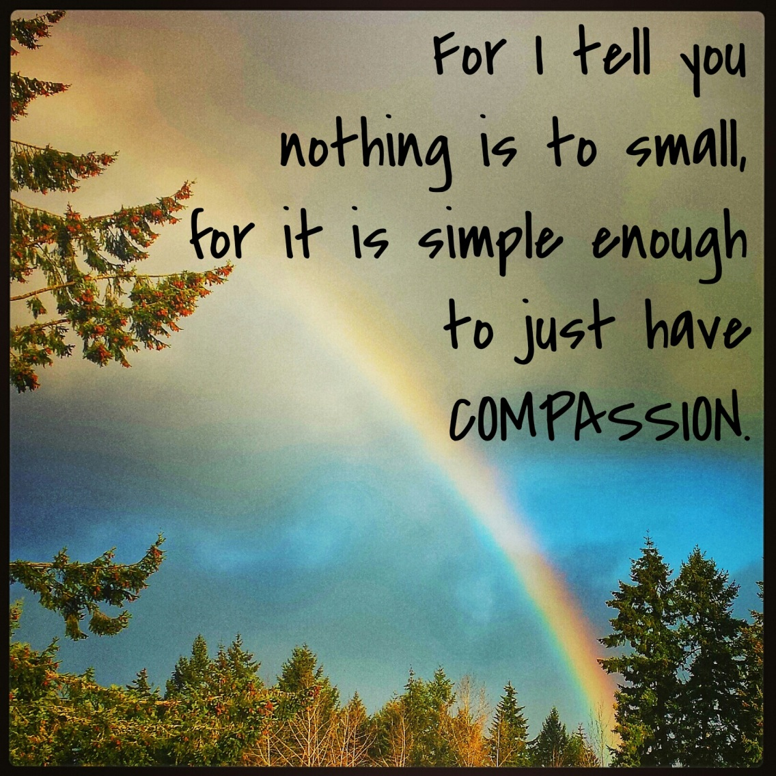
Why is Compassion important?

Slide 7
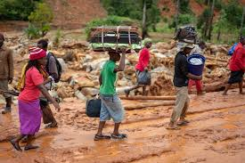
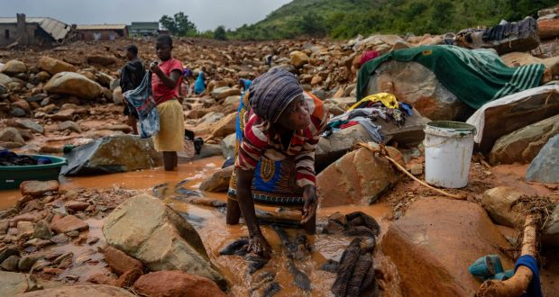
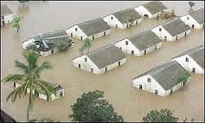
Can you think of any situation in the world at the moment where compassion would support people in need?

Slide 8
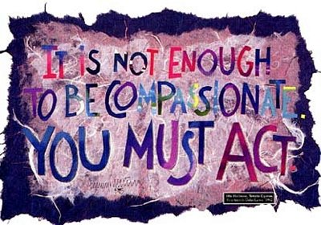

Slide 9
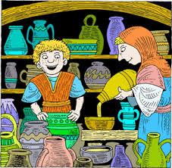
Elisha and the Widow in Need
(2 Kings 4:1-7)

Slide 10
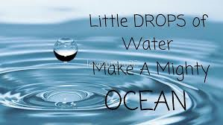
Every time you decide to be compassionate or not, you change the world a little bit. And you change yourself into a better human being.
“Little drops of water make the mighty ocean.”

Slide 11

Time for reflection
Dear God, please help me to notice when people are hurting and show me how to share Your love with them. Amen.

