Slide 1
Josh Groban
What do you think the song is about?

Slide 2
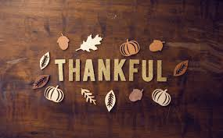
Hymn-Thank you Lord

Slide 3

I am thankful each day……………….
https://youtu.be/JIodsXEvo4U

Slide 4
The Psalms of David
Make a joyful noise to the Lord, all the earth! Serve the Lord with gladness! Come into his presence with singing! Know that the Lord, he is God! It is he who made us, and we are his; we are his people, and the sheep of his pasture. Enter his gates with thanksgiving, and his courts with praise! Give thanks to him; bless his name! For the Lord is good; his steadfast love endures forever, and his faithfulness to all generations. Psalm 100:1-5 ESV
Gratitude is an attitude that comes out of the habit of giving thanks. All through the Psalms, no matter what David was facing, we read his outpouring of gratitude to God. As he encountered good times and bad times, David always turned back to the truth of God's goodness. This attitude often carried him through the hardest of situations. Use this example to teach your child that gratitude is a habit that is learned through practice. Just as we teach little ones to say please and thank you through repetition and relentless reminders, we learn to express our thanks to the Father through consistency. Yet, while gratitude is a habitual attitude, we want our thanksgiving to come out of a genuine heart. The more we meditate on God's goodness and practice our thanks no matter what our circumstance, the more it will naturally flow out of a heart that loves him.

Slide 5
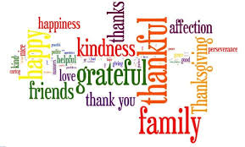
What are you most thankful for?

Slide 6

UNCRC
Are you most thankful for?..........................

Slide 7
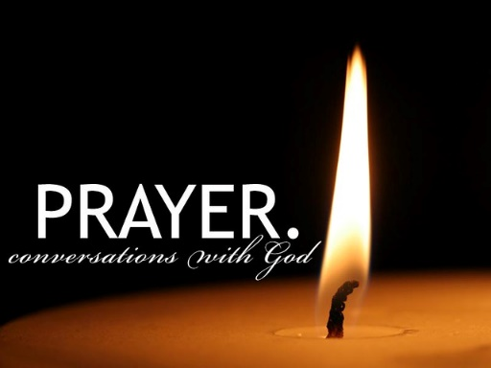
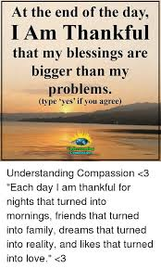
Reflection

Slide 8
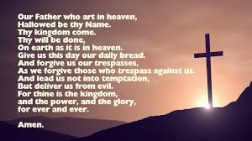
The Lord’s Prayer

Slide 9
Paul's Thanksgiving for His Friends
For this reason, because I have heard of your faith in the Lord Jesus and your love toward all the saints, I do not cease to give thanks for you, remembering you in my prayers, that the God of our Lord Jesus Christ, the Father of glory, may give you the Spirit of wisdom and of revelation in the knowledge of him, having the eyes of your hearts enlightened, that you may know what is the hope to which he has called you, what are the riches of his glorious inheritance in the saints, and what is the immeasurable greatness of his power toward us who believe, according to the working of his great might. Ephesians 1:15-19 ESV
It is good to express our thankfulness to others. The Bible instructs us to encourage one another often. Paul, in his multiple letters to the churches he was leading, always reminds his friends how thankful he is for them. Usually, following his words of thanks are words of encouragement to help build them up. Thanks and giving go hand in hand. Use this passage to encourage your child to use words of thanksgiving and encouragement with their friends and loved ones. God can use us to share his love with others by simply sharing words of gratitude and support.

Slide 10
Class Worship
Like we have just heard about Paul, be thankful for and appreciate the people in your class.
In class worship take each of you in turn and tell each other a compliment. For example;
James thank you for being such a good friend at playtime.
Olivia thank you for helping me cut my lunch.
Include the adults also!

