Slide 1
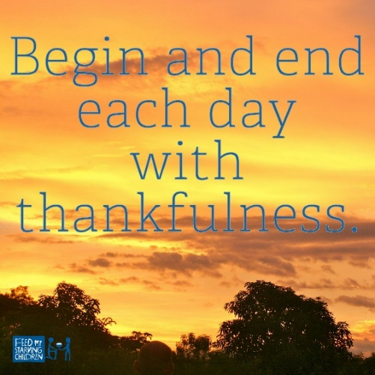

Thankfulness

Slide 2
Thankfulness By Daniel – Daniel 2:23
King Nebuchadnezzar had a dream and was troubled by what it might mean. He asked the wise men of the land to interpret his dream. Instead of telling them the dream, he requested that the men not only interpret the dream, but also figure out on their own what the dream was about. The servants of the king were not able to perceive the contents of the dream nor interpret what it might mean. In anger the king ordered them killed.
Daniel heard the news that he and the other wise men were to be slain even though he had not even known of the king’s desire for interpretation. Daniel requested that King Nebuchadnezzar give them a little time. He, Shadrach, Meshach and Abednego prayed and asked God to reveal to them the dream and the interpretation of it. Before Daniel returned to the king with the answer he thanked God for revealing to them the dream.
Read more: https://www.whatchristianswanttoknow.com/5-bible-lessons-about-being-thankful/#ixzz65XDrA13h

Slide 3


Slide 4
Thankfulness
T- Trust, people I can trust.
H- Healthy mind, healthy body.
A- Aspirations.
N- Never giving up.
K- Kindness.
F- Family.
U- Unity
L- Love

Slide 5
Class Worship
KS2 – Write your own individual THANKFUL Acrostic.
Eys/KS1- Write a class THANKFUL Acrostic.

Slide 6
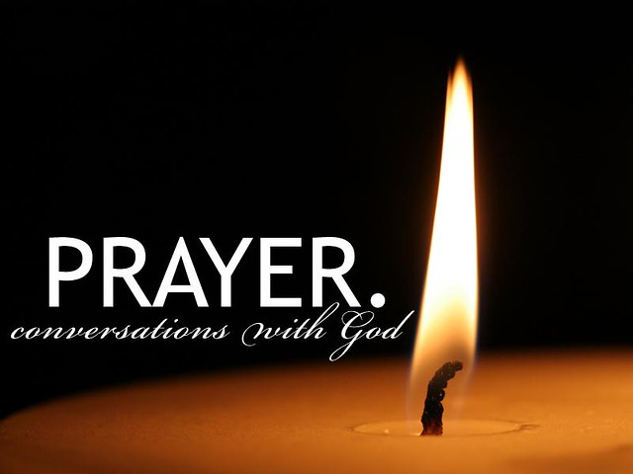
Reflection

Slide 7
A Prayer for When I am Thankful
God, thank You for this day! Thank You for the birds and the animals, the flowers and the trees, the lakes and the streams, and the sun that rises and sets over them each day. Thank You for creating everything we see! Thank You for the life we live, and for making each person different. Thank You for Jesus, who died for us so that we can go to heaven one day just for believing in Him. What an amazing God You are! In Jesus’ Name, Amen.

Slide 8
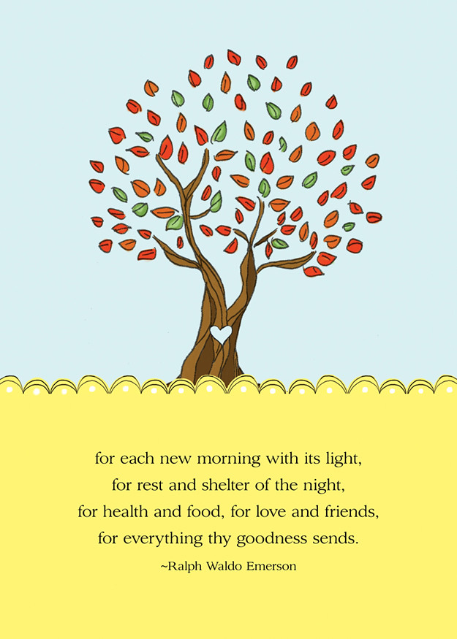
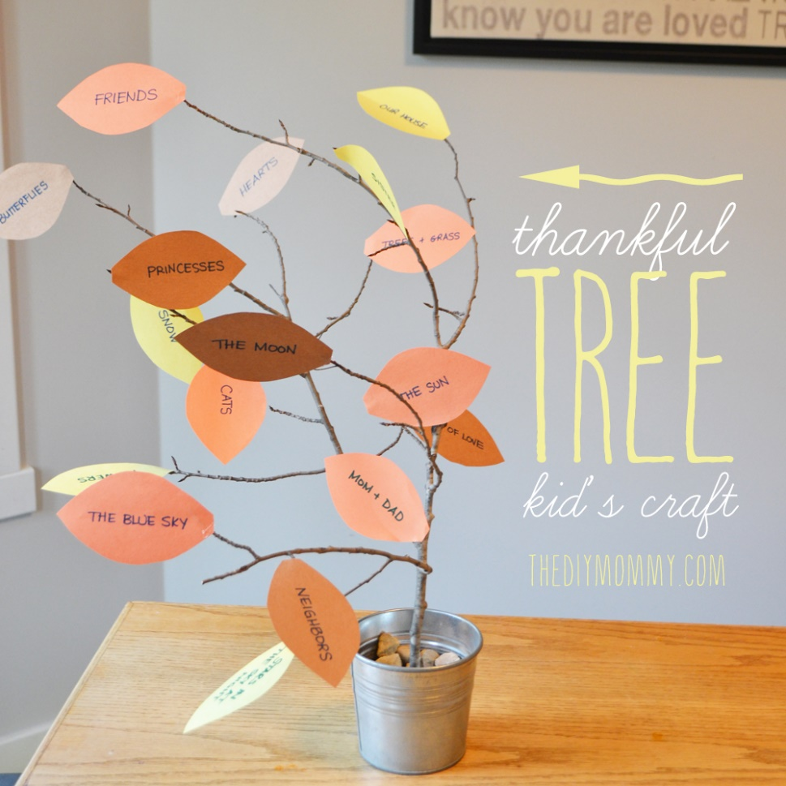
Thankfulness Tree

Slide 9


