Slide 1
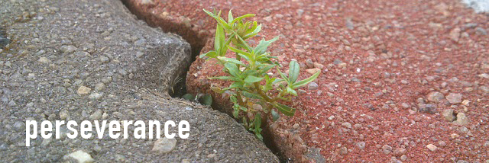
Why does this picture epitomise perseverance?

Slide 2

How are we encouraged and given skills to persevere through difficult times?

Slide 3
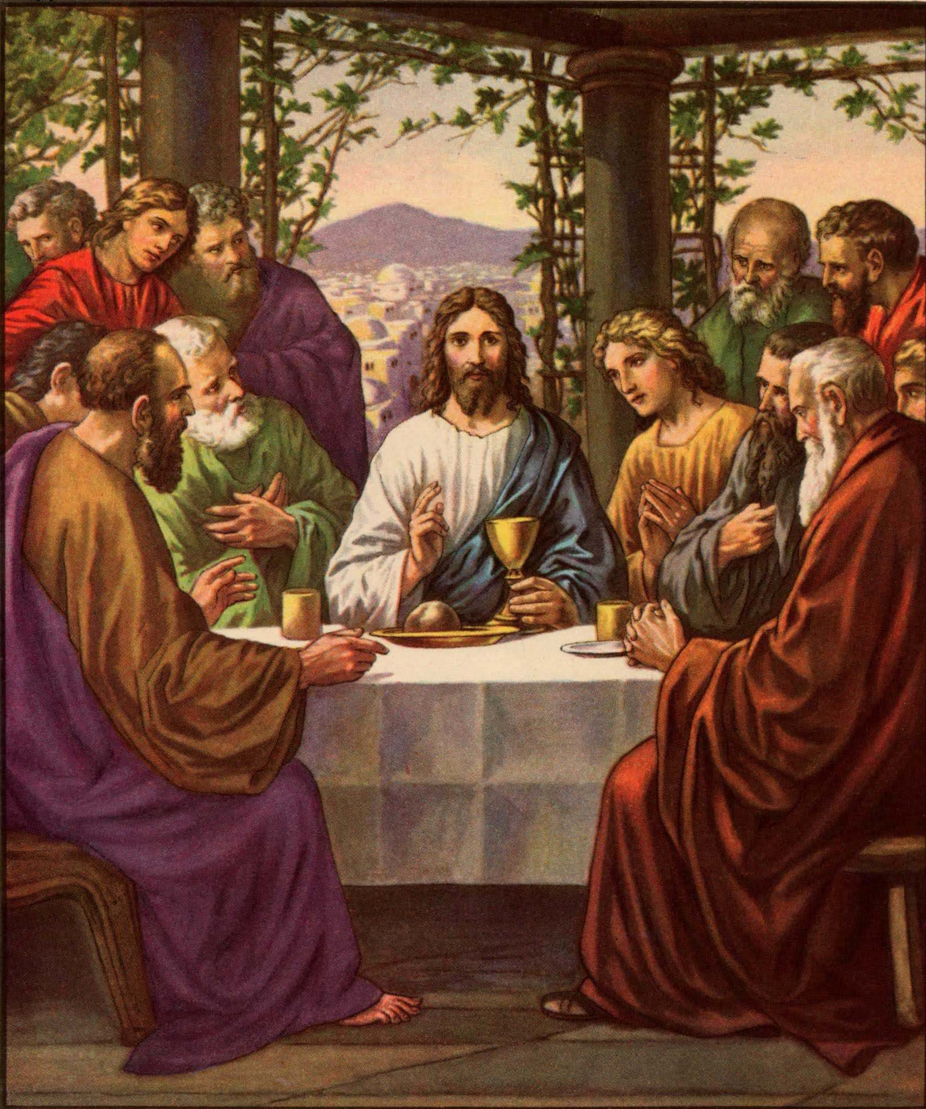
Jesus frequently encouraged his disciples to “endure patiently” the difficulties and obstacles they encountered and to persevere in the face of adversity. He himself trusted in God even when his enemies tried to stop his work and plotted his death.

Slide 4

“If at first you don’t succeed try,
try and try again.”
W.E. Hickson
What does this mean?

Slide 5
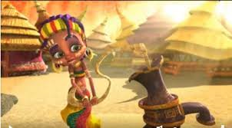
ZAHRA
https://youtu.be/Ci1l3iTONKU
What words does it make you think of?

Slide 6
What makes Zahra have the strength not to give up?

Slide 7

“‘If you can’?’ said Jesus. ‘Everything is possible for one who believes.’ Immediately the boy’s father exclaimed, ‘I do believe; help me overcome my unbelief!’” (Mark 9:22-24)

Slide 8

Dear Lord.
Thank you for giving us strength and the faith to believe that anything is possible and nothing is impossible. Help us to use this faith and strength in every part of our daily life.
Amen

Slide 9
Class Worship
Think about what gives you strength when things are difficult
Eys/KS1-Draw around someone and label the different parts of your body that give you strength and help you to overcome difficulties.
KS2-Write a blog about perseverance and strength to inspire others for or new school website.

