Slide 1

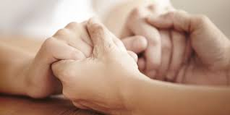

Slide 2
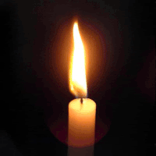
Gather:
God our Father you are always kind and ready to forgive.
Help us to forgive one another.
Take some time to reflect on these questions:
If we are angry with someone else,
how can we expect God to be gentle with us?
If we are unkind to someone else,
how can we ask God to be kind to us?
If we will not forgive others,
how can we expect anyone to forgive us?

Slide 3
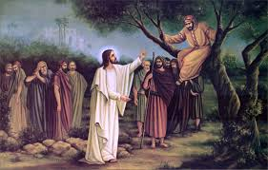
Word:
Here is a story about a person who didn’t have many friends…until he met Jesus.
This story is from the Gospel of St Luke.

Slide 4
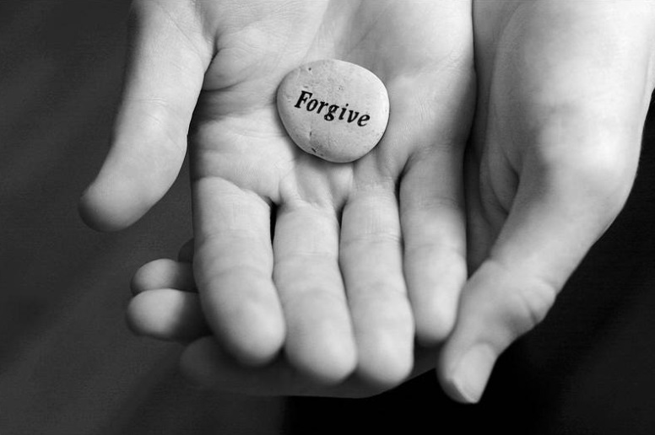
Response to Word:
Jesus was a good friend to Zacchaeus because he forgave him and gave him a second chance. God will always give us a second chance when we are truly sorry. Just like Zacchaeus, we can make a change to be a better person.
Take time to be calm.
Listen to the music.
Think of times when we have done something wrong, and remember that when we say sorry we are always forgiven.
Colour the word ‘Forgive’ as you reflect and place it on the cross.

Slide 5

Based on Joel 2:12-13
God says to us,
“Change. Come back to me with all your heart.
Make a new start.
Turn to me for I am kind and understanding,
Loving and gentle.
I am always ready to forgive you.
I will never change.”

Slide 6
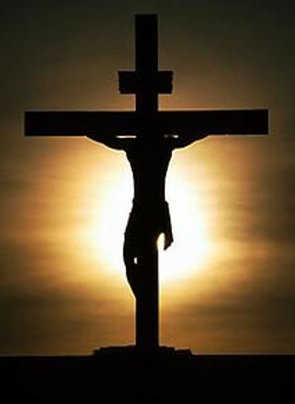
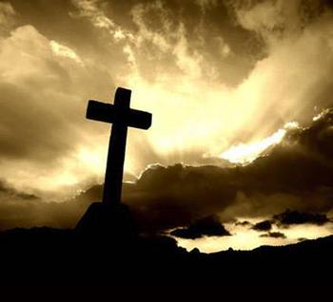
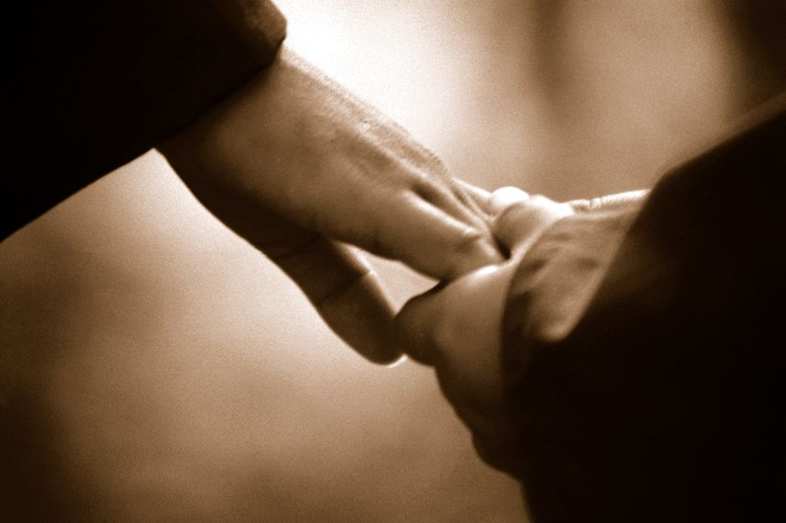
‘God our Father loves us and always forgives us’
Dear Father in Heaven,
We are sorry for everything that we have done wrong. I know that you are always with me and thank you for always forgiving me, whatever I have done. Amen.
Let us say together the Act of Contrition:
‘Oh my God because you are so good, I am very sorry that I have sinned against you, and with your help I will try not to sin again.’

Slide 7
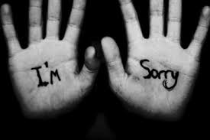
Going Forth:
Is there someone whom you need to forgive?
How could you show that person that you have forgiven them?

