Slide 1

FORGIVENESS

Slide 2
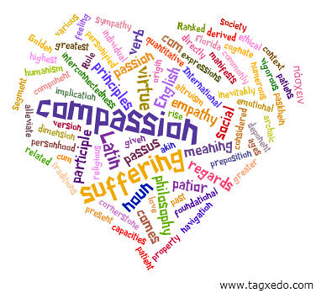
How does forgiveness link with compassion?

Slide 3
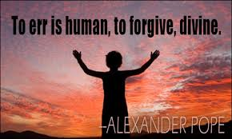
Watch this famous clip……….
https://youtu.be/__cM7IFKFDk

Slide 4
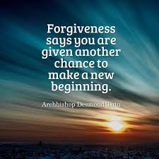
Would/should/could you be able to forgive?

Slide 5
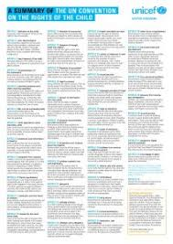
Which Rights did Cinderella not get from her step-sisters and step- mother ?

Slide 6
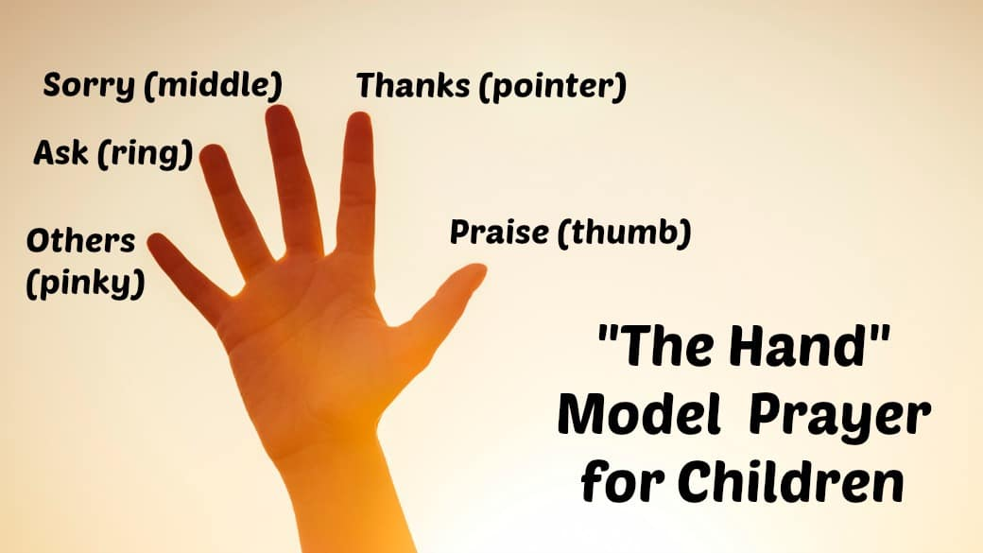
Prayer

Slide 7

Dear Lord,
We thank you that you give us the compassion to forgive others and thank you for forgiving me when I might have made wrong choices.#
Amen.

Slide 8
Colossians 3:12-14
12 As God’s chosen ones, holy and beloved, clothe yourselves with compassion, kindness, humility, meekness, and patience. ¹³Bear with one another and, if anyone has a complaint against another, forgive each other; just as the Lord* has forgiven you, so you also must forgive. ¹⁴Above all, clothe yourselves with love, which binds everything together in perfect harmony.

Slide 9
Class Worship
Eys/KS1- Watch the story of the angry bee on You Tube. What is the key message of the story? What would you do? What should the angry bee do?
KS2- Is everything forgiveable? Talk about different scenarios. Where would you put them on the line and why?
Forgiveable Not forgiveable

