Slide 1
Spirituality
What is spirituality?

Slide 2
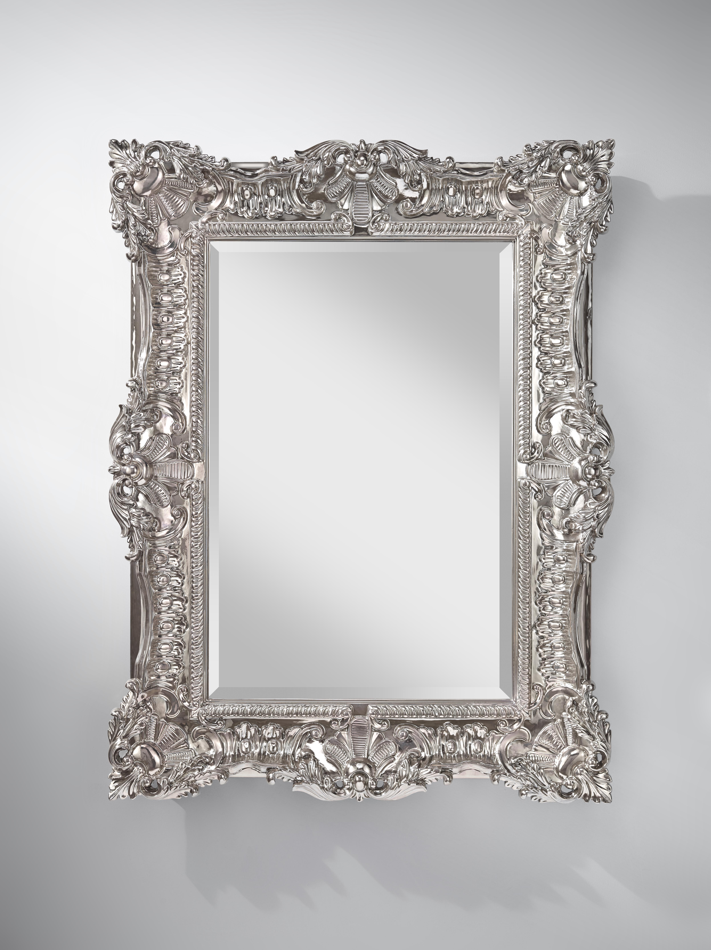
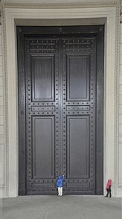
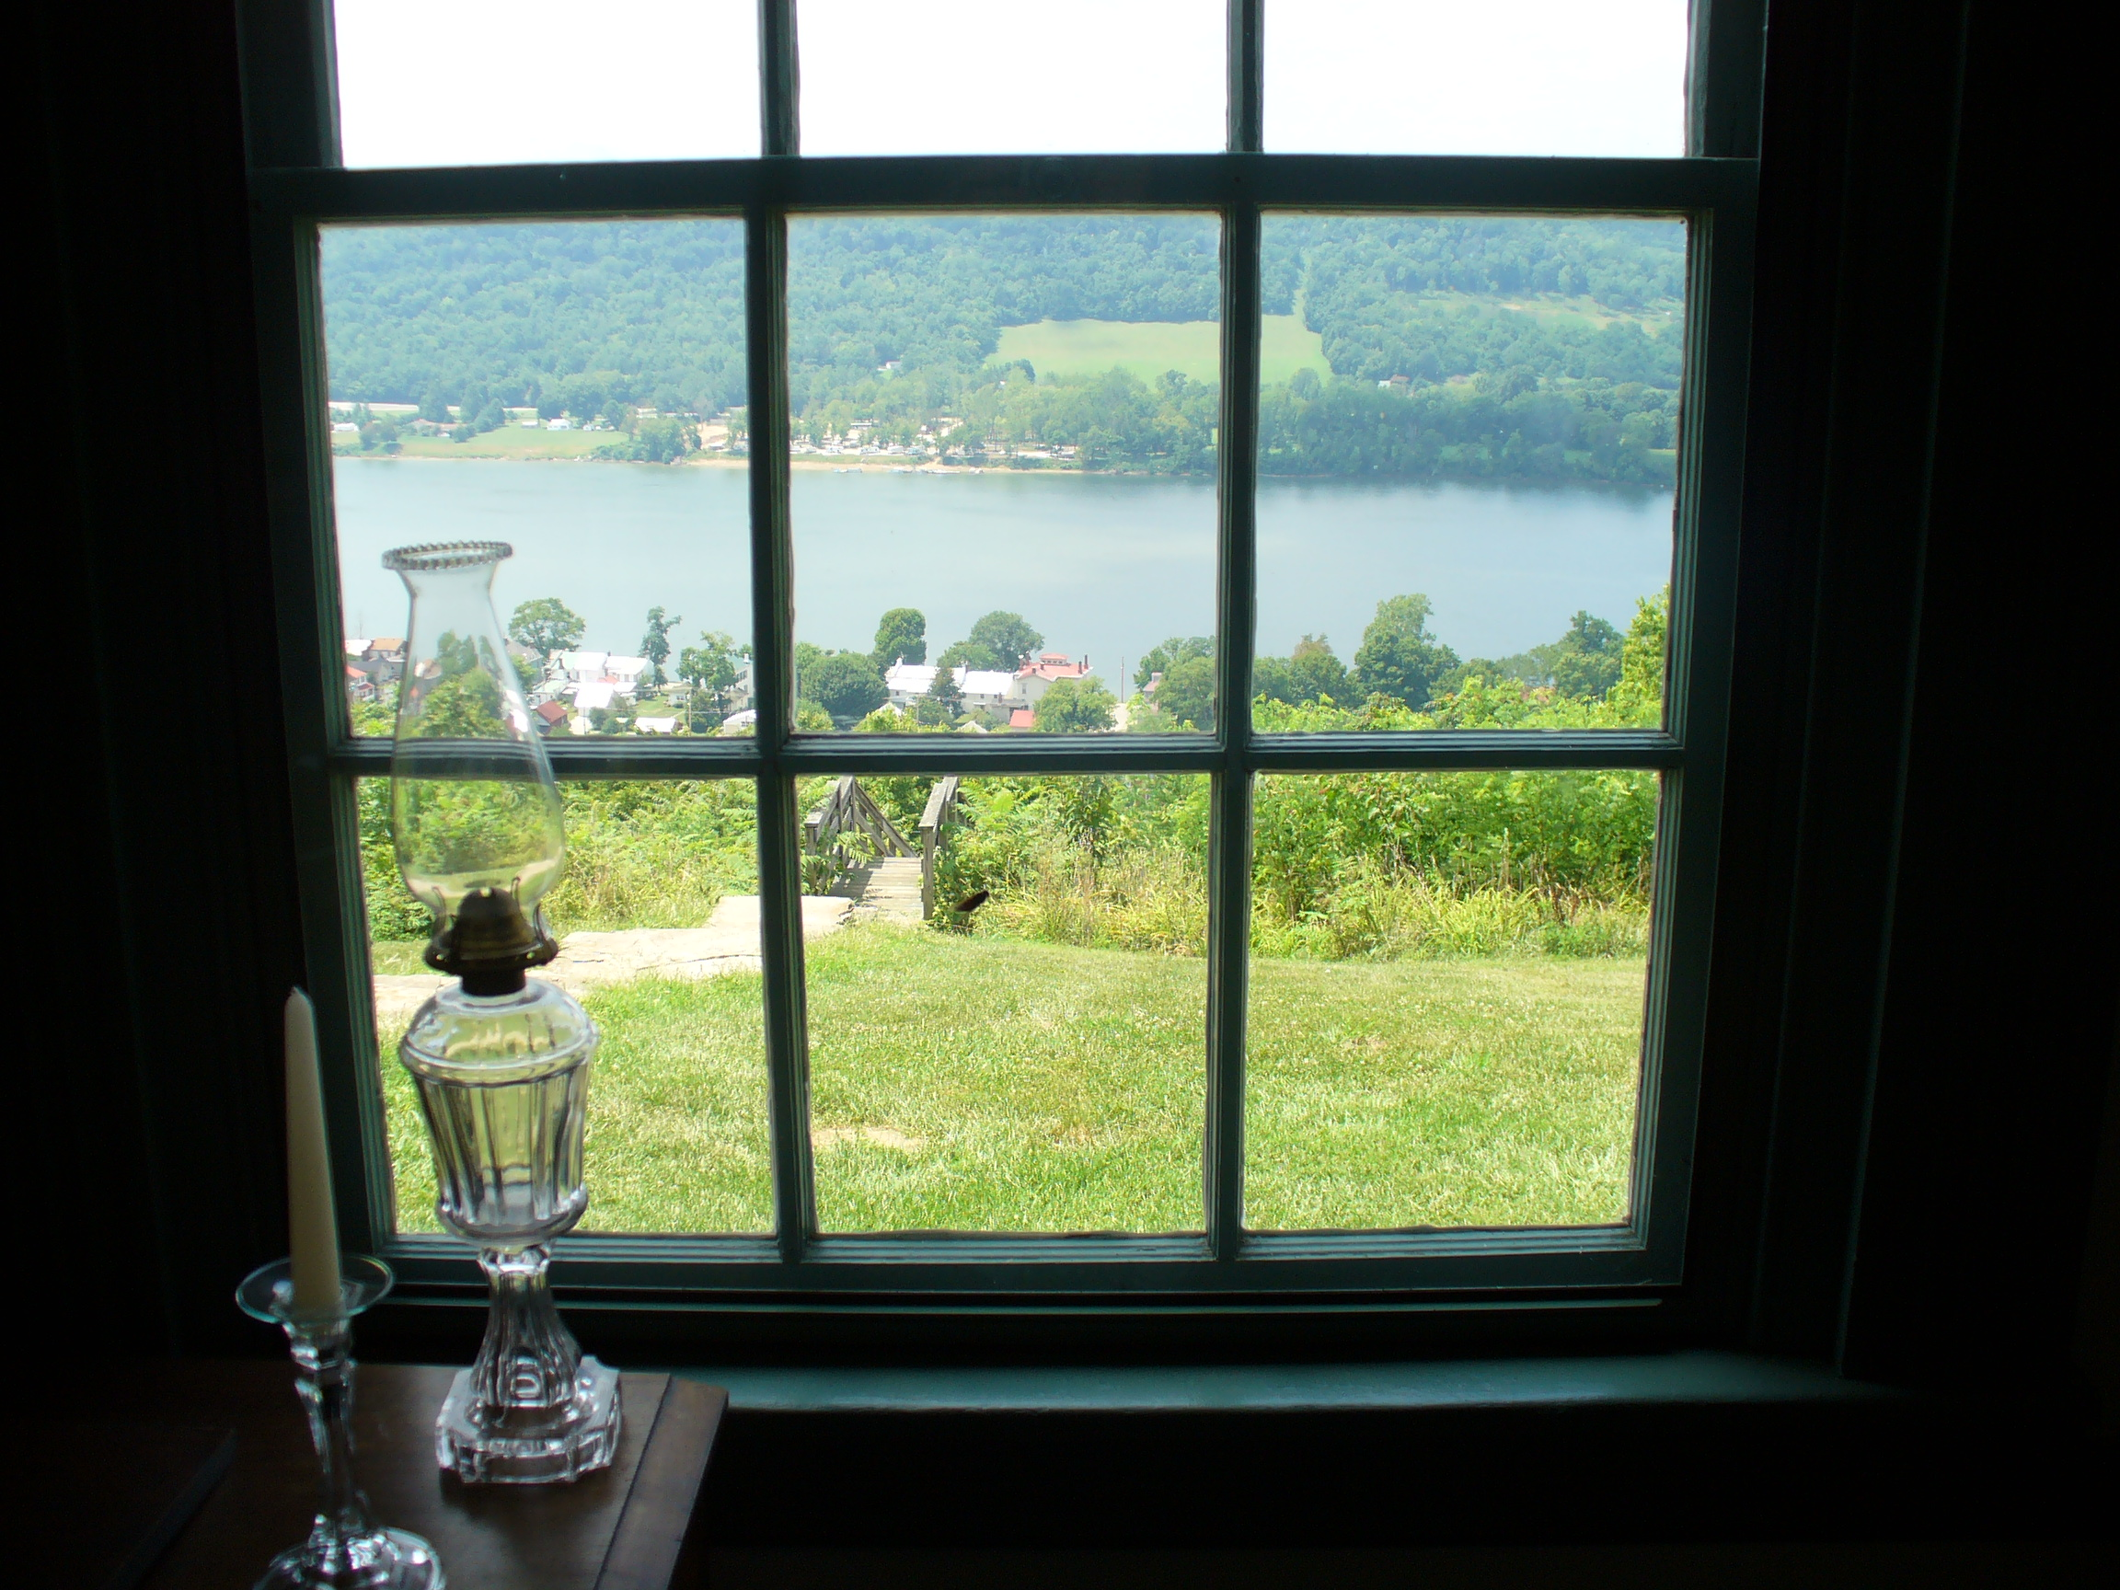
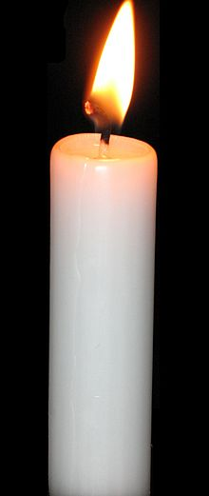
Spirituality can be thought about through these things:

Slide 3
Which word goes with which picture?
Self
Beauty
Beyond
wonder

Slide 4
Door-Open up the door to others
Candle-Hope in darkness
Mirror-Inner self/reflectiveness
Window-Looking out-Awe and Wonder

Slide 5
https://youtu.be/iysgRVPp6PM

Slide 6

What words would you use linked to spirituality?

Slide 7
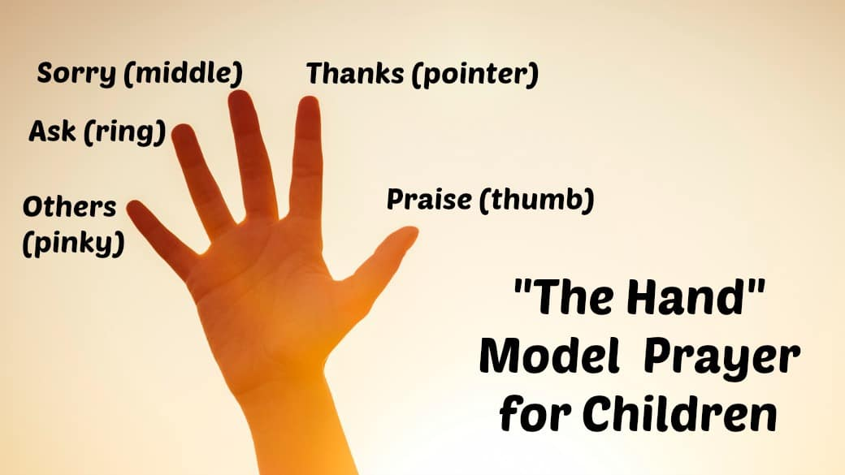
Prayer

Slide 8


