Slide 1
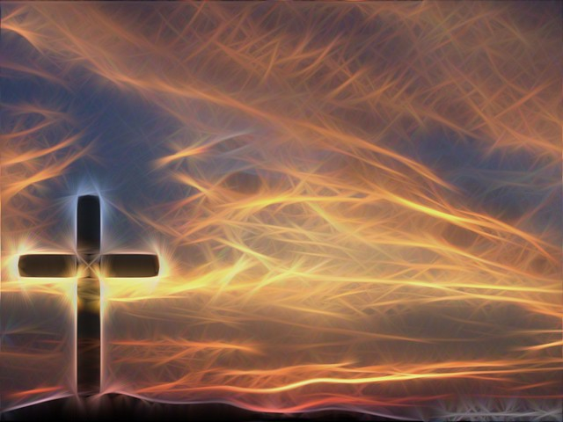
Spirituality

Slide 2
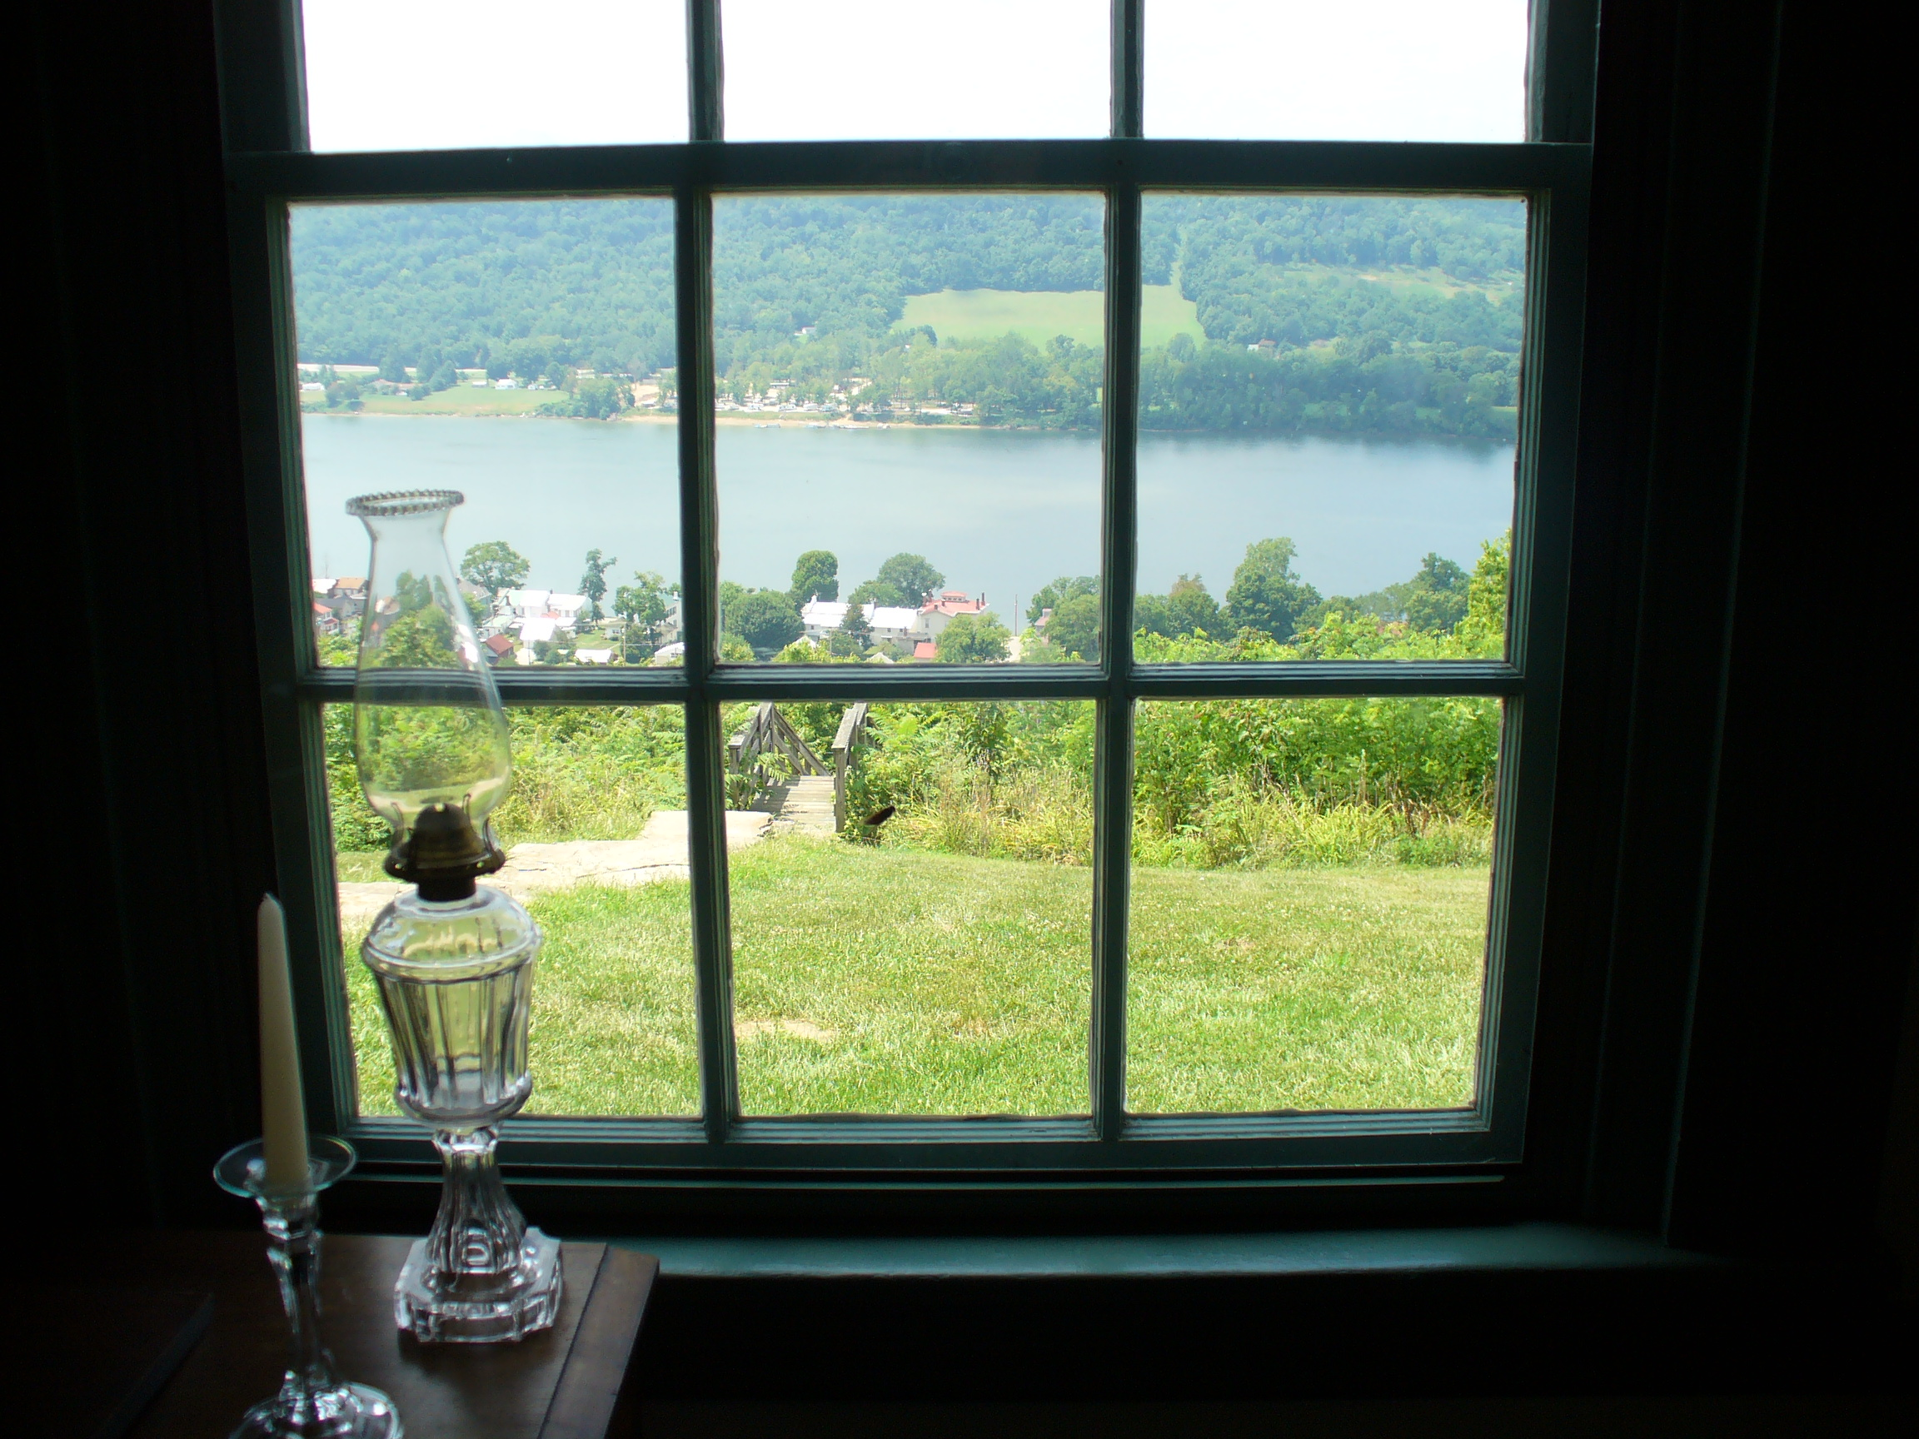
Beauty is in the eye of the beholder……….
What does that mean?

Slide 3
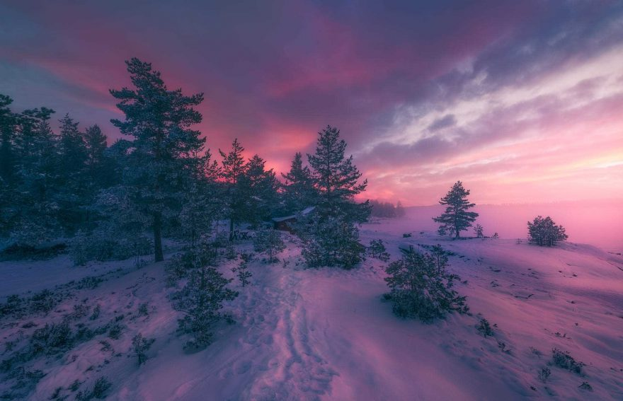
Which window would you choose to look out on?
Which would you choose?-Why?
Window 1

Slide 4

Window 2

Slide 5
The saying "Beauty is in the eyes of the beholder," goes to say that defining beauty can be tough. However, God's words can lead us to discover what our individual meaning of beauty truly is and should be; that is deter from looking at physical appearance for God looks at the heart in all people and things.
1 Peter 3:3-4
3 Your beauty should not come from outward adornment, such as elaborate hairstyles and the wearing of gold jewelry or fine clothes.
4 Rather, it should be that of your inner self, the unfading beauty of a gentle and quiet spirit, which is of great worth in God’s sight.

Slide 6
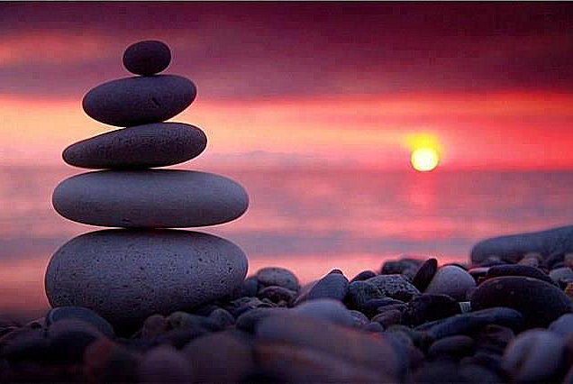
How does this clip link to spirituality?

Slide 7
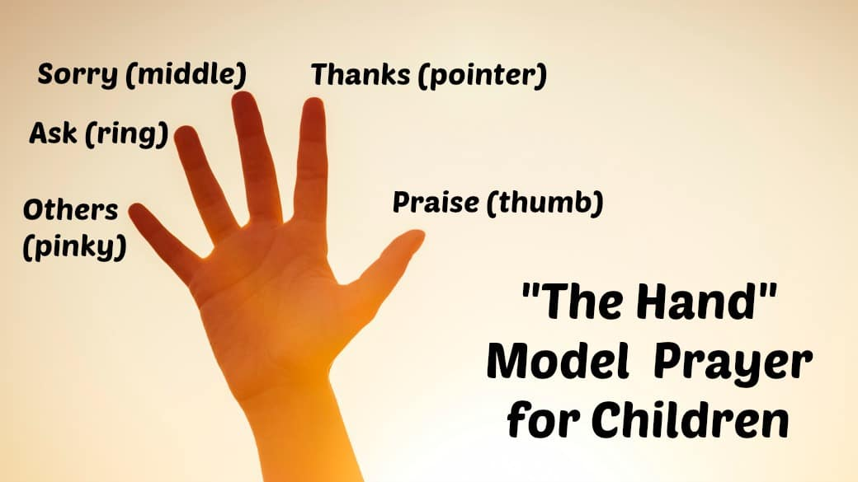
Prayer

Slide 8

Dear Lord,
Help us to appreciate all beauty. The beauty around us and the beauty that we all have within us.
Amen

