Slide 1
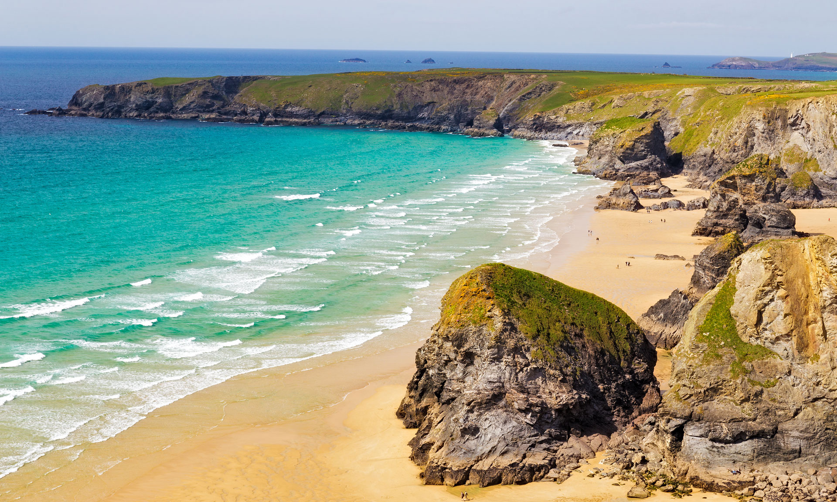
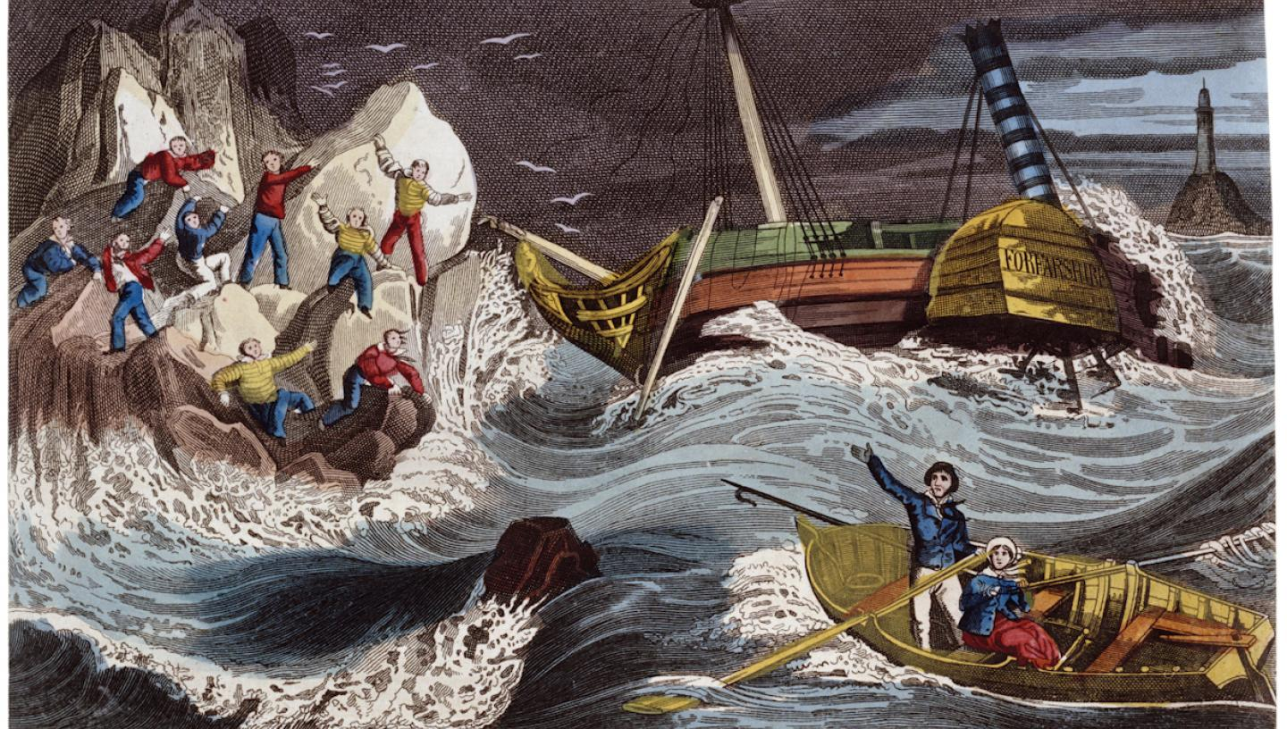
History: The learn about the life of Grace Darling and the work of the RNLI.
Chronological understanding:
Order 3 or more people/events using timeline
Knowledge and understanding of past events, people and changes in the past
Historical interpretation: Understand why some people in the past did things.
Historical enquiry - Organisation and communication – stories and recounts about the past.
Grace Darling
Art: Printing
Look at a selection of paintings of Grace Darling rescuing survivors. Talk about the textures used for the stormy seascapes
Print with hard and soft materials. Build repeating patterns and recognise pattern in the environment.
Texture: Make rubbings to collect textures and patterns.
Robins
Class
Summer Term 2 2025
Music Use a variety of instruments to compose. Learn songs fro the school play.
English: Little Wandle Phonics and spelling programme. Texts: Hello Lighthouse: write a narrative. Life Savers: information text.
Speech marks and and the use of an apostrophe for contractions and belonging.
PE: Running/
Athletics
Sending
and receiving
games
Concept:
Courage
Computing: Grouping Data
Jigsaw/PSHE:
Changing Me
Science: Ask questions about the world around us.
Observe closely using simple equipment
Use observations and ideas to suggest answers to questions
Observe changes over time and with guidance begin to notice patterns and relationships
Say what I am looking for and what I am measuring
Use simple equipment safely
Maths:Year R – continue with NCETM – Mastering Number programme and White Rose Maths programme.
Year 1: Revision of 4 rules of number. Fraction of quantities, measure: capacity and Time.
Measure: mass, capacity and time.
Year 2: Fractions and Multiplication, Measure and Geometry.
RE: What is the good news that Jesus brings?
Key Dates:June 9th Year 1 phonics screening week.
July 2nd – Sports day
July 11th – Reports
Safeguarding:Bullying

