Slide 1
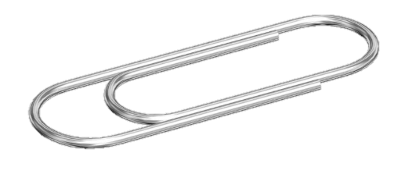
THIS IS A PAPERCLIP. IT IS USED TO HOLD PAPER TOGETHER.
An envelope opener?
Reset electrical devices?
A DIY keyring?
Removing hair from a hairbrush?
e.g. You could use a paperclip as an emergency hairclip!
BUT WHAT ELSE COULD YOU USE IT FOR?
THINK OUTSIDE THE BOX!

Slide 2
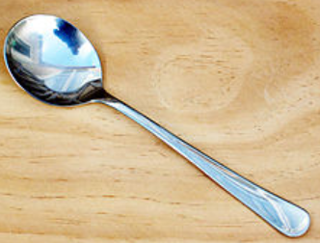
THIS IS A SPOON. IT IS USED FOR EATING.
A digging tool?
A shoehorn?
A liquid measurer?
A funny mirror?
e.g. You could use two spoons together as an instrument
BUT WHAT ELSE COULD YOU USE IT FOR?
THINK OUTSIDE THE BOX!

Slide 3
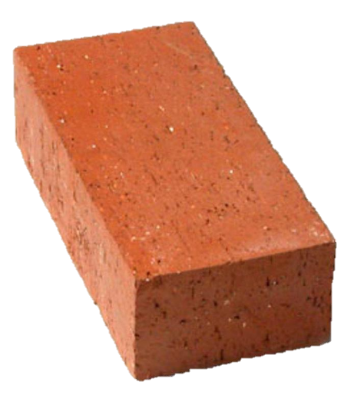
THIS IS A BRICK. IT IS USED TO BUILD HOUSES.
A paperweight?
A cheap dumbbell?
A nutcracker?
A diving aid?
What skill have you been using whilst thinking up other uses for the items?
e.g. You could use a brick as a step to reach high places!
CREATIVITY!
BUT WHAT ELSE COULD YOU USE IT FOR?
THINK OUTSIDE THE BOX!

Slide 4
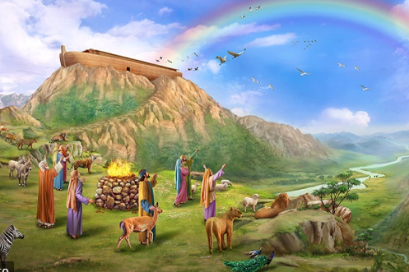
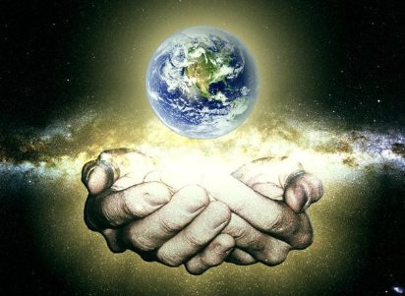
CREATIVITY!
What is creativity?
Creativity is being able to think outside the box, come up with new ideas, solve problems in different ways. It is about using your imagination!
But, why is creativity important?
How has God shown creativity?

Slide 5
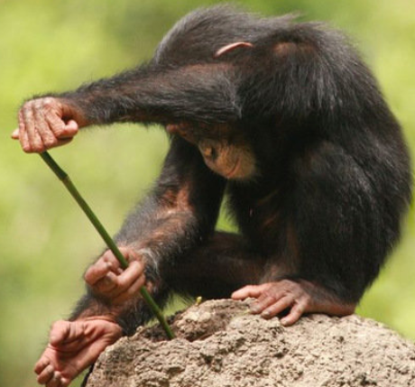
REASON 1
Being creative helps us to solve problems. It means that we are able to deal with troubles/ issues better, as we can think of ways out of them.

Slide 6

REASON 2
It helps us to make the world a better place. Creative inventors, for example, think of new ideas to make life easier and simpler.

Slide 7

REASON 3
Being creative improves your confidence. When you are creative, you often face many failures. Understanding that failure is just a part of the learning process makes you more confident!

Slide 8
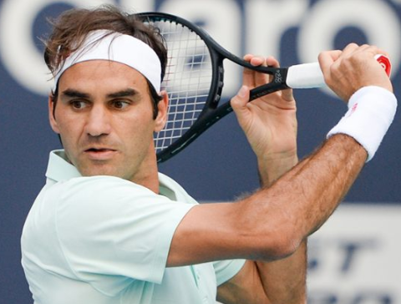
REASON 4
Being creative means that you keep trying to improve. Instead of getting lazy when they achieve something, creative people think about how they can do something even better!

Slide 9
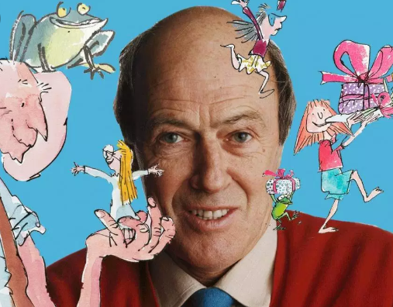
REASON 5
Being creative helps you to bring joy to others. Think about all of the best things that the world’s best writers, artists and inventors (and many others) have brought to the world.

Slide 10
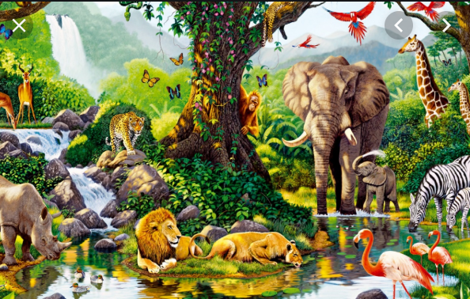
GOD’S CREATIVITY
Many people often call God our ‘creator.’ That is because he made all of the world around us – the earth, plants, animals and humans.
Think about how many weird and wonderful things there are on our planet. God sure was creative when he made the earth!

Slide 11
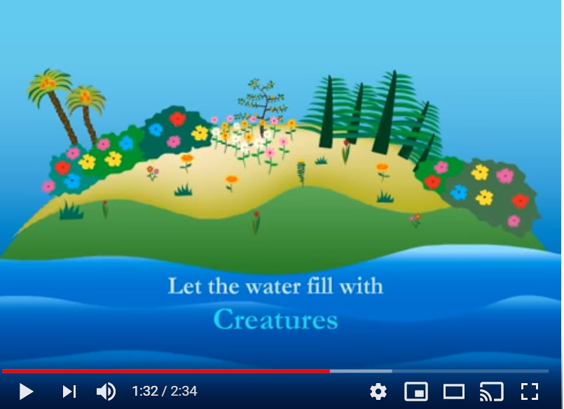
GOD’S CREATIVITY
Link to Genesis – The Creation of the World

Slide 12


KEY QUESTION
“Only some people are creative.”
Do you
agree or disagree?

Slide 13
CREATIVITY FOR ALL
We are made in God’s image, and so we can all be creative! Let’s prove it… I need 3 volunteers.

Slide 14
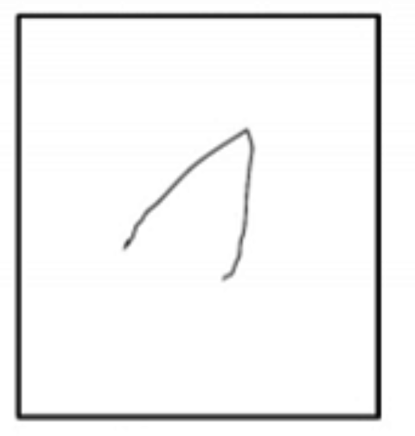
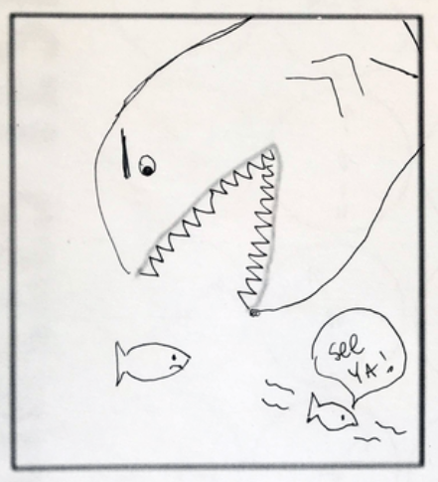
CREATIVE CHALLENGE
I have drawn a few lines on each of your page. Your task is to turn it into a drawing. What you draw is totally up to you! But draw quickly, you only have 2 minutes!

Slide 15

COUNTDOWN CLOCK!

Slide 16
CREATIVITY FOR ALL
As our test has proven, everyone is capable of being creative, it is just about unleashing your creative potential;
But how do you think we can show that we are being creative at school?

Slide 17
CREATIVITY LEARNING HABITS
ASK QUESTIONS
BE OPEN TO CHANGE
BRAINSTORM
ACT, DANCE, SING, DRAW PRETEND!
PLAY AND PRETEND
THINK OF PROBLEMS THAT NEED FIXING!
WHEN YOU FAIL, TRY AGAIN!

Slide 18
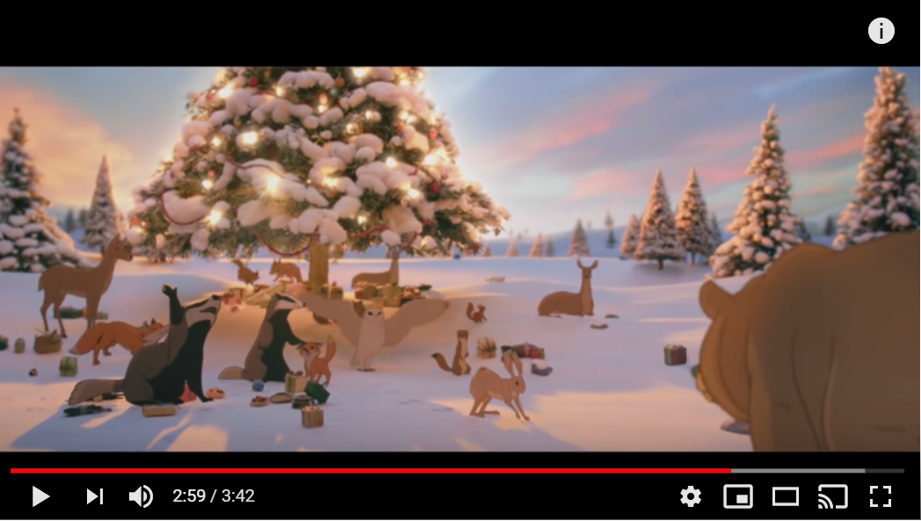
VIDEO
CREATIVITY IS AMAZING!

Slide 19
VIDEO
CREATIVITY IS AMAZING!
How did they make the video?
How did they have to be creative?
What details did they have to think about?
What was the end result?

Slide 20
PRAYER
Dear Lord,
Please help us to keep trying with problems, even when they are difficult and we can’t find the solution straight away. Help us to never get lazy or give up. Help us to always try to improve at everything we do. Thank you for showing us the way with your amazing creation. The world is a beautiful place.
Amen

Slide 21
CITATION OF IMAGES
SLIDE 1: www.wikipedia.org – Paper Clip
SLIDE 2: www.wikipedia.org – Spoon
SLIDE 3: www.pixabay.com – Brick
SLIDE 4: www.flickr.com – Brain Creativity
SLIDE 5: www.pixabay.com – Chimp Solving Problem
SLIDE 6: www.pixabay.com – Light Bulb Moment
SLIDE 7: www.pixabay.com - Confidence
SLIDE 8: www.wikipedia.org – Roger Federer
SLIDE 9: www.flickr.com – Roald Dahl
SLIDE 10: www.flickr.com – Animal Collage
SLIDE 11: www.youtube.com – God’s Creation - Genesis
SLIDE 15: www.youtube.com – 2 minute countdown clock
SLIDE 18: www.youtube.com – Lily Allen – Somewhere Only We Know

