Slide 1


Worship
COMPASSION
CREATIVITY
COURAGE

Slide 2
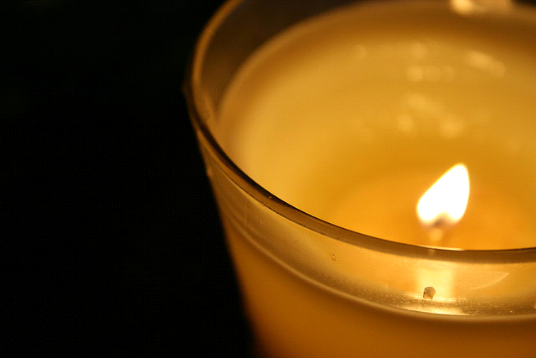
Candle Prayer
Heavenly Father
We light these candles to
remind us that You are
the light of the world.
We come together now
to
pray and to praise
and to
remove all darkness
from our
hearts and minds.
Amen

Slide 3


Slide 4

What does looking after your mental health mean?

Slide 5

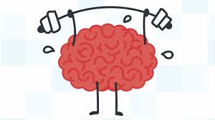
We focus on our physical health-keeping fit which helps our body, but what can we do to make sure our brain and emotions are kept healthy to?

Slide 6
Watch this short video on how important looking after our mental health is…………………
https://youtu.be/nCrjevx3-Js

Slide 7

Don’t forget Miss Nicoll has put lots of resources on the school website to!
What will you do today to help your mental health?
Who will you talk to if you have worries?

Slide 8
Dear Lord,
Please help us to know that no matter how we are feeling, there is always someone to talk to and a way to make things feel better.
Amen

Slide 10

May the peace of The Lord be with you always
And also with you

Slide 11
Worship
COMPASSION
CREATIVITY
COURAGE

