Slide 1


Worship
COMPASSION
CREATIVITY
COURAGE

Slide 2
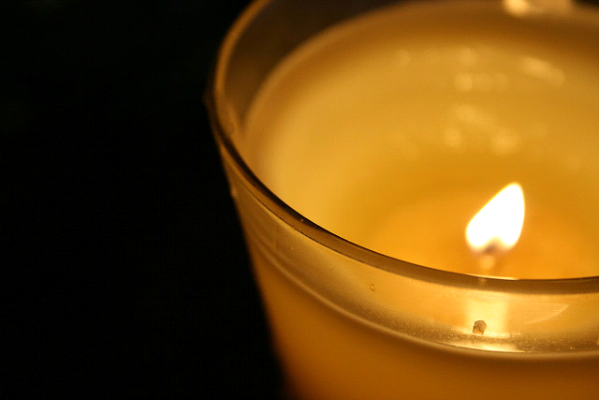
Candle Prayer
Heavenly Father
We light these candles to
remind us that You are
the light of the world.
We come together now
to
pray and to praise
and to
remove all darkness
from our
hearts and minds.
Amen

Slide 3
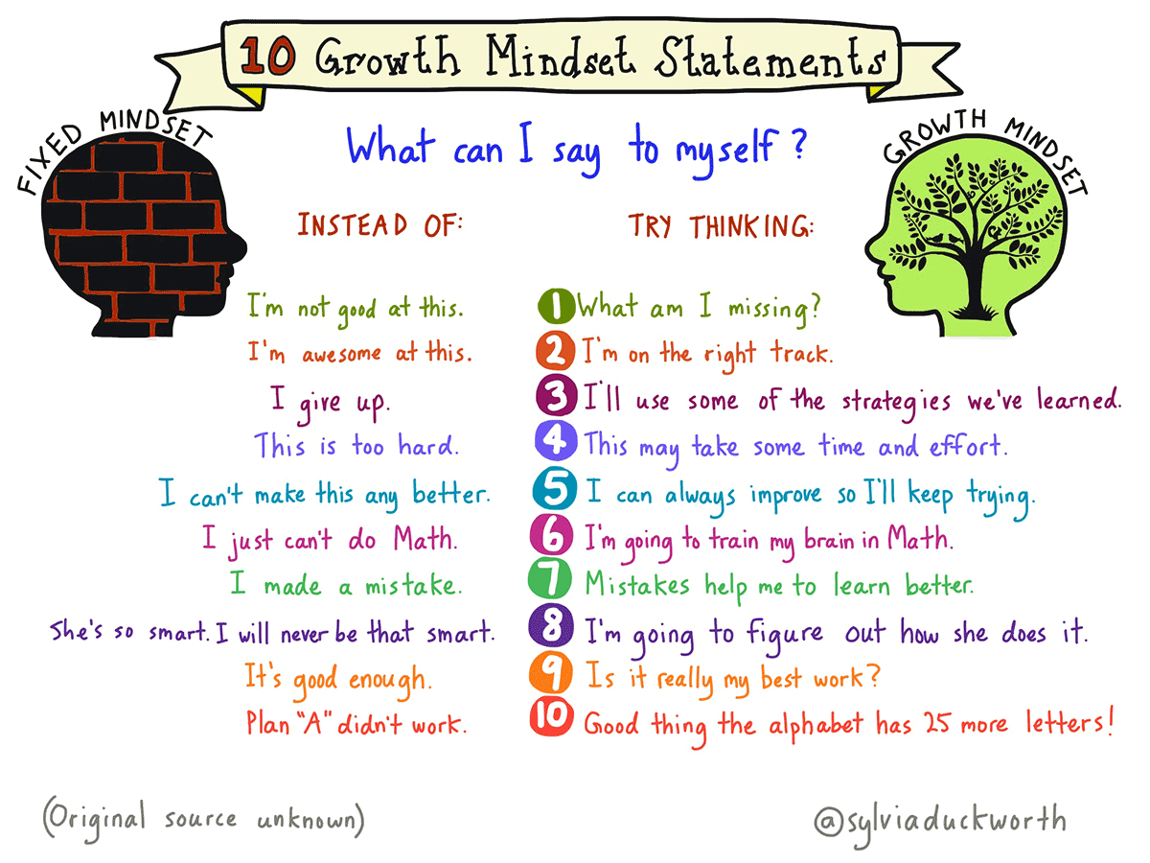
Creativity- Growth Mindset

Slide 4
What does looking after your mental health mean?

Slide 5


Slide 6
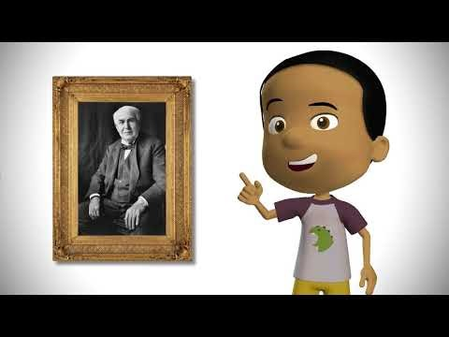

Slide 7
What are you good at?
How could you use your creativity to make the world a better place?
The Bible tells us that what is in our heart – what we believe – will shape everything that we do.
God created all of us to be creative, to do things our way. We are not all creative in the same way but we can use our creativity to shine Jesus’s light for others.

Slide 9

May the peace of The Lord be with you always
And also with you

Slide 10
Worship
COMPASSION
CREATIVITY
COURAGE

