Slide 1
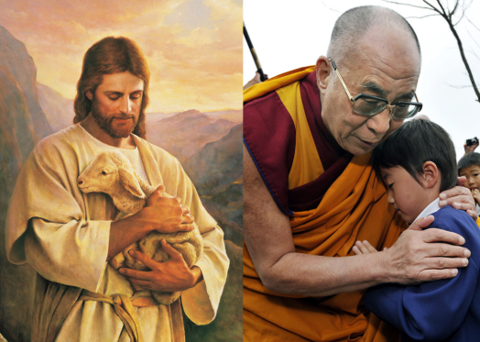
“If you want others to be happy, show compassion.
If you want to be happy, show compassion.”
DELAI LAMA
THINK: How did Jesus show ‘compassion?’

Slide 2

COMPASSION!
What is COMPASSION?
It is about showing kindness and consideration to help others, especially when they are upset.
It is about having genuine feelings for other people’s struggles.

Slide 3

SHOWING COMPASSION
In short, compassion is about showing sympathy for the problems or difficulties of others and doing something to help them.

Slide 4
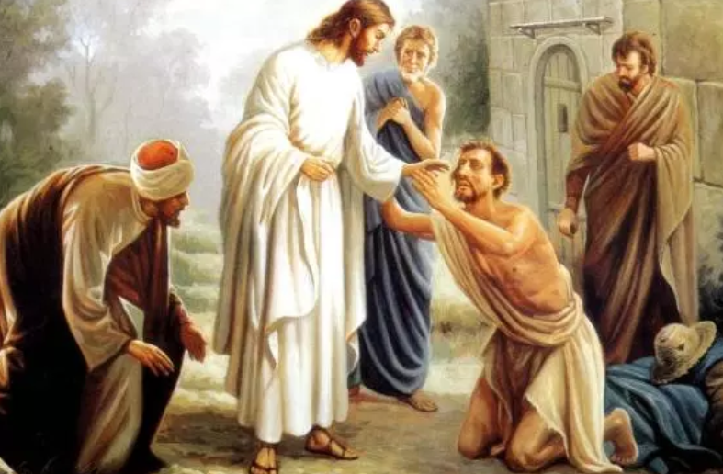
HOW DID JESUS SHOW COMPASSION?
Whenever Jesus encountered those in need (for example the sick) he did all that he could to help them.
For example, he healed the sick (Matthew 14: 13-14) and he gave sight to the blind (Matthew 20:30-34)
He also had compassion towards those who had no leadership, teaching them many things (Mark 6: 34)
Above all, he showed compassion towards people and all of the mistakes that they had made. He chose to suffer alongside them.

Slide 5
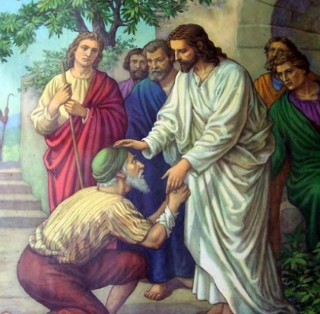
OUR READING
We are now going to read a bible story about Jesus healing a man with a condition called leprosy.
It demonstrates how Jesus showed great compassion for all of humanity.
It is adapted from a story in Mark 1 40:42

Slide 6
DISCUSSION
What do you think Jesus was trying to show people by doing things like this?
What would you have done if you were a character in this story?
How might people at the time have responded to Jesus’ actions?
Do you think the people in this story learned something from this experience?

Slide 7


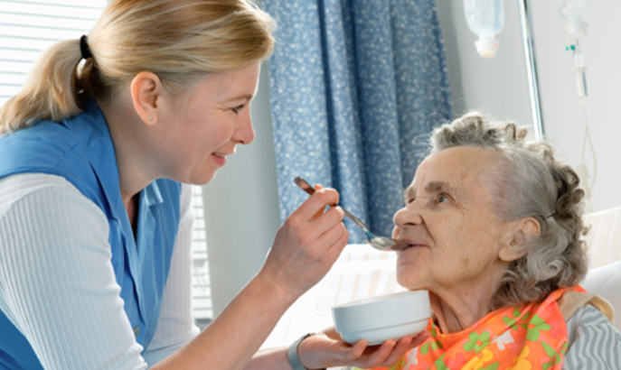
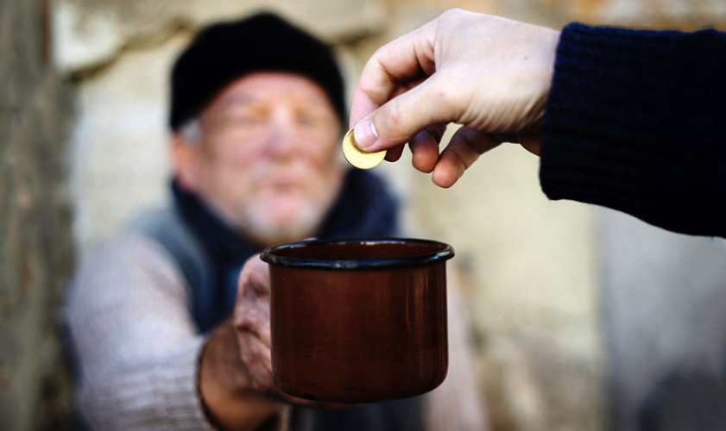
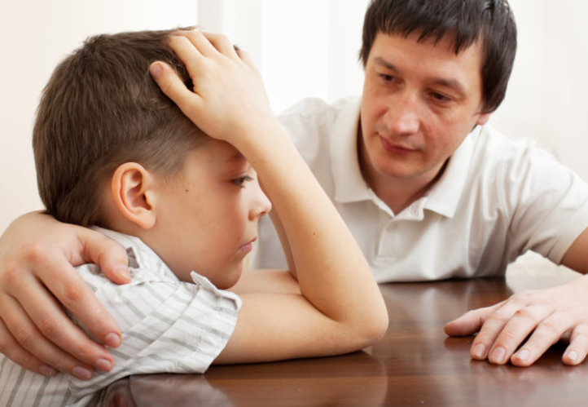
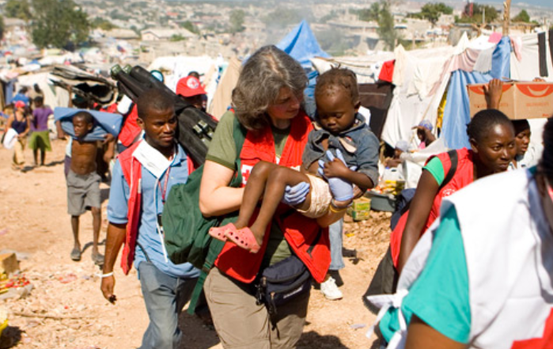
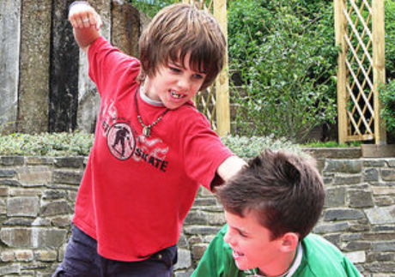
WHO IS SHOWING COMPASSION?

Slide 8
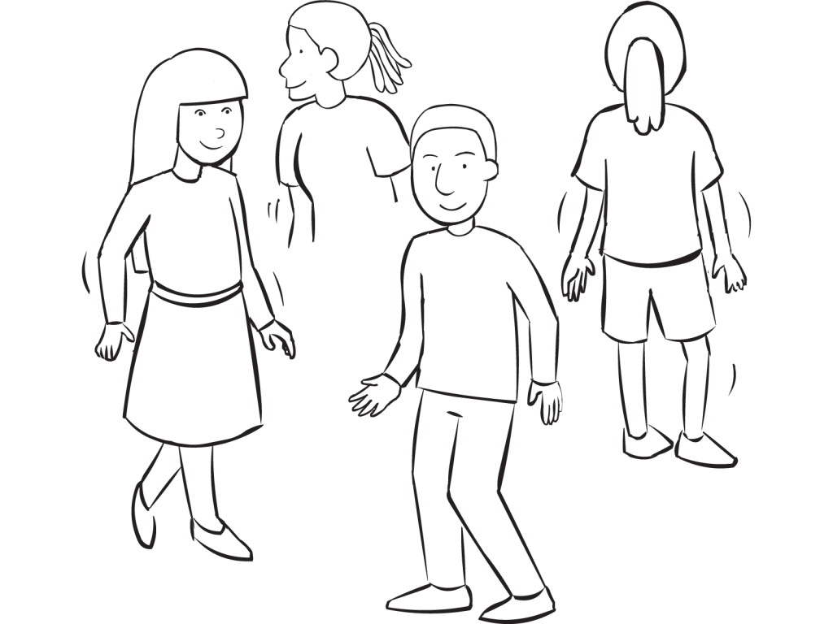
FREEZE FRAME ACTIVITY: HOW WE REACT TO THOSE IN NEED.
We need five volunteers!
Volunteer A is someone who is in trouble.
Volunteers B-E are different people who come across Volunteer A
After you see each freeze frame, think about what each person could be saying.
Which person is the most compassionate?

Slide 9

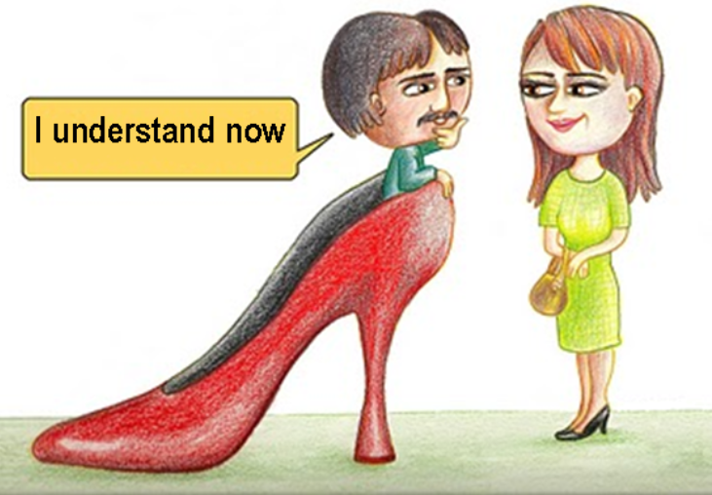
SHOWING COMPASSION
In order to show compassion, you need to be able to think about how other people feel.
This is called ‘putting yourself in someone else’s shoes.’

Slide 10

‘IN YOUR SHOES’
WE ARE NOW GOING TO TEST YOUR COMPASSION!
WE WILL NEED ONE VOLUNTEER FOR EACH SCENARIO THAT WE READ - SEE IF YOU CAN STEP INTO THE PERSON’S SHOES AND IMAGINE HOW THEY MUST FEEL.
EVERYONE ELSE – THINK ABOUT HOW WE MIGHT BE ABLE TO HELP THIS PERSON

Slide 11
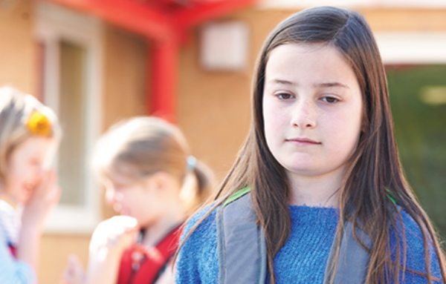
SCENARIO 1
STARTING A NEW SCHOOL
A new girl has started at school. It is her first day.
She has come from a different part of the country and doesn’t know anyone here.
-She looks very serious and has hardly smiled all day.
-It is break time and she is sat by herself.
VOLUNTEER – Step into her shoes. How do you imagine she feels?
EVERYONE – How can we help her?
How can we show compassion?

Slide 12
SCENARIO 1
STARTING A NEW SCHOOL
VOLUNTEER – Step into her shoes. How do you imagine she feels?
Nervous
Scared
Missing her old friends
Worried about what people will think of her
Hopeful that she will make new friends
EVERYONE – How can we help her? How can we show compassion?
Introduce yourself/ make conversation
Ask how her first day is going/ how can you help?
Invite her to play with you
Introduce her to others

Slide 13

SCENARIO 2
TEST RESULTS
There is a boy in the class who finds spelling really difficult.
Every week in the spelling test he hardly gets any spellings right.
-He is good at some other subjects (like maths and PE) but never does well in spelling.
-Some other children have begun to make fun of him for his spelling test results.
VOLUNTEER – Step into his shoes. How do you imagine he feels?
EVERYONE – How can we help him?
How can we show compassion?

Slide 14
SCENARIO 2
TEST RESULTS
VOLUNTEER – Step into his shoes. How do you imagine he feels?
Disappointed
Hopeless
-Upset that people are saying unkind things
-Feels like giving up
EVERYONE – How can we help him? How can we show compassion?
Make him feel better/ talk about all the things he is good at
Motivate him to keep trying
Ask the children to stop making fun/ tell a teacher
Maybe you can practice your spellings together?

Slide 15

SCENARIO 3
CIRCUMSTANCES OUTSIDE SCHOOL
- Two children at your school have a dog that is really sick.
The dog has been in vets for nearly a week. He may get better. He may not.
-They seem to be ok in class, but have been crying when they leave their parents each morning.
VOLUNTEER – Step into their shoes. How do you imagine they feel?
EVERYONE – How can we help them?
How can we show compassion?

Slide 16
SCENARIO 3
CIRCUMSTANCES OUTSIDE SCHOOL
VOLUNTEER – Step into their shoes. How do you imagine they feel?
Worried/ anxious
Scared
- Distant/ can’t concentrate on school at the moment
- May be in a worse mood than normal
EVERYONE – How can we help them? How can we show compassion?
See if there’s any small things you can do to make their day a bit better/ easier
Ask them if they want to talk to someone about it
If they don’t, see if there is anything you can do to take their mind off it.

Slide 17
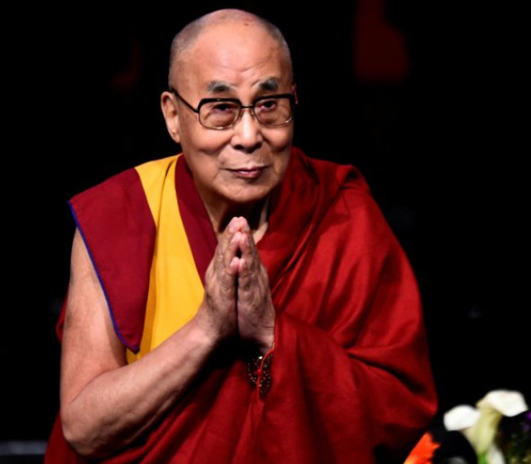
BACK TO OUR QUOTE…
“If you want others to be happy, show compassion.
If you want to be happy, show compassion.”
DELAI LAMA
How can showing compassion make us happy?

Slide 18
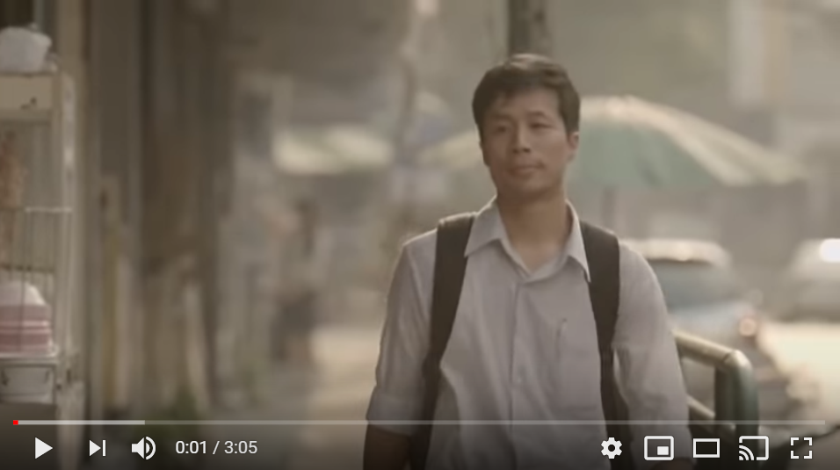
VIDEO
COMPASSION HELPS EVERYONE!

Slide 19
VIDEO
COMPASSION HELPS EVERYONE
What did the man do in the video?
Why did he do it?
How do the other people react?
What happened because of his actions?
What does the man get from showing compassion? What’s in it for him?

Slide 20
HOW CAN WE SHOW COMPASSION AT SCHOOL?
IN LESSONS?
AT BREAK/ LUNCHTIME?
AT SCHOOL EVENTS/ ON TRIPS?

Slide 21
HOW CAN WE SHOW COMPASSION OUT OF SCHOOL?
AT HOME?
IN THE LOCAL COMMUNITY?
IN THE WIDER WORLD?

Slide 22
PRAYER
Dear God,
Thank you for showing compassion for us all every day. Please help us to notice when other people are struggling. Please also help us to show the compassion to help them whenever we can.
Thank you for always loving us, and for being there for us in our lowest moments. Please give me the strength to be there for others when they need support.
Amen.

Slide 23
CITATION OF IMAGES
SLIDE 1: www.wikipedia.org – Dalai Lama
SLIDE 2: www.pixabay.com – Compassion
SLIDE 3: www.pixabay.com – Showing Compassion
SLIDE 4: www.flickr.com – Jesus showing compassion
SLIDE 5: www.pixabay.com - Jesus heals man with leprosy
SLIDE 7: All images taken from www.flickr.com
SLIDE 8: www.freestockimages.com – Freeze Frame
SLIDE 8: Both images taken from www.flickr.com
SLIDE 9: www.freestockimages.net - Footsteps
SLIDE 10: www.flickr.com – Girl Bullied
SLIDE 12: www.pixabay.com – Failed Test
SLIDE 17: www.youtube.com – Good Human Compassion Video

