Slide 1

Leona Lewis- Footprints in the sand

Slide 2
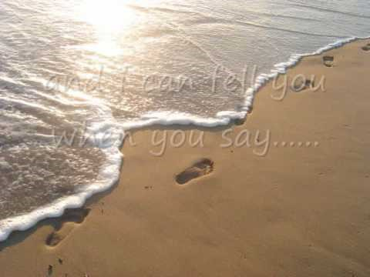

Slide 3
Compassion-
How our actions and attitudes reflect the kindness, mercy and compassion of Jesus and the love of God for everyone

Slide 4
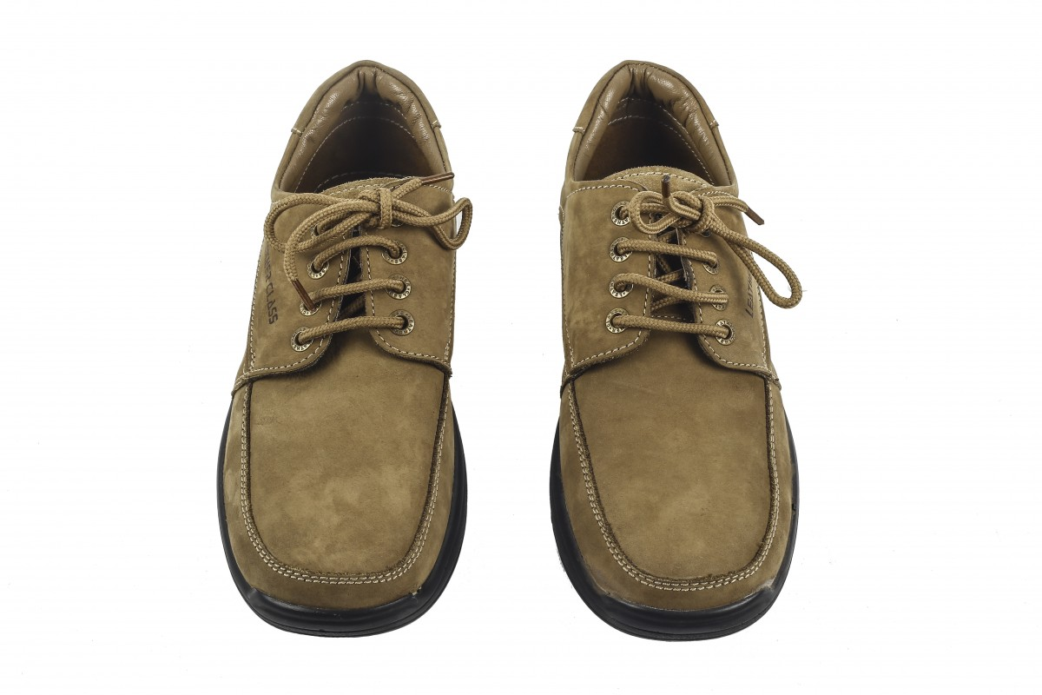
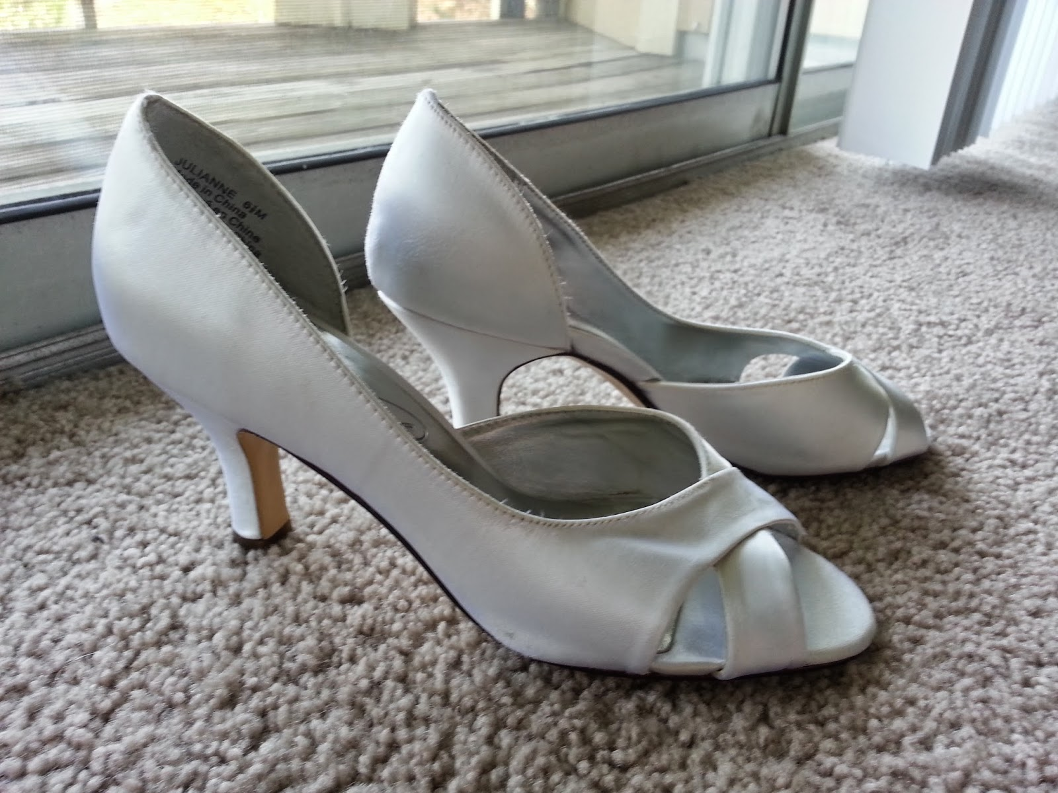
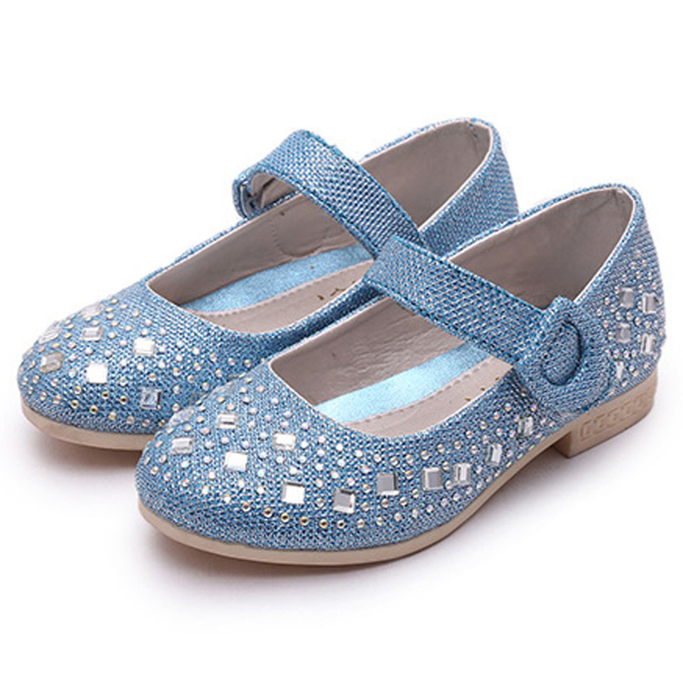
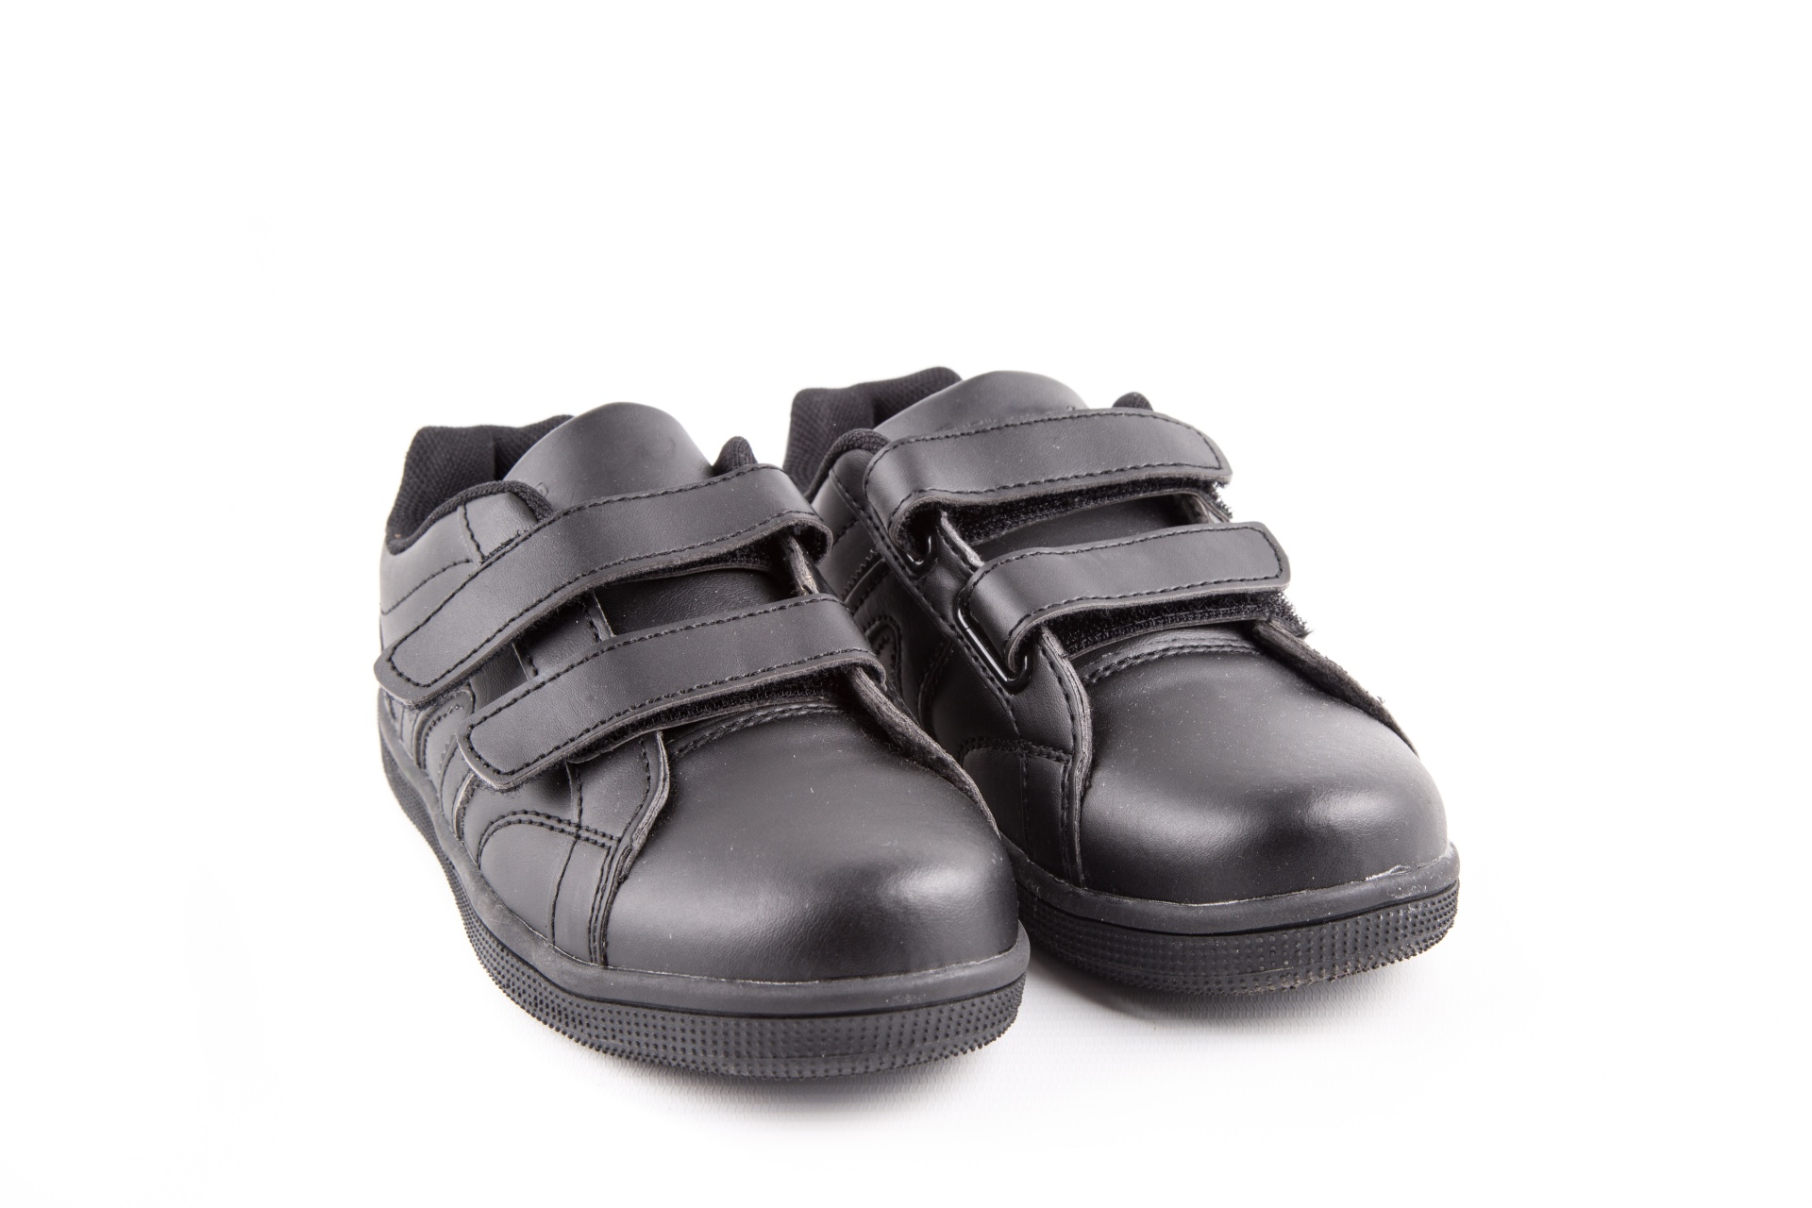

Slide 5
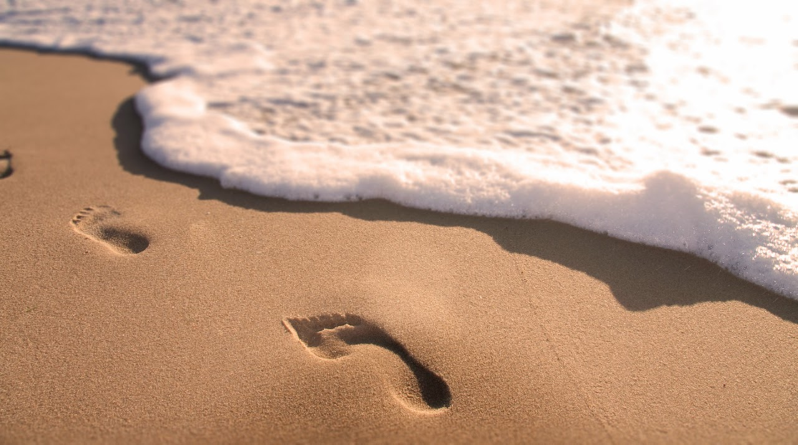
Footprints in the sand

Slide 6
Development
God never leaves us to face life alone. He is always there loving us, guiding us when we feel weighed down and weary.

Slide 7
Reflection
Think quietly to yourself to a time when needed help or guidance. Perhaps it was a time at home, especially recently or at school. Who helped you? How did they help you?

Slide 8
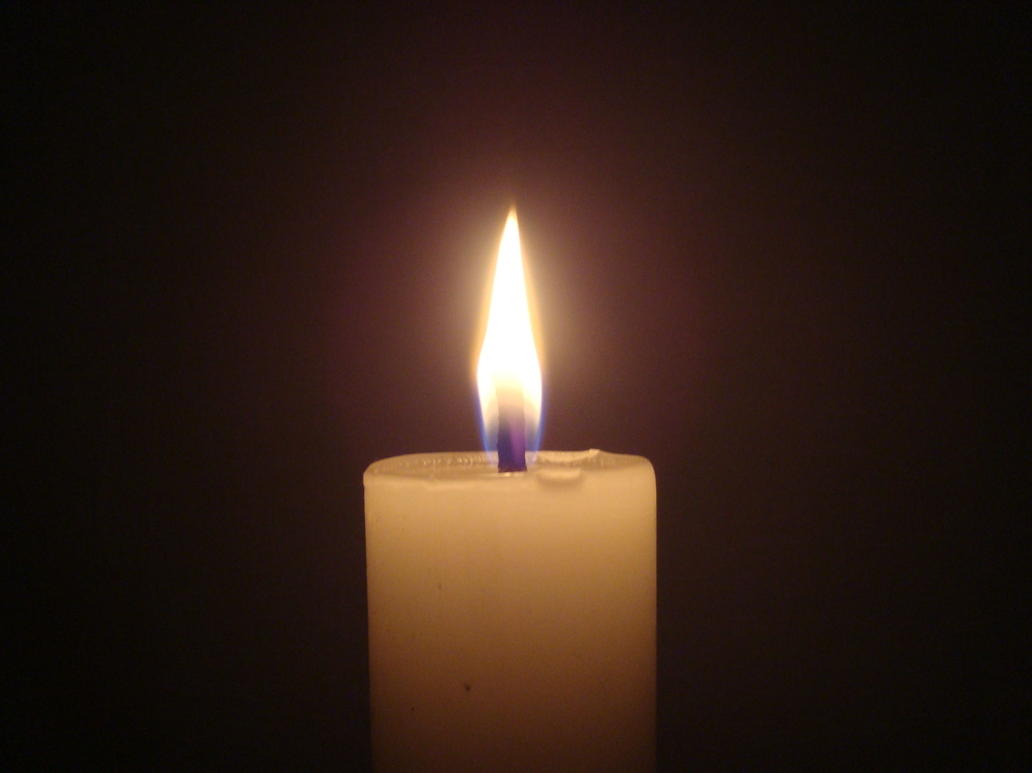
Prayer
Dear Lord,
Thank you for always being by our side when you are needed to help guide us and lead us on the right path.
AMEN.

Slide 9
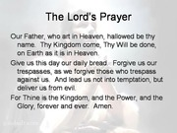
The Lord’s Prayer

Slide 10
Class Worship
Create something special for prayer in your class worship area- Could be something like a tree, wings of a bird-you choose. Take pictures to send to me and add prayers when you wish.

