Slide 1
Colour the school with kindness-cOMPASSION

Slide 2
Kid President- How to change the World
https://youtu.be/4z7gDsSKUmU?t=172

Slide 3
MEAN
kIND

Slide 4
uNHELPFUL
hELPFUL

Slide 5
sELFISH
sHARING

Slide 6
lYING
hONESTY

Slide 7
mISERABLE
jOYFUL

Slide 8
aNNOYED
pATIENT

Slide 9
dISLIKE
fORGIVE

Slide 10
Colour your world with kindness
https://vimeo.com/80492342

Slide 11


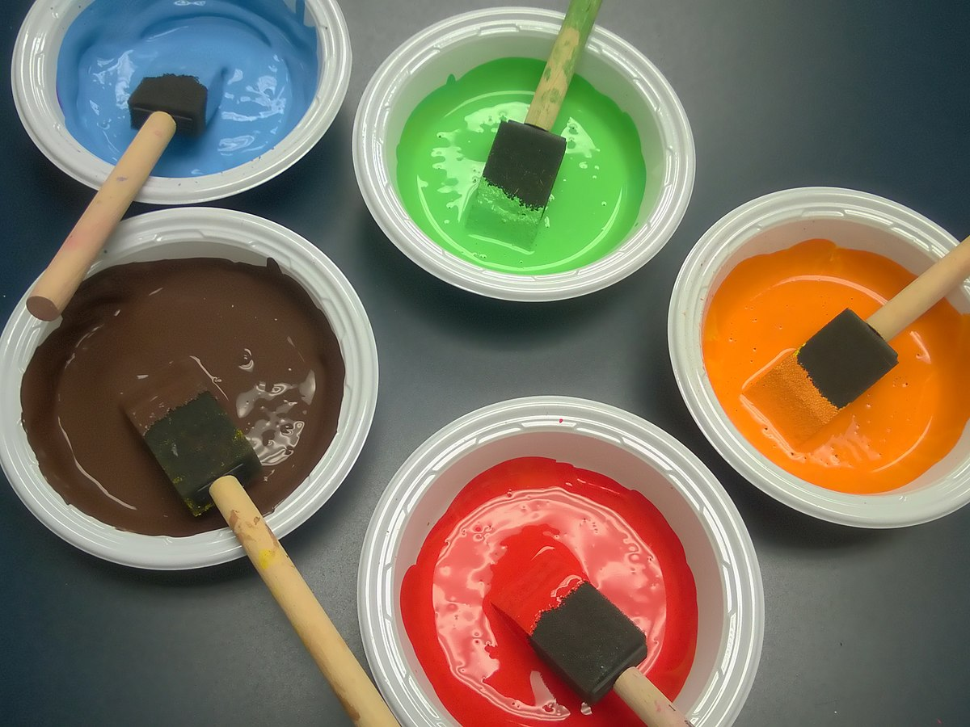
Here’s your canvas!

Slide 12
Kind

Slide 13
Helpful

Slide 14
Sharing

Slide 16
Honesty

Slide 17
Joyful

Slide 18
Patient

Slide 19
Forgive

Slide 20


Thumbs up or thumbs down?

Slide 21
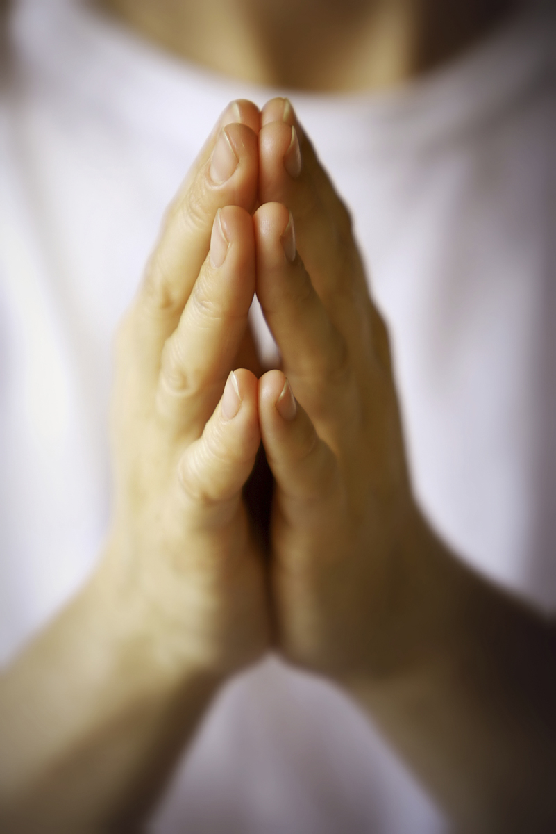
Prayer

Slide 22
Song-Our God is a great big god
https://www.you-tube.com/watch?v=eaxpxwbce31

