Slide 1
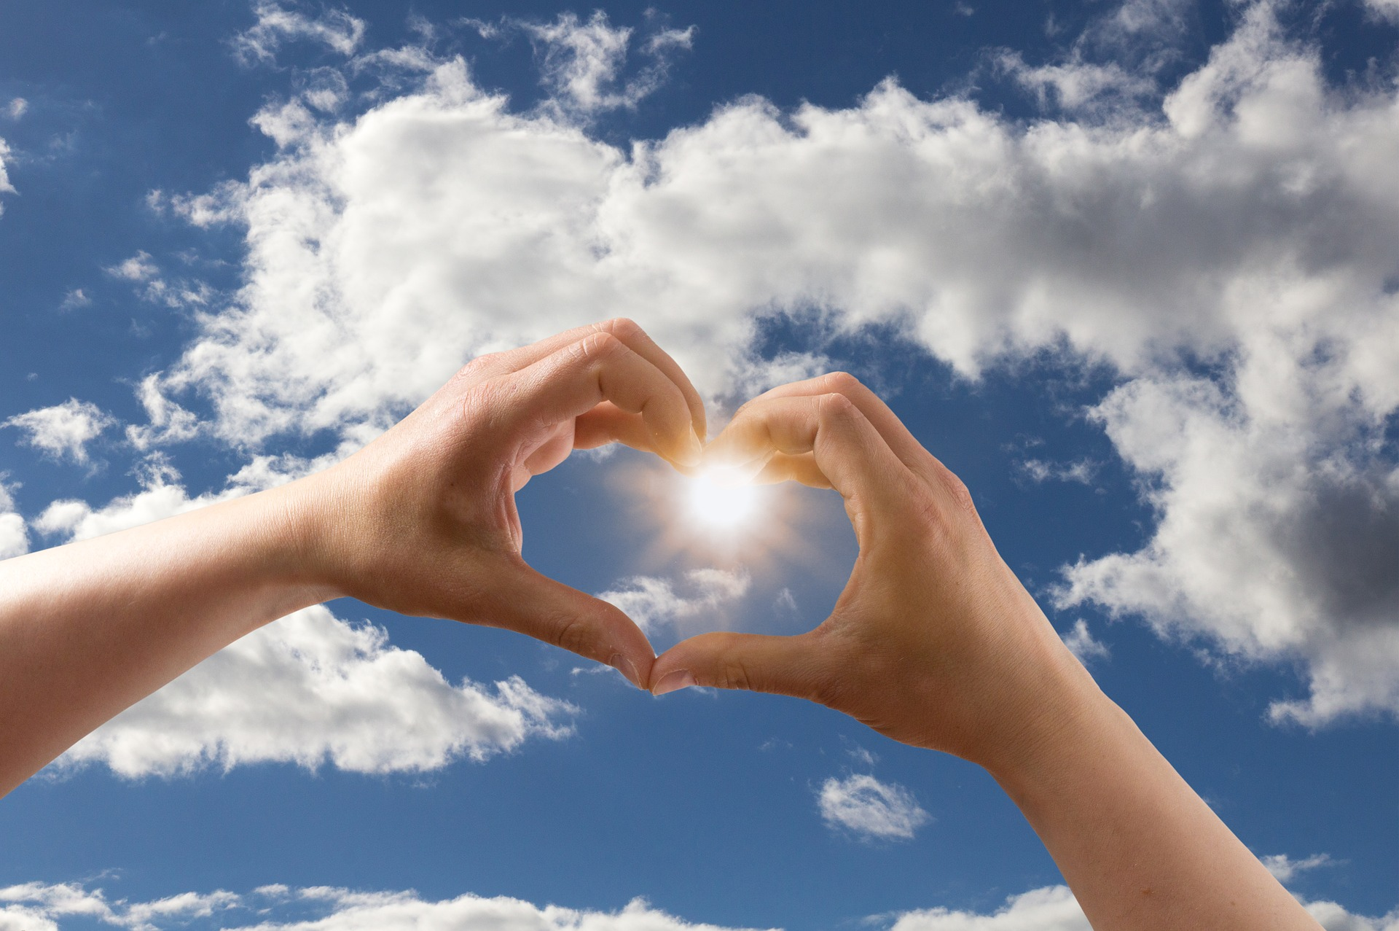
A Glimpse of God’s Kingdom
All pictures copyright-free from pixabay

Slide 2
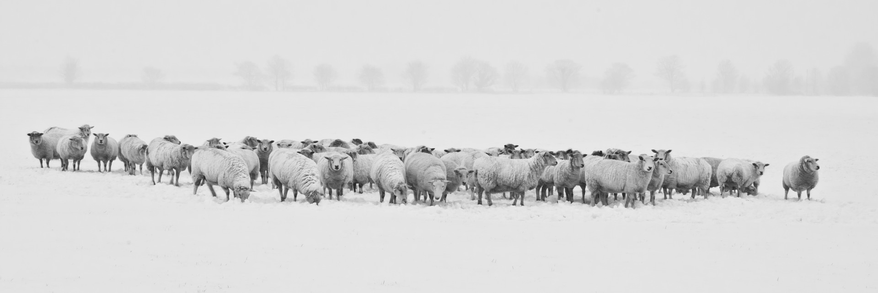
Sheep

Slide 3
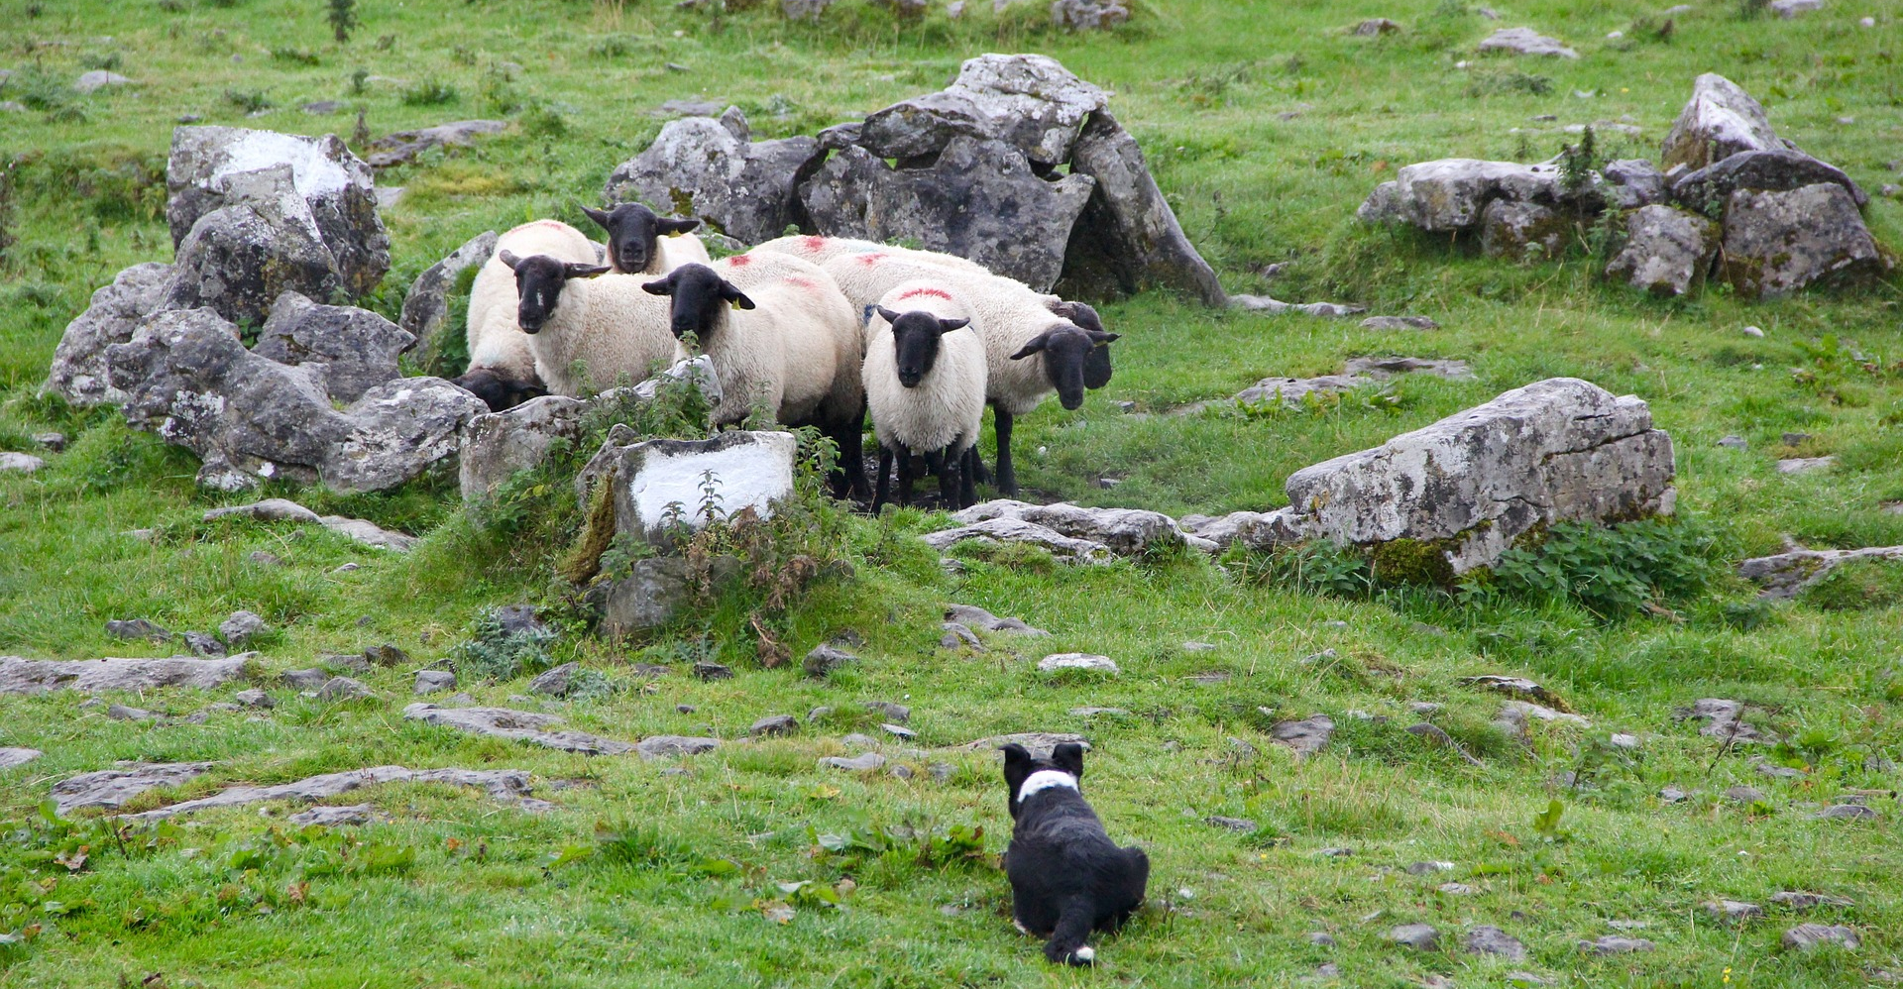
What does the sheepdog do with them?

Slide 4
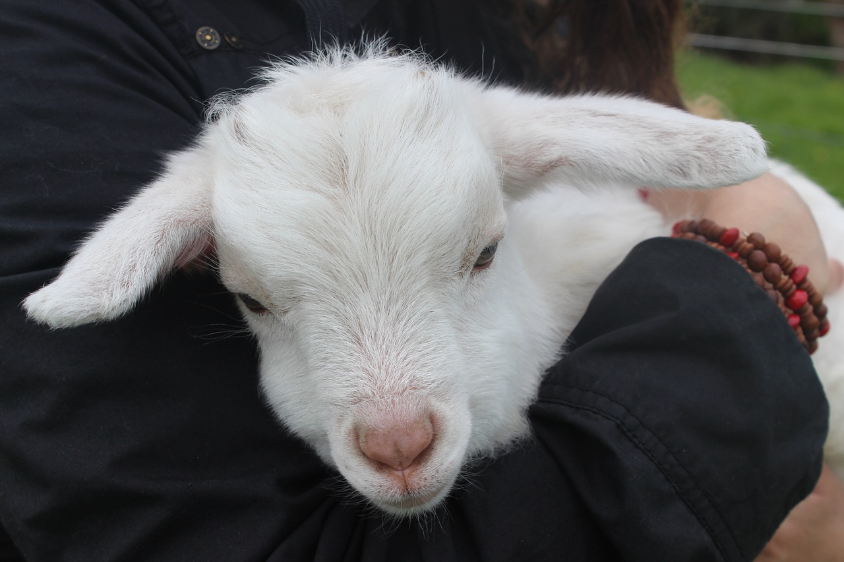
Psalm 23

Slide 5
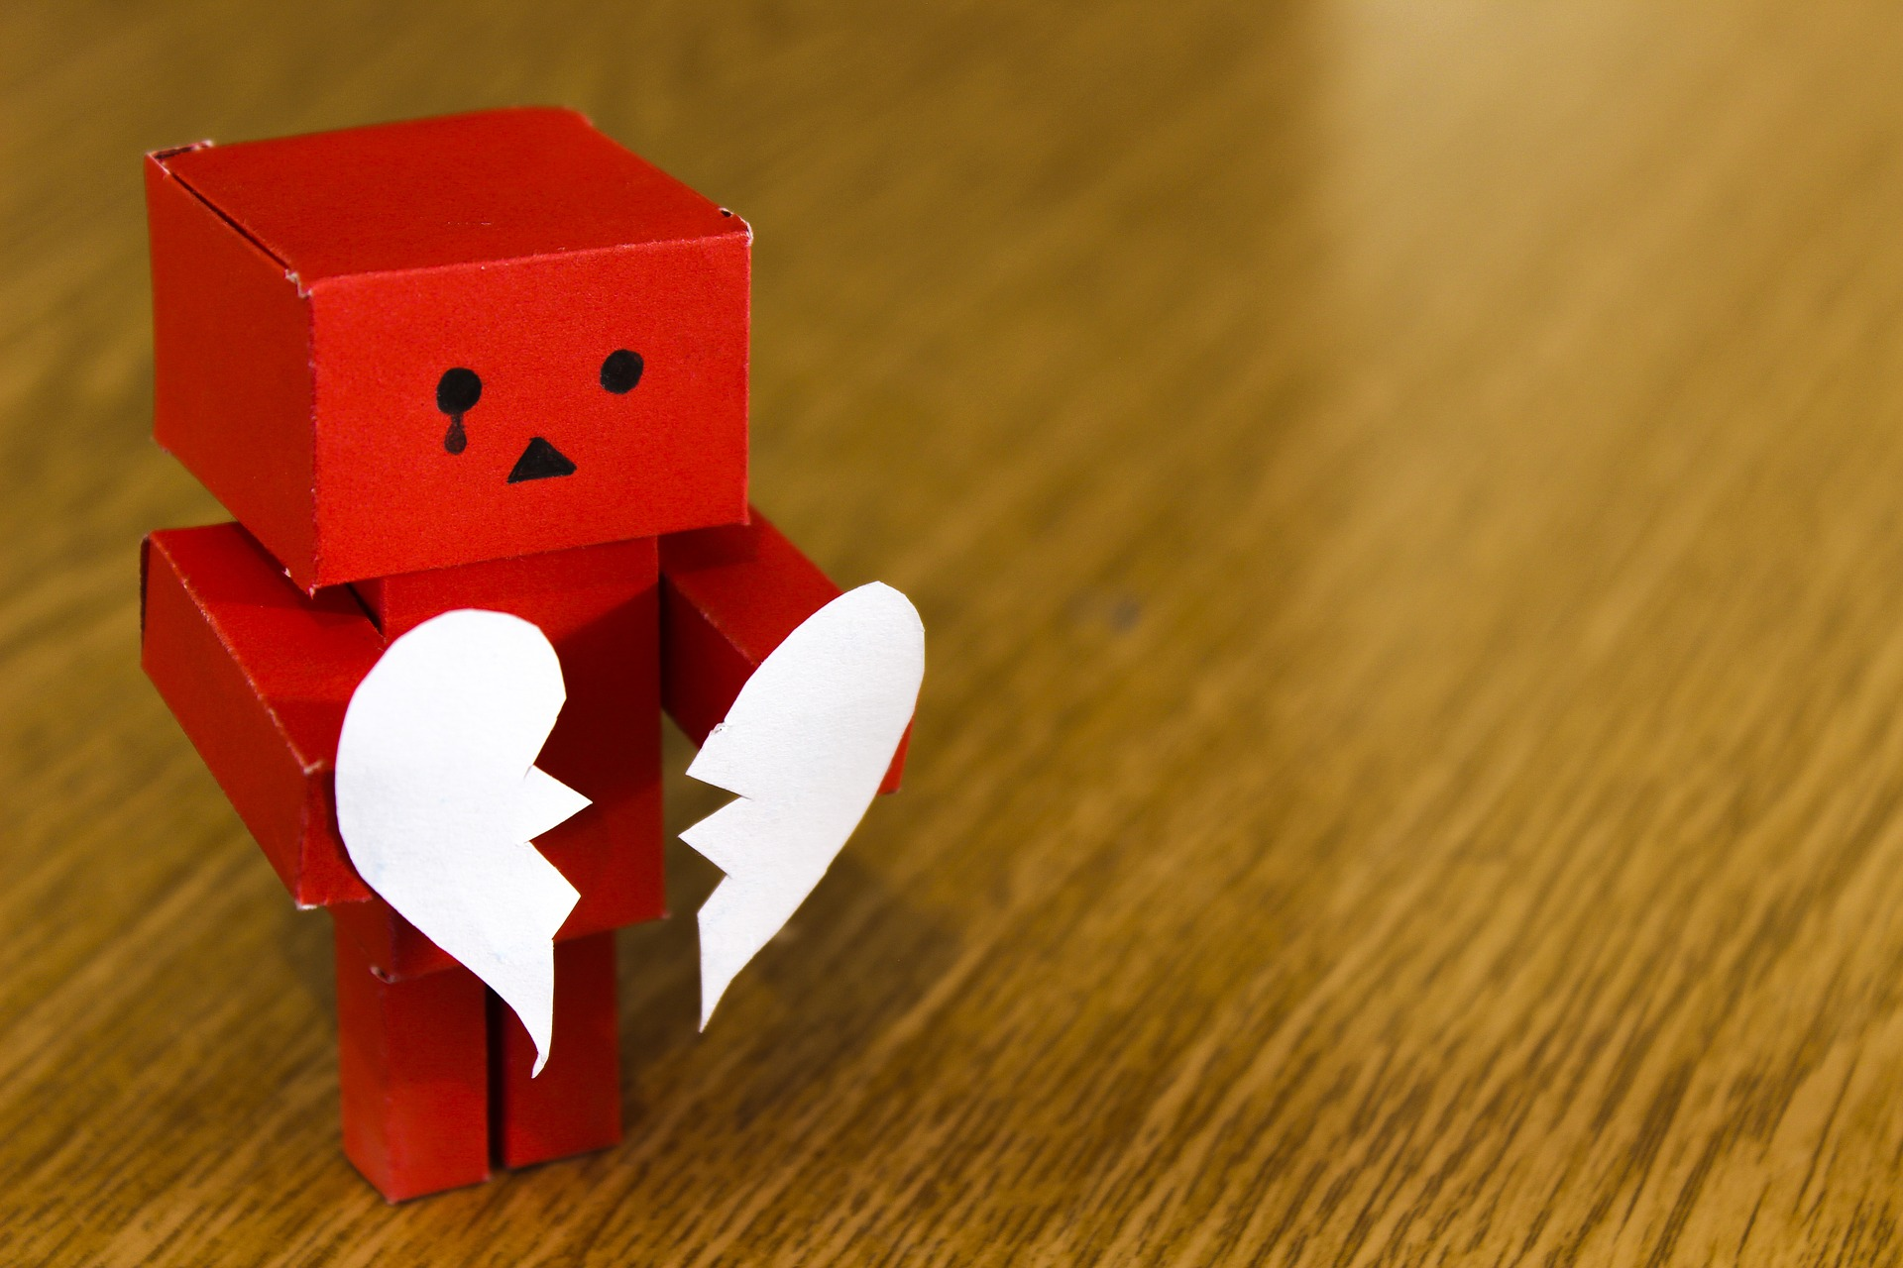
…..You, God, are my shepherd……
…..even in the darkest times of my life, you will never leave me…..
your shepherd-presence makes me feel safe…..

Slide 6
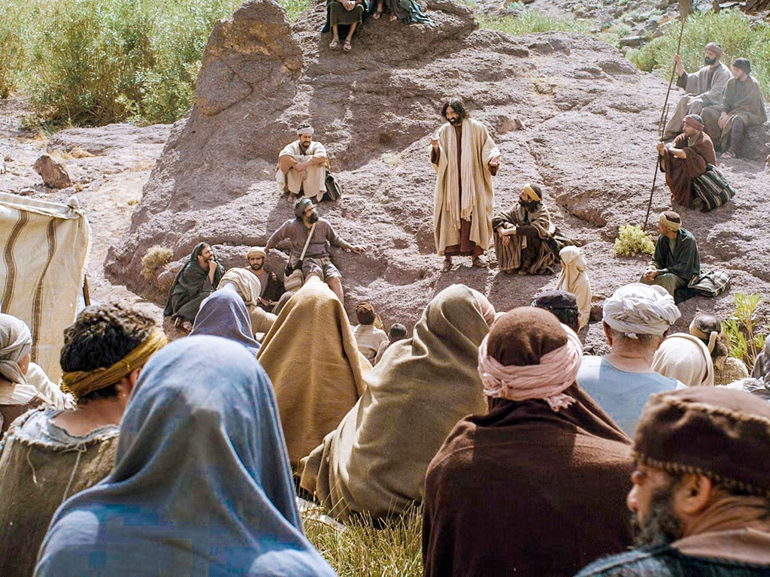

Those who are sad now are happy, because God will comfort them.

Slide 8
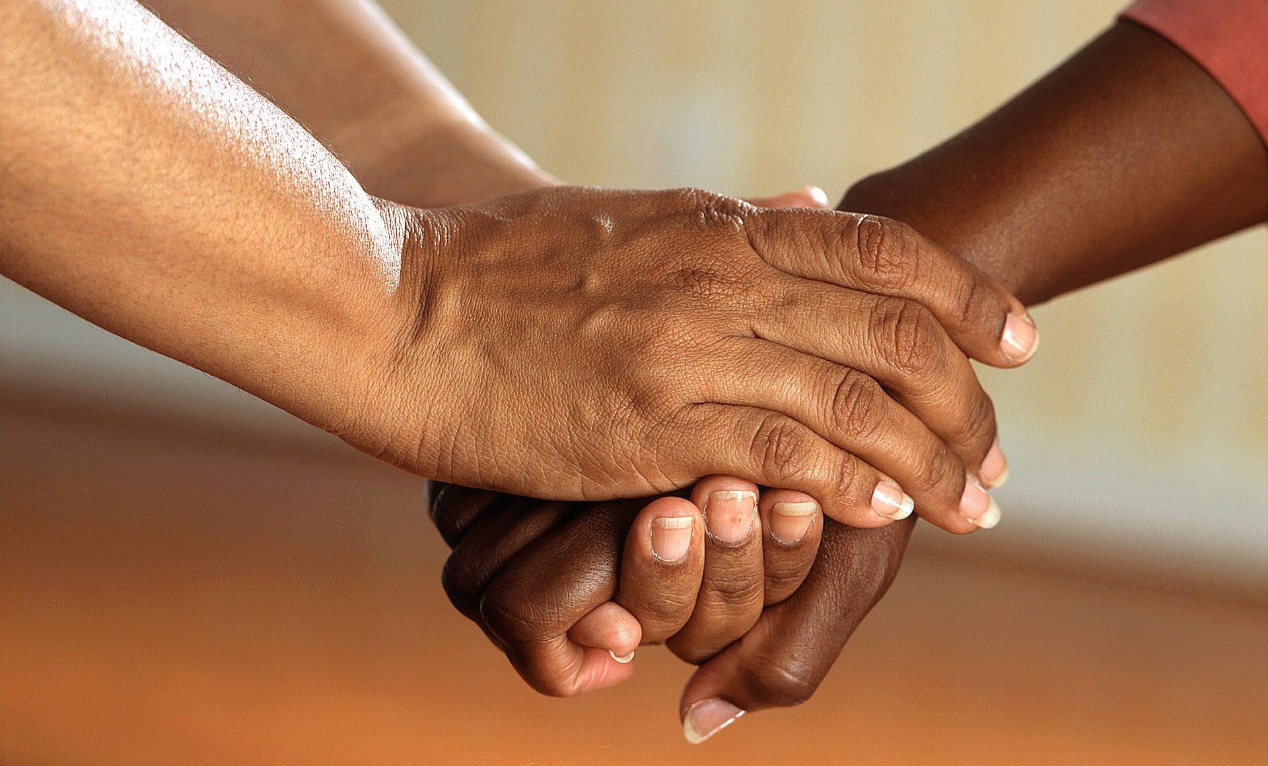
Prayer station image

