Slide 1
Trust

Slide 2
When we think about trust, what group of people do we think about?

Slide 3
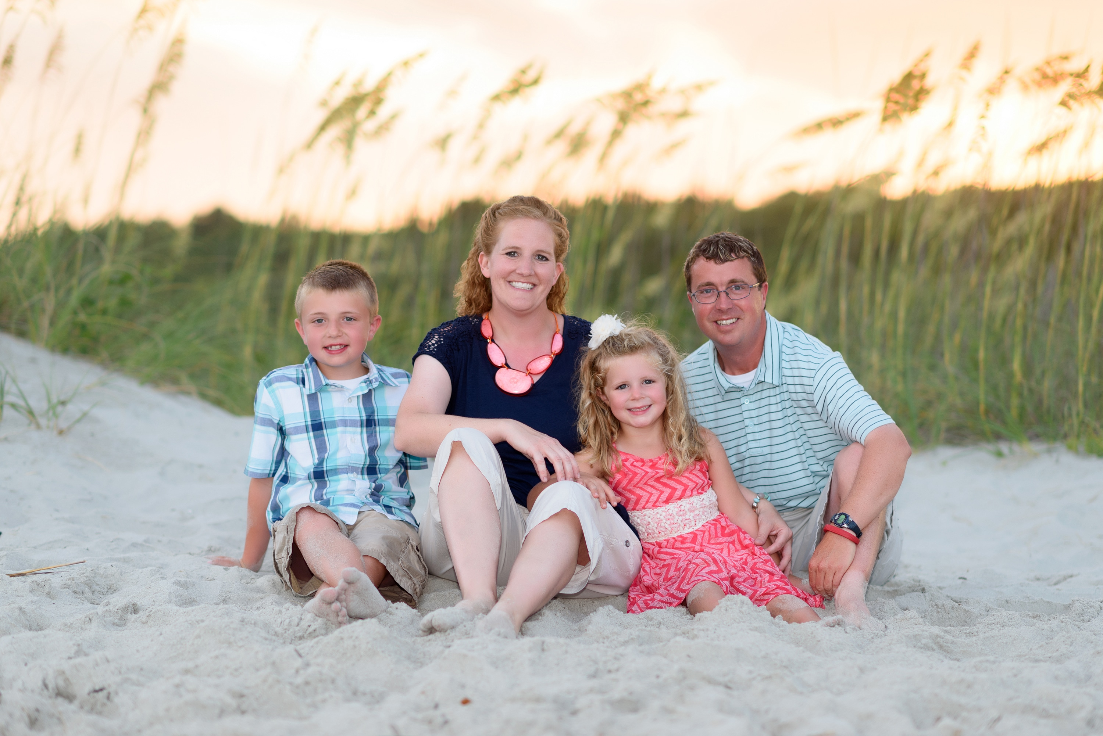
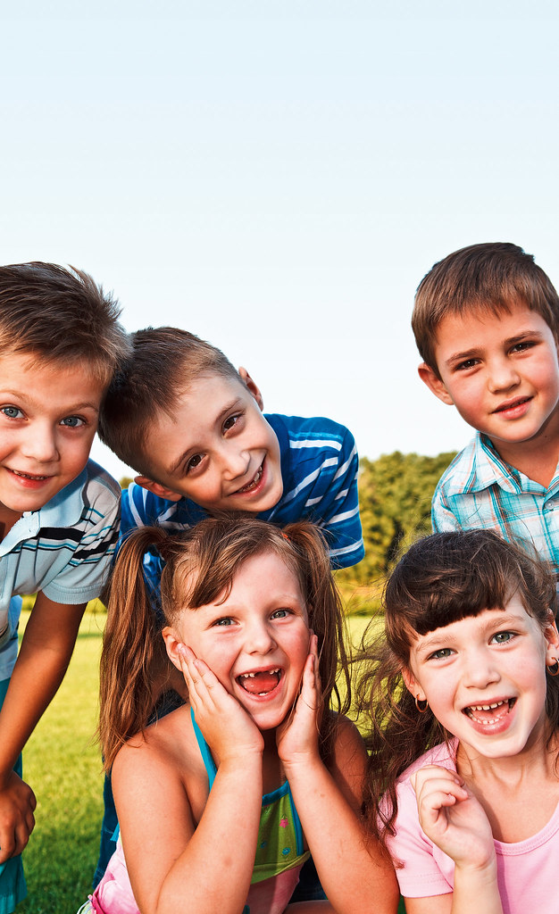
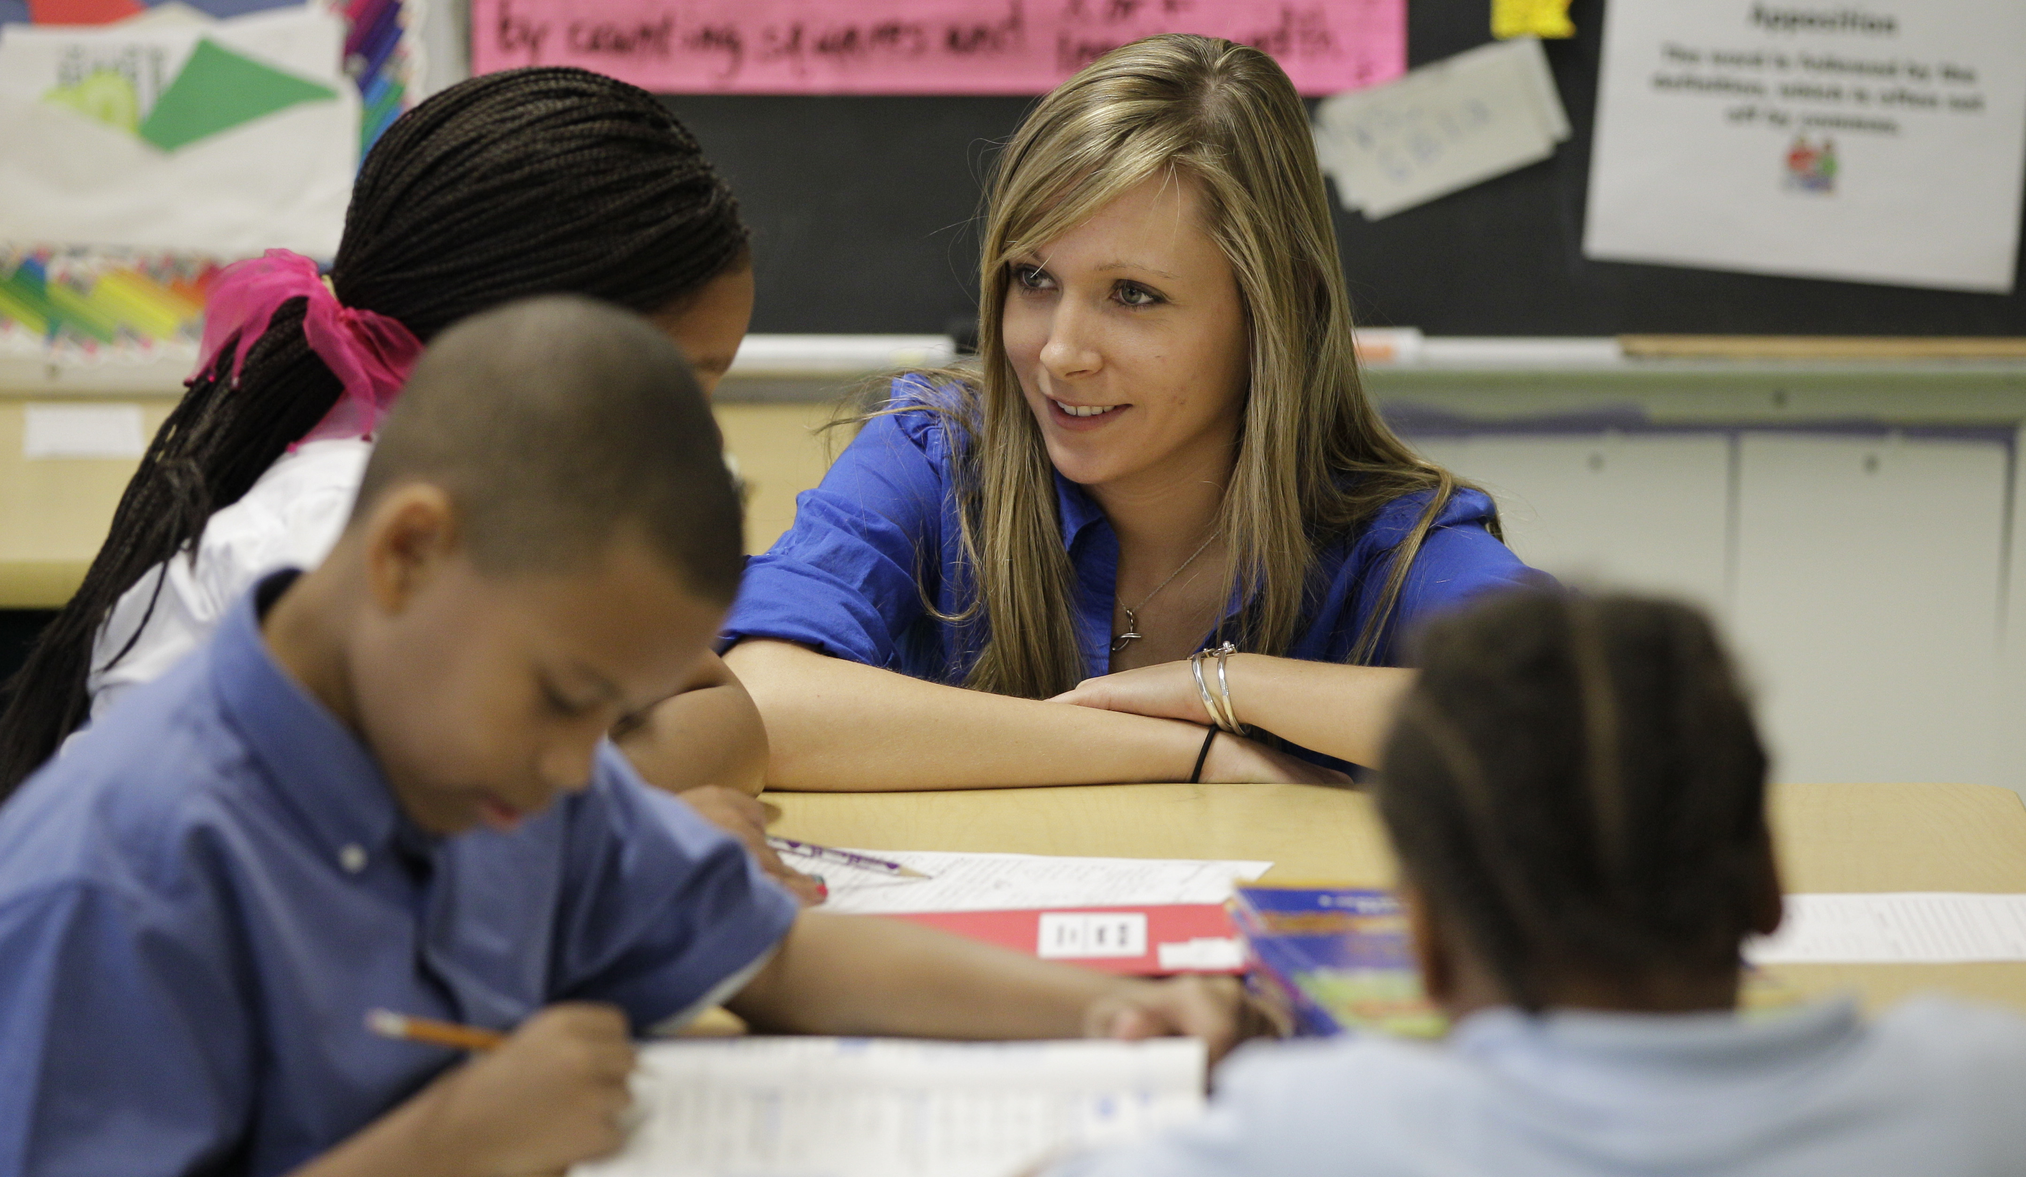

Slide 4
Friends
How do we know we can trust our friends?
Who did Jesus trust as his friends?
Is there anyone who Jesus trusted who didn’t turn out to be a good friend?

Slide 5
https://www.youtube.com/watch?v=qWxk2QFblEE

Slide 6
How do you know you are a trustworthy friend?

